Slide 1
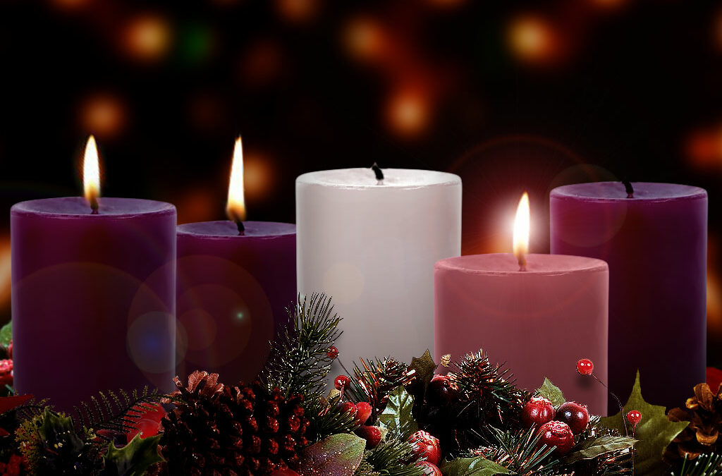
Joy 喜樂
In James 在雅各書中
24.12.08 Brother Jon
Notes:
Joy: The 3nd Advent Candle
Look at Joy in James

Slide 2
James 雅各書 1:2-4,12 (WEB/CUVt)
^{1:2} My brethren, count it all joy when ye fall into divers temptations; ³ Knowing this, that the trying of your faith worketh patience. ⁴ But let patience have her perfect work, that ye may be perfect and entire, wanting nothing. (KJV). 我的弟兄們，你們落在百般試煉中，都要以為大喜樂； 因為知道你們的信心經過試驗，就生忍耐。 但忍耐也當成功，使你們成全、完備，毫無缺欠。
^{1:12} Blessed (Joyful) is the man who (patiently) endures temptation, for when he has been approved, he will receive the crown of life, 忍受試探的人是有福的，因為他經過試驗以後，必得生命的冠冕；這是主應許給那些愛他之人的。
Notes:
For James the development of patience is the key….

Slide 3
Read
The Text
Observe
Confirm
Apply
閱讀正文
觀察
確認
應用

Slide 4
James 雅各書 1:2-4,12 (WEB/CUVt)
^{1:2} My brethren, count it all joy when ye fall into divers temptations; ³ Knowing this, that the trying of your faith worketh patience. ⁴ But let patience have her perfect work, that ye may be perfect and entire, wanting nothing. (KJV). 我的弟兄們，你們落在百般試煉中，都要以為大喜樂； 因為知道你們的信心經過試驗，就生忍耐。 但忍耐也當成功，使你們成全、完備，毫無缺欠。
^{1:12} Blessed (Joyful) is the man who (patiently) endures temptation, for when he has been approved, he will receive the crown of life, 忍受試探的人是有福的，因為他經過試驗以後，必得生命的冠冕；這是主應許給那些愛他之人的。
Notes:
For James the development of patience is the key….

Slide 5
James 雅各書 1:2-4,12 (WEB/CUVt)
^{1:2} My brethren, count it all joy when ye fall into divers temptations; ³ Knowing this, that the trying of your faith worketh patience. ⁴ But let patience have her perfect work, that ye may be perfect and entire, wanting nothing. (KJV). 我的弟兄們，你們落在百般試煉中，都要以為大喜樂； 因為知道你們的信心經過試驗，就生忍耐。 但忍耐也當成功，使你們成全、完備，毫無缺欠。
^{1:12} Blessed (Joyful) is the man who (patiently) endures temptation, for when he has been approved, he will receive the crown of life, 忍受試探的人是有福的，因為他經過試驗以後，必得生命的冠冕；這是主應許給那些愛他之人的。
Notes:
For James the development of patience is the key….

Slide 6
The Text
^{1:2} My brethren, count it all joy when ye fall into divers temptations; ³ Knowing this, that the trying of your faith worketh patience. ⁴ But let patience have her perfect work, that ye may be perfect and entire, wanting nothing. (KJV). 我的弟兄們，你們落在百般試煉中，都要以為大喜樂； 因為知道你們的信心經過試驗，就生忍耐。 但忍耐也當成功，使你們成全、完備，毫無缺欠。
^{1:12} Blessed (Joyful) is the man who (patiently) endures temptation, for when he has been approved, he will receive the crown of life, 忍受試探的人是有福的，因為他經過試驗以後，必得生命的冠冕；這是主應許給那些愛他之人的。
Notes:
For James the development of patience is the key….

Slide 7
James 雅各書 1:2-4,12 (WEB/CUVt)
^{1:2} My brethren, count it all joy when ye fall into divers temptations; ³ Knowing this, that the trying of your faith worketh patience. ⁴ But let patience have her perfect work, that ye may be perfect and entire, wanting nothing. (KJV). 我的弟兄們，你們落在百般試煉中，都要以為大喜樂； 因為知道你們的信心經過試驗，就生忍耐。 但忍耐也當成功，使你們成全、完備，毫無缺欠。
^{1:12} Blessed (Joyful) is the man who (patiently) endures temptation, for when he has been approved, he will receive the crown of life, 忍受試探的人是有福的，因為他經過試驗以後，必得生命的冠冕；這是主應許給那些愛他之人的。

Slide 8
Observe: What is connected to Joy?
Patience
Temptation
→ Not the first things I think of when speak of Joy
Can we see these connections elsewhere in Scripture?
耐心
試探
這不是我首先想到的
我們能在聖經的其他地方看到這些連結嗎？

Slide 9
James 雅各書 5:7-11 (WEB/CUVt)
⁷Be patient therefore, brothers, until the coming of the Lord. Behold, the farmer waits for the precious fruit of the earth, being patient over it, until it receives the early and late rain. ⁸You also be patient. Establish your hearts, for the coming of the Lord is at hand. ⁹Don't grumble, brothers, against one another, so that you won't be judged. Behold, the judge stands at the door. ¹⁰Take, brothers, for an example of suffering and of patience, the prophets who spoke in the name of the Lord. ¹¹Behold, we call them blessed who endured. You have heard of the patience of Job, and have seen the Lord in the outcome, and how the Lord is full of compassion and mercy.
⁷弟兄們哪，你們要忍耐，直到主來。看哪，農夫忍耐等候地裡寶貴的出產，直到得了秋雨春雨。 ⁸你們也當忍耐，堅固你們的心，因為主來的日子近了。 ⁹弟兄們，你們不要彼此埋怨，免得受審判。看哪，審判的主站在門前了。 ¹⁰弟兄們，你們要把那先前奉主名說話的眾先知當作能受苦能忍耐的榜樣。 ¹¹那先前忍耐的人，我們稱他們是有福的。你們聽見過約伯的忍耐，也知道主給他的結局，明顯主是滿心憐憫，大有慈悲。
Waiting 等候
Patience
忍耐
Joy
喜樂
Notes:
After waiting patiently the farmer has joy with the crop….
After patiently enduring, Job received much in returned…
What about the prophets? Moses, Elijah…

Slide 10
Aspects of The Fruit
of the Spirit…
^{Gl5:22}But the fruit of the Spirit is love, joy, peace, patience, kindness, goodness, faith(fulness), ²³gentleness, and self-control.
^{Gl5:22}聖靈所結的果子，就是仁愛、喜樂、和平、忍耐、恩慈、良善、信實、 ²³溫柔、節制。
Notes:
Patience is the key. Waiting is the means by which this aspect of the Spirit’s fruit ripens in our life.

Slide 11
Jesus 耶穌 (Hebrews 希伯來書 12:2)
…let us run with patience the race that is set before us, ²looking to Jesus, the author and perfecter of faith, who for the joy that was set before him endured the cross,
存心忍耐，奔那擺在我們前頭的路程， ²仰望為我們信心創始成終的耶穌。他因那擺在前面的喜樂，就輕看羞辱，忍受了十字架的苦難，便坐在神寶座的右邊。

Slide 12
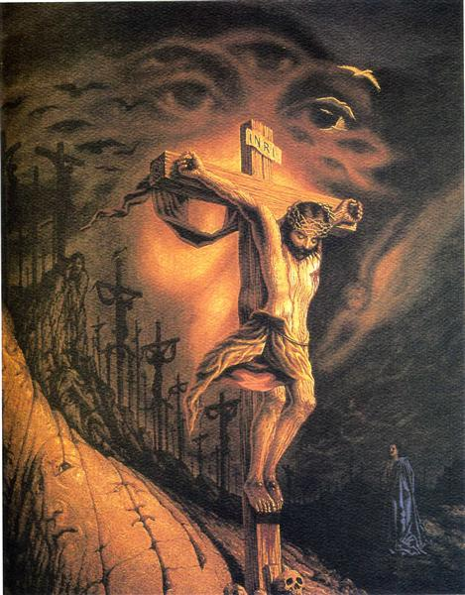
Meditate on Cross 默想十字架
Notes:
Christmas has no meaning without the cross.
If Jesus did not endure, celebration of Christmas would be meaningless

Slide 13
Observations 觀察
Patience and Joy are connected in Scripture
For Jesus, Joy is
  Not because of the cross and death
  But because of what the cross and what his death accomplished
For the Farmer, Joy is
  Not because of the sowing and waiting
  But because of the coming harvest
There is a waiting period, for which patience is required.
聖經中忍耐與喜樂是相連的
對耶穌來說，喜樂
  不是因為十字架和死亡
  但是因為十字架和他的死所成就的
對農民來說，快樂
  不是因為播種和等待
  但但因為即將到來的收穫
有等待期，需要耐心等待
Notes:
Now back to our text…

Slide 14
James 雅各書 1:2-4,12 (WEB/CUVt)
^{1:2} My brethren, count it all joy when ye fall into divers temptations; ³ Knowing this, that the trying of your faith worketh patience. ⁴ But let patience have her perfect work, that ye may be perfect and entire, wanting nothing. (KJV). 我的弟兄們，你們落在百般試煉中，都要以為大喜樂； 因為知道你們的信心經過試驗，就生忍耐。 但忍耐也當成功，使你們成全、完備，毫無缺欠。
^{1:12} Blessed (Joyful) is the man who (patiently) endures temptation, for when he has been approved, he will receive the crown of life, 忍受試探的人是有福的，因為他經過試驗以後，必得生命的冠冕；這是主應許給那些愛他之人的。

Slide 15
Joy 喜悅
Not because of the temptation itself
But because of what the temptation accomplishes:
  Makes us strong, pure and holy
  Approval of God
  Receive the crown of life
Conditional on patient endurance (Stop grumbling!)
不是因為誘惑本身
但是由於誘惑所帶來的後果：
  使我們堅強、純潔、聖
  神的認可
  得生命的冠冕
需要忍耐忍受 (停止埋怨)
Notes:
Grumbling is the opposite of Joy and Patience. These fruits of the spirit.
I have never heard the expression: “Jon is a joyful grumbler. Jon grumbles joyfully. Jon is a patient grumbler. Jon grumbles patiently.”

