Slide 1
喜樂 Joy
Joy¹ 2017-12-10
Joy² 2018-12-09
Joy³ 2019-12-08
Joy⁴ 2020-12-06
Joy⁵ 2021-12-05
Joy⁶ 2022-12-11
χαρά / χαίρω
57/74
Brother Jon
Sister Ruth

Slide 2
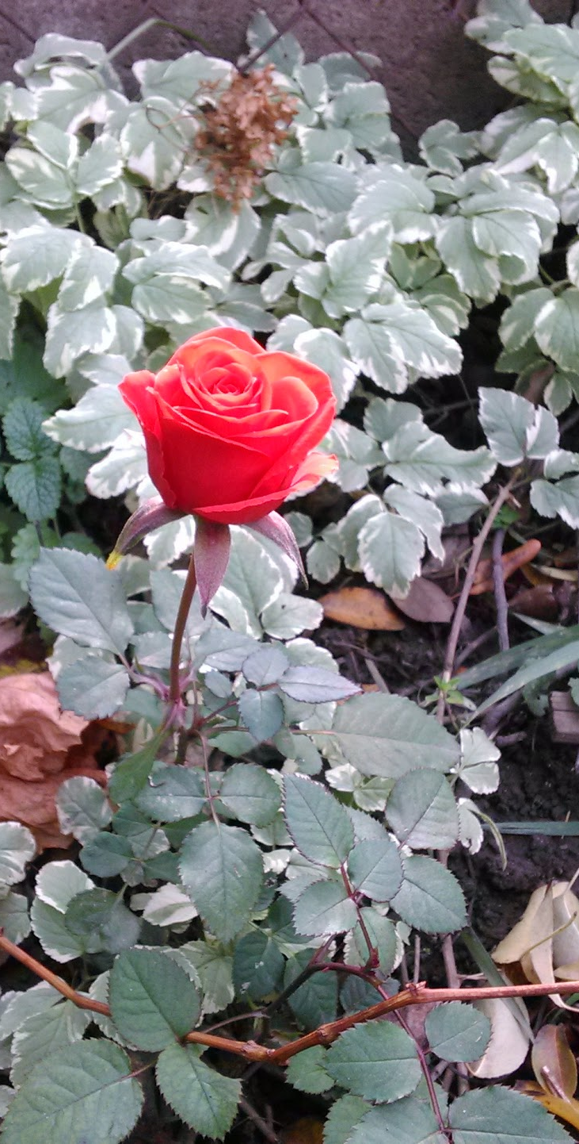
Joy¹
Joy is
  A Fruit of the Spirit
  A Mark of a Christian
We experience joy when:
  we face troubles
  the Gospel is preached
  we consider our future
  we receive concern of brothers/sisters
Joy’s Focus: The LORD
The Joy of Jesus

Slide 3
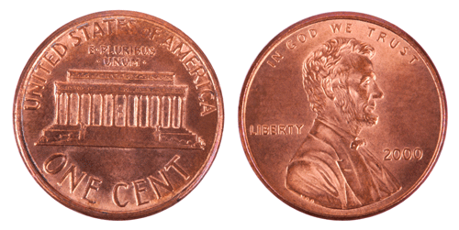
Joy²: Two Sides of a Coin
Suffering Joy
God gives Joy…
Satan gives suffering…
No Suffering → No Joy.
We get both or neither!

Slide 4

喜樂 Joy³
Preceded by Shame
Focused on joy-giver
Blessing the world
Hannah, Mary, Zechariah, Joseph, David, Jesus…
先羞辱
專注在喜樂給予者
祝福世界
汉娜, 玛丽, 撒迦利亞，約瑟，大衛，耶稣
…who for the Joy set before him,
Endured the cross.

Slide 5

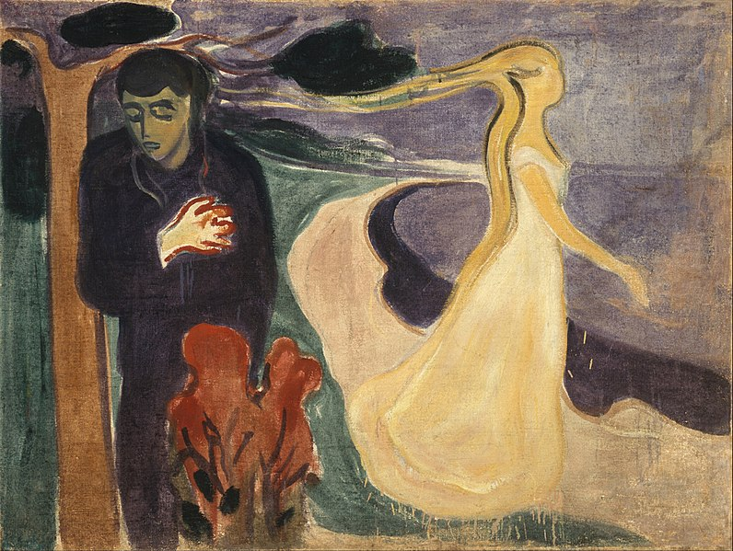
Joy⁴
Joy (喜樂) found in
Relationship (關係)
Separation (距離)
→ Despair (絕望)
In the Garden
Moment of Decision
Eternity

Slide 6
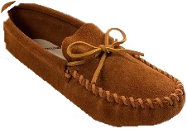
Joy⁵ : 4 Josephs
Joseph of the Old Testament – “son” of Jacob
Joseph of the transition – “father” of Jesus
Joseph from Arimathea – “undertaker” of Jesus
Joseph of the latter days – “representation” of us
Pain/Sorrow
Joy

Slide 7
喜樂 Joy⁶
"Must Go“ – The Leading of the Spirit
Looking for Joy in All the Wrong Places
Encountering the Source of Joy
Joy of Jesus
John 4:3-26; 32
Key Verses: John 4:10, 32

Slide 8
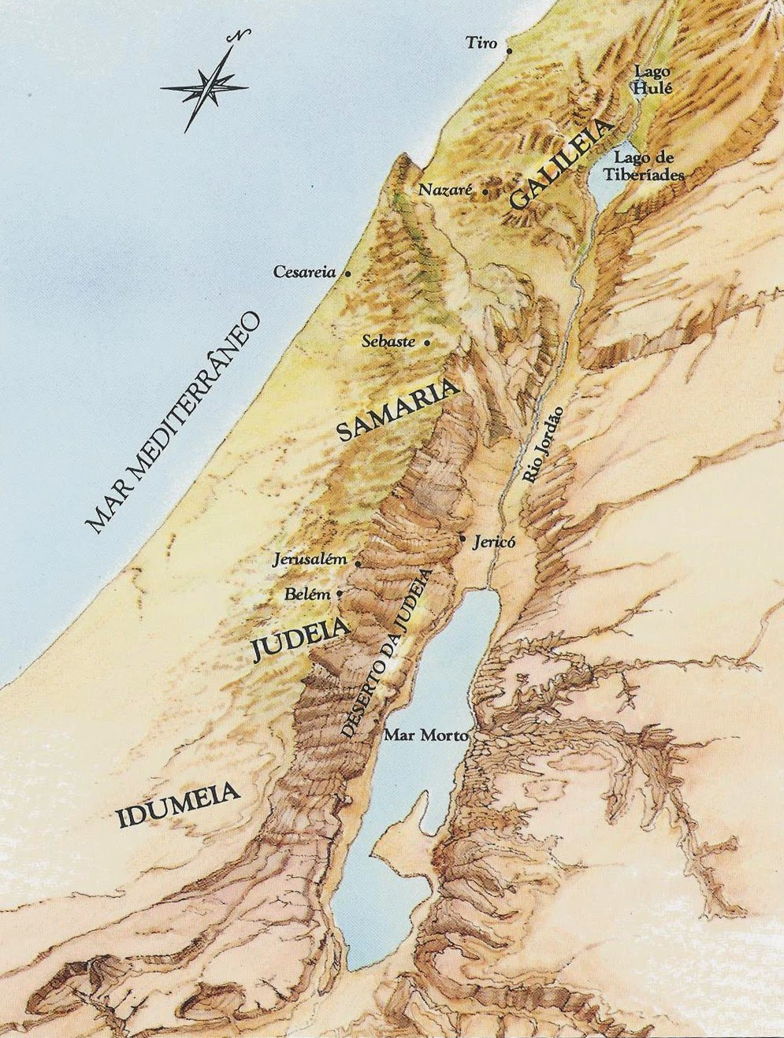




"Must Go“ – The Leading of the Spirit
“He left Judea, and departed into Galilee. He needed to pass (必須經過) through Samaria.”
Adalia Helena: MAPAS BÍBLICOS
Notes:
He needed to go through Samaria.
Why does the Bible emphasis this?
The classic answer is that Jews and Samaritans do not get along.
But I think this is irrelevant – Jesus was not bound by these prejudices.
If it was only this reason then John would not have emphasised it.
Also he passed through Samaria a few times and there is no “emphasis” on this.
2) Lets look at the geography.
Lets We see the map…
-- the main route avoids the mountains of Samaria and takes flat land.
-- One could also take the coastal highway. (today’s route)
-- Both ways avoid the mountains
-- instead Jesus goes through the mountains.

Slide 9
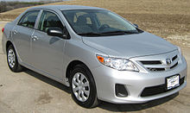
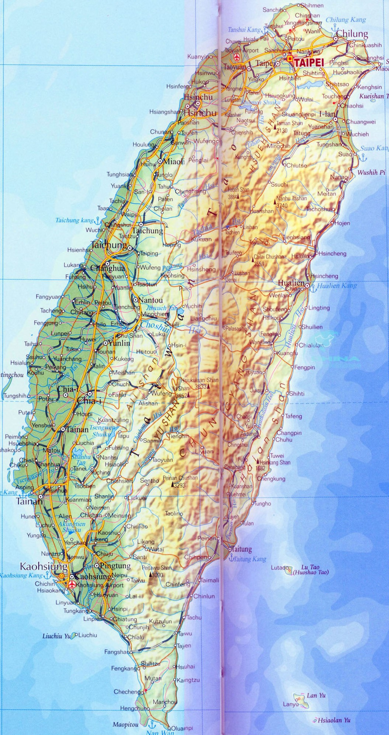









Analogy: 比喻:高雄到台北
Notes:
Analogy:
It is like I am driving from Gaosheng to Taiwan and I tell people
standard route: 1 or 3
But I take provincial highways.

Slide 10


"Must Go“ – The Leading of the Spirit
“He left Judea, and departed into Galilee. He needed to pass (必須經過) through Samaria.”
Prompting of Holy Spirit: a divine appointment
Examples:
  Sister In Qingdao
  Myself
  Courtney/Aleta
Adalia Helena: MAPAS BÍBLICOS
Notes:
Prompting of Holy Spirit → divine appointment
Compelling to do something one normally would not do.
I am sure many of us have felt that.
When we normally would do something
but feel compelled to do something we or others don’t understand.
Example 1: sister in Qingdao
-- going to go to Korea for a meeting
-- simplest route is air but she said: “I must go by ship.”
-- her friends tried to convince her to take the airplane but she was insistent.
-- When she came back she told met, built relationship and led two young ladies to on ship.
-- a divine appointment
Example 2: myself
--myself 1991 was going to Beijing.
--felt God wanted me to go via Taipei
--During 6 week stopover in Taipei I met a girl who became my penpal.
--and 6 years later my wife!
Both Courtney and Aleta have shared in past similar experiences.
-Divine appointments
- Like Jesus we must listen and obey.

Slide 11
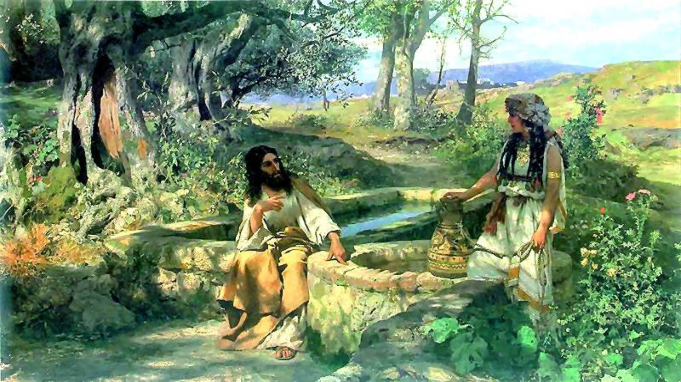
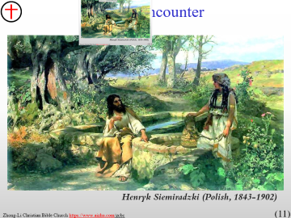

The Encounter
Henryk Siemiradzki (Polish, 1843-1902)
Notes:
11 ： The Encounter
Why did Jesus Need Must go through Samaria?
-- The next chapter continues with Jesus in Galilee
-- There is only one stop on the trip that is recorded: The town of Sychar.
-- There is only the encounter with one person that is recorded.
An awkward encounter…
mid-day.
A man and a woman alone
A preacher and a woman not know for her fine moral behaviour
No one goes out for water at noon time…
Jesus engages the woman: He makes the first move.
(Is it not God who made the first move to engage us – not us who made the first move?)
Evangelism: Do we wait for people to come to us or do we seek to engage others? Lets follow Jesus’ example.

Slide 12
Looking for Joy in the Wrong Places
5 husbands, living with another man…
Seeking to find joy, fulfillment in sex and male companionship.
Finding only temporary (快乐) not real joy (喜乐)
Woman realizes “this is a dead end.”
Notes:
Vs 16
On the surface, a reasonable request.
A male rabbi should not be giving council to a married woman without her husband present.
But the request brings to the forefront where the woman has been seeking to find joy and fulfillment.
She has sought “Joy in Sex” and Joy in male companionship.
She found only temporary joy (快乐) but not true joy (喜乐) → disappointment
She has tried to find Joy – but has been left unsatisfied.
Today many people seek Joy through relationships. weather in reality, social media, or online pornography

Slide 13
Lookin’ for Love in all the Wrong Places
Johnny Lee
1
Well, I spent a lifetime lookin' for you
Single bars and good time lovers were never true
Playing a fools game, hopin' to win
And tellin' those sweet lies and losin' again
C
I was lookin' for love in all the wrong places
Lookin' for love in too many faces
Searchin' their eyes
Lookin' for traces of what I'm dreaming of
Hoping to find a friend and a lover
I'll bless the day I discover another heart
Lookin' for love
2
I was alone then, no love in sight
I did everything I could to get me through the night
Don't know where it started or where it might end
I turned to a stranger just like a friend
1 我花了一輩子的時間尋找你
單身酒吧和美好時光的戀人
從來都不是真的
玩傻瓜遊戲，希望贏
說著那些甜蜜的謊言，再次迷失
C
我在所有錯誤的地方尋找愛
在太多面孔中尋找愛
搜索他們的眼睛尋找痕跡
我夢寐以求的
希望找到一個朋友和一個愛
我會祝福我發現另一顆心的那一天
尋找愛
2
那時我很孤獨，看不到愛
我竭盡全力讓我度過這個夜晚
不知道它從哪裡開始
或可能在哪裡結束
我像朋友一樣轉向陌生人
Fr 0:00 to 2:18
Notes:
Today many people seek Joy through relationships. weather in reality, social media, or online pornography
This songs echoes this sentiment love and joy.
Yes, sex brings temporary joy (快乐) but one…
Yes, opiods bring temporary joy (快乐) but the fix wears off.
Yes, relationships and praise bring temporary joy but the fix wears off.
Yes, a great big dinner brings temporary joy (快乐) but you have to leave the huoguo dian！
Yes, online1 gaming can distract us from the sorrow in our heart but we have to rejoin the real world.
The end of this song points towards the source of Joy.
Jesus will talk of this to the lady.

Slide 14
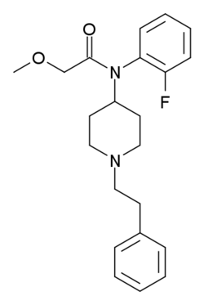
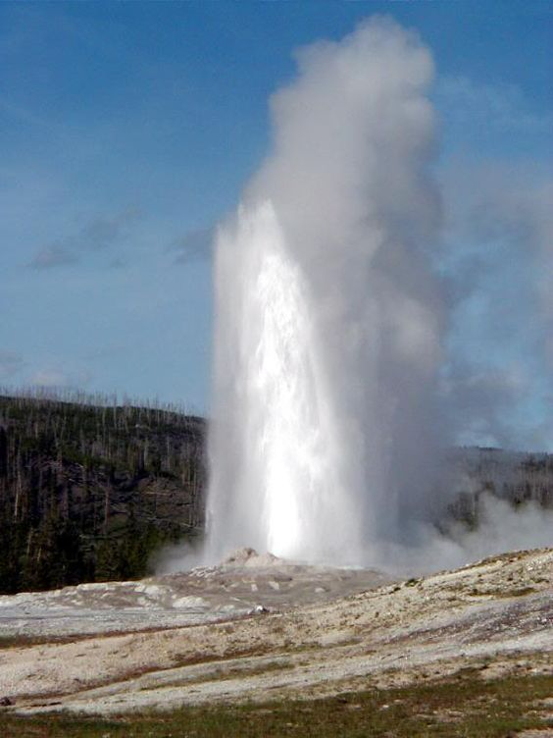
The Source of Joy
Internal not External
Source: Jesus
Gift
Eternal
“…given you living water. The water that I will give will become a well of water springing up to eternal life.”
…給了你活水。我所賜的水、要在他裡頭成為泉源、直湧到永生。(vs14)
Notes:
Jesus now explains to the woman the true source of joy (living water)
The source of true Joy is not external circumstances (sex, $$$, food, alcohol, Fentanyl). These only temporarily mask the pain. As the woman found with her many husbands… The relationship could give temporary happiness
Rather the Joy must come from inside of us.
Nature of true joy is it is eternal, not temporary.
Clearly this type of joy is valuable.
It will satisfy our heart’s longing
It will be eternal.
How can I get this Joy?
This is the question of the woman
It is not something you can buy – it is a gift.
From who? From Jesus.
Summary: True Joy is a gift from Jesus that is not dependent on external circumstances.
Application: Even as Christians, we often, like the woman, look for Joy and fulfillment in the wrong places.
- Christian Service
- Friendships
Spouse
Children
Lets refocus and

Slide 15
Joy for Jesus
Before: John 4:6
After: John 4:32
Jesus therefore, being tired from his journey, sat down by the well. 耶穌因走路困乏、就坐在井旁．
the disciples urged him, saying, "Rabbi, eat." But he said to them, "I have food to eat that you don't know about." 門徒對耶穌說、拉比、請吃。耶穌說、我有食物吃、是你們不知道的。
Why was Jesus
not Hungry?
He had obeyed the prompting of the Holy Spirit
He was doing what God trusted him to do.
He had shared about God’s kingdom.
A woman had repented.
He was high!
Joy!
Notes:
Lets now look at the Joy of Jesus
Lets compare.
Before the encounter, Jesus is tired, Jesus is hungry – he sent his disciples to get food.
Reading the Scripture: Jesus therefore, being tired from his journey, sat down by the well. 耶穌因走路困乏、就坐在井旁
After the encounter: He is not hungry. He does not seem tired at all.
Reading the Scripture: the disciples urged him, saying, “Rabbi, eat.” But he said to them, “I have food to eat that you don‘t know about.” 門徒對耶穌說、拉比、請吃。耶穌說、我有食物吃、是你們不知道的。
The disciples are confused. They think that Jesus must have eaten to be so revived and not hungry.
Why was Jesus not hungry? He had sent his disciples away to get food. He had not eaten.
Joy!
He had obeyed the prompting of the Holy Spirit
He was doing what his Father had sent him to do.
Eric Liddell: “When I run, I feel God’s pleasure” Almost a definition of Joy. Feeling God’s pleasure
He had shared about God’s kingdom.
A woman had repented
He was high! (and not due to drugs!)
The ultimate Joy
When we obey God’s promptings and see God working in our lives and those of others
When we see God turning a person’s life around
“Truly there is great rejoicing in heaven when one sinner repents”
When we are thankful that God has been willing to use us. Thankful that we have not refused His leading
A overwhelming Joy that takes away hunger and earthly desires.

Slide 16
Joy 喜乐
found while doing
  What God wants us to do
  When God wants us to do it
Let’s
  not be satisfied with just temporary joy
  seek eternal joy
  cultivate a thankful heart
做
  神要我們做
  在神的時候
不要滿足快樂
尋求喜乐
讓我們記得保持一顆感恩的心

Slide 17
Lookin’ for Love in all the Wrong Places
Johnny Lee
You came knockin’
on my heart's door
You're everything
I've been looking for
No more lookin’ for love
in all the wrong places
Lookin' for love
in too many faces
Searchin' their eyes
Lookin' for traces
of what I'm dreaming of
Now that I found a friend and a lover
God bless the day
I discovered You
你來敲我的心門
你就是我一直在尋找的
不再
在所有錯誤的世界
尋找愛
在太多面孔中
尋找愛
注目人们的眼睛
尋找一点
我夢寐以求的愛
現在我找到了朋友和愛
上帝祝福
我發現你的那一天
Fr 2:18 to end
Notes:
When I listen to the last verse of this song my heart is full of gratefulness to God.
Just as Jesus made a special trip to meet the woman,
Jesus knocked on my heart door
Not me seeking him but He seeking
He allowed me the chance to discover him
And in discovering him I found not just joy but also a friend and love

Slide 18
Benediction: Joy
Now unto him that is able
to keep you from falling, and
to present you faultless
before the presence of his
glory with
exceeding joy,
To the only wise God
our Saviour, be
glory and majesty,
dominion and power,
both now and ever.
Amen. (Jude 1:24-25)
那能
保守你們不失腳、
叫你們無瑕無疵、
歡歡喜喜站在他榮耀之前的
我們的救主獨一的神，
願
榮耀、威嚴、
能力、權柄，
因我們的主耶穌基督
歸與他，
從萬古以前並現今，
直到永永遠遠。
阿們。
(猶大1:24-25)

