Slide 1
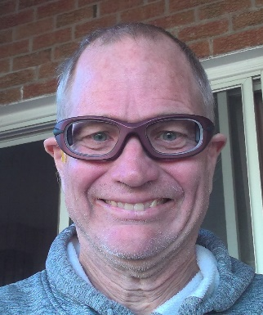
Walking with God
與上帝同行 (Pt2)
Following up on Pastor Schultz message…
Micah 彌迦6:6-8
Speaker: Brother Jon
Translator: Sister Ruth
Date: Nov 13, 2022

Slide 2
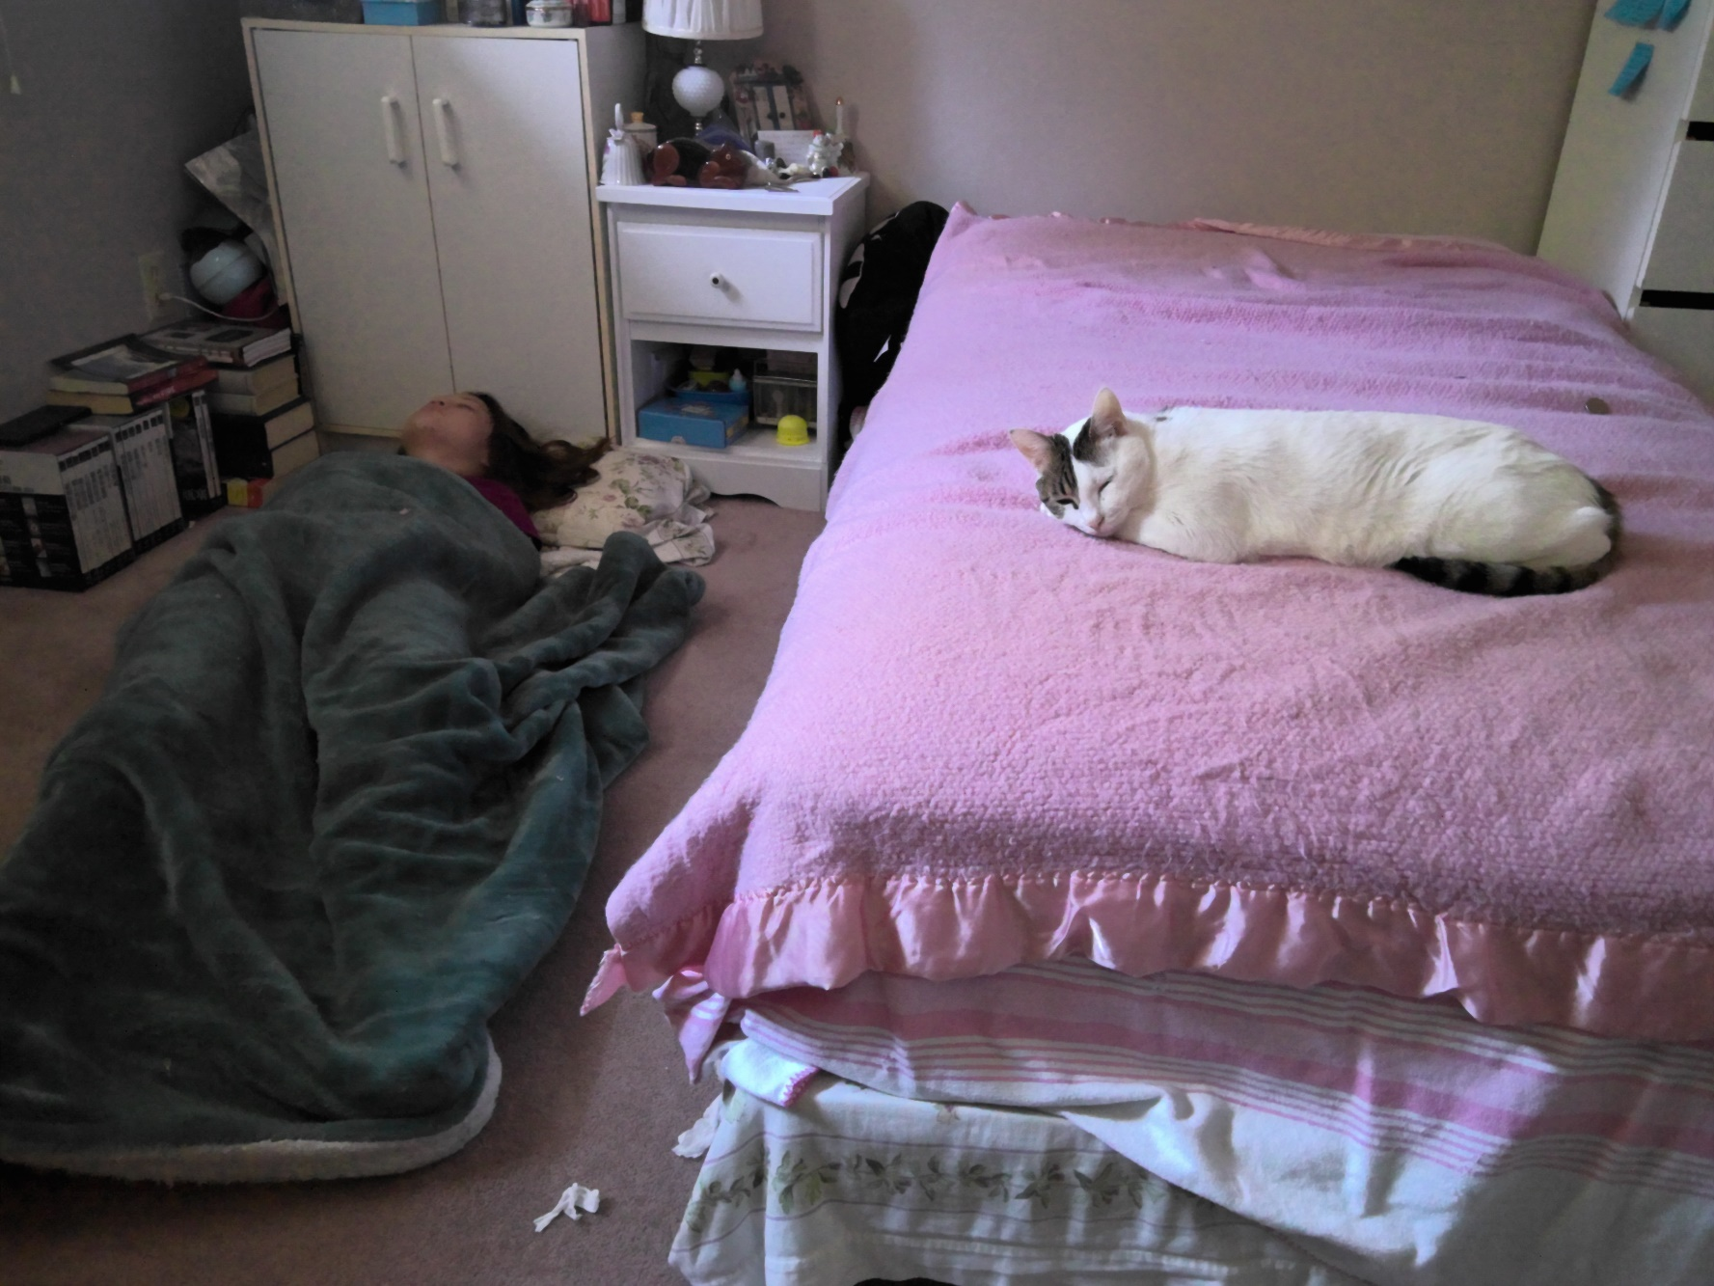

Slide 3
Micah 彌迦6:8
What does Yahweh require of you, but
to act justly,
to love mercy, and
to walk humbly with your God?
他向你所要的是什麽呢？只要你
行公义，
好怜悯，
存谦卑的心，
与你的神同行。
Notes:
Our key verse.
(Read English, read Chinese)
This verse tells us simply what God requires of us…
For English speakers God requires 3 things! 1) to act Justly, 2) to love mercy 3) to walk humbly with him
For Chinese speakers God requires 4 things: 1) act justly, 2) show mercy, 3) have a humble heart 4) walk with God.
So what does walking with God mean?
Pastor Schultz discussed this 2 weeks ago, so lets just review his outline….

Slide 4
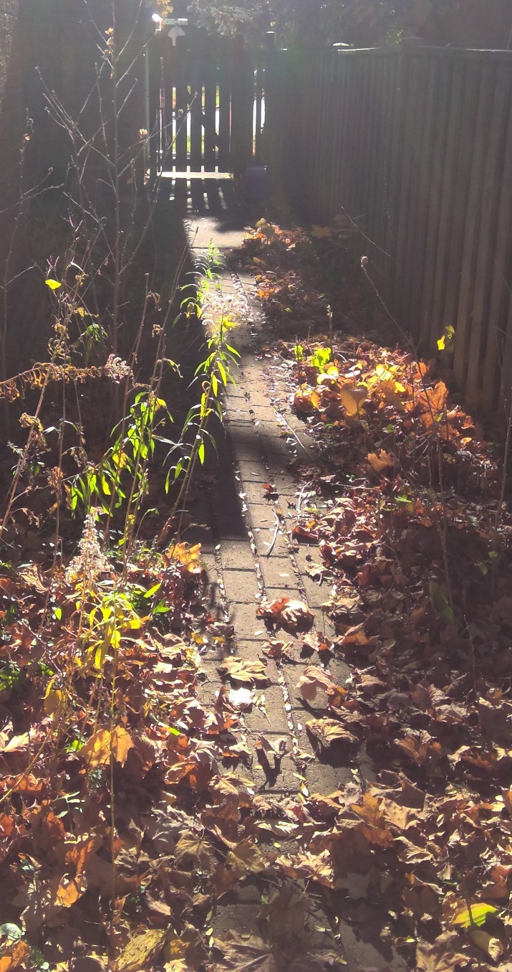
Walking with God means 與上帝同行
to go in God's direction
以上帝的方向
to proceed at God's pace
以上帝的步伐
to share intimacy
親密關係
to arrive at a destination
到達目地
Notes:
The direction is chosen by God not by ourselves.
The speed is chosen by God not by ourselves. We do not want to rush ahead or dilly dally behind.
The conversation during the walk is intimate and intense. God has given many images, so that we might connect with one,
God has given us the image of father/son OR mother/daughter (if we had that close loving relationship with a parent)
God has given us the image of bride/bridegroom – young lovers (if we have had that kind of relationship with an SO)
God has given us the image of 2 brothers (if we have had a brother and experienced that king of relationship)
God has given us the image of two close friends
For myself the image of father/son connects the most to me…
There is a destination. It is not a meaningless meander. There is a destination to arrive at.
God is not just taking us for a Sunday afternoon stroll through the rutabaga patch.
(I am not sure how well this Canadian expression translates into American English, let alone into Chinese!)
I am also not sure whether Joseph ever invited Anita on a Sunday afternoon stroll through the rutabaga patch!
I have side tracked.

Slide 5
Walk the Talk
“If you talk the talk, you’ve got to walk the walk”
“Don’t talk the talk, if you don’t walk the walk”
1st usage: “…Howard Herring of the North American Watch company, walks the walk, and talks the talk, of a hero today.” (Mansfield News, Ohio, USA 1921)
A shorter version is Aristotle’s “walk the talk.”
As Christians we need to do both…
Notes:
“If you talk the talk, you’ve got to walk the walk”
“Don’t talk the talk, if you don’t walk the walk”
I add this aside for Joseph’s sake. The first usage of this expression was in 1921 in his home state in the town of Mansfield (right in the middle of the state if I remember correctly. It is not used in a Christian setting. “Howard Herring of the North American Watch company, walks the walk, and talks the talk, of a hero today.”
As shorter version of this would be from Aristotle: “walk the talk.”
Whatever, the meaning of these phrases are the same.
Our words must match our actions for our words to be credible.
I think there are 2 types of people here.
Some of us are good at the talk but neglect the walk.
Some of us concentrate on the walk but neglect the talk
I don’t think God is happy with either…
if we just walk the walk then people will only see that we are ‘good’ people and they will not be able to experience a relationship with God
If we just talk the talk then we bring God’s name into disrepute and people will reject “our God”.
Example: Iran -- government policies have reduced the number of practicing Moslem
--- Christianity is becoming the fastest growing religion in Iran by 5.2% annually,
--- Atheism is also on the rise with an annual growth of 7.2%.
In summary we need to “walk the talk”.

Slide 6
What God does not want 神不想要的
How shall I come before Yahweh, and bow myself before the exalted God?
Shall I come before him with burnt offerings, with calves a year old?
Will Yahweh be pleased with thousands of rams? With tens of thousands of rivers of oil?
Shall I give my firstborn for my disobedience? The fruit of my body for the sin of my soul?
我朝見耶和華，在至高神面前跪拜，當獻上什麼呢？
豈可獻一歲的牛犢為燔祭嗎？
耶和華豈喜悅千千的公羊，或是萬萬的油河嗎？
我豈可為自己的罪過獻我的長子嗎？
為心中的罪惡獻我身所生的嗎？
Notes:
“How shall I come before Yahweh, and bow myself before the exalted God?
Shall I come before him with burnt offerings, with calves a year old?
Will Yahweh be pleased with thousands of rams? With tens of thousands of rivers of oil?
Shall I give my firstborn for my disobedience? The fruit of my body for the sin of my soul? ”
A series of rhetorical questions…
When I come to God, should I bring my tithe?
What does God want from me? Does God want my money?
Upping the ante!
--- What can pay for my sin and my rebellion against Father God?
--- Is child sacrifice what God wants? My firstborn child’s life to substitute for me so I don’t have to die?
Micah is describing a transactional relationship.

Slide 7
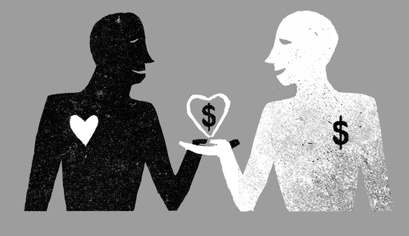
Transactional Relationship
https://www.huffpost.com/entry/conscious-relationships_b_4450074
God does not want a transactional relationship
So what does God want?
Notes:
What is a transactional relationship?
For exam: A give B something to B gives A something.
a) husband-wife
Modern: Husband responsible to pay for the rent and the food Wife must provide “sex on demand.”
Traditional Chinese: Husband provides for wife. Wife must provide son. IF NO, then marriage ends.
These are transaction relationships.
In summary A transactional relationship is when couples treat marriage as a business deal. Each person in that relationship has clear responsibilities and rewards. Those responsibilities will define what each individual is expected to contribute, as well as the rewards each will receive (or expects to receive) as a result of their efforts.
This is not a loving relationship.
b) temple religion:
If God does this for me, I will do this for God. If God does not do this for me, I will not do this for God.
I gave money to temple, so the God must do what I ask.
I did the ceremony, god must give me protection.
The answer to these rhetorical is: … NO!
Key point: God does not want a transactional relationship with us.
But we need to reflect: Do I enter relationships with others (God, God’s children) with a transactional point of view
- I attend morning and evening so God should give me…
- I listen to boring sermon by brother Jon so God owes me big…
-
But what does God want?
Glad you asked.
Micah is ready with the answer!

Slide 8
Micah 彌迦6:8
What does Yahweh require of you, but
to act justly,
to love mercy, and
to walk humbly with your God?
他向你所要的是什麽呢？只要你
行公义，
好怜悯，
存谦卑的心，
与你的神同行。
Notes:
3 things for English speakers, 4 things for Chinese speakers!
The first 2 relate to character
: justice and mercy are the key characteristics of God’s nature.
If we are made in the image of God,
If God is our Father,
we should be like him in character.
It is a fundamental tenant of our belief: God is just. God does not tolerate injustice.
It is a fundamental tenant of our belief: God is loving and merciful.
Both are perfect and both are in balance
→ this balance is most clearly seen in Jesus:
Dying for our sin to satisfy God justice
Being willing to die for our sin to demonstrate God’s love for us
The last line relates to relationship.
: walking together with God
: not with a proud heart (I am a chosen one. I am so great God chose me (not you) to be his special friend.)
What does it mean to walk with God?
Well I guess we have come full circle…

Slide 9
Walking with God means 與上帝同行
to go in God's direction
以上帝的方向
to proceed at God's pace
以上帝的步伐
to share intimacy
親密關係
to arrive at a destination
到達目地
Notes:
The direction is chosen by God not by ourselves.
The speed is chosen by God not by ourselves. We do not want to rush ahead or dilly dally behind.
The conversation during the walk is intimate and intense. God has given many images, so that we might connect with one,
God has given us the image of father/son OR mother/daughter (if we had that close loving relationship with a parent)
God has given us the image of bride/bridegroom – young lovers (if we have had that kind of relationship with an SO)
God has given us the image of 2 brothers (if we have had a brother and experienced that king of relationship)
God has given us the image of two close friends
For myself the image of father/son connects the most to me…
There is a destination. It is not a meaningless meander. There is a destination to arrive at.
God is not just taking us for a Sunday afternoon stroll through the rutabaga patch.
(I am not sure how well this Canadian expression translates into American English, let alone into Chinese!)
I am also not sure whether when Joseph was dating Anita, He invited her on a Sunday afternoon stroll through a rutabaga patch!
But he is from Ohio, so maybe…
Smilely. Smilely.
I have side tracked.

Slide 10
Hymn: To Obey is Better
To obey is better than sacrifice
I don't need your money, I want your life
And I hear you say that I'm coming back soon
But you act like I'll never return
Well you speak of grace and my love so sweet
How you thrive on milk, but reject My meat
And I can't help weeping of how it will be
If you keep on ignoring My words
Well you pray to prosper and succeed
But your flesh is something I just can't feed
To obey is better than sacrifice
I want more than Sunday and Wednesday nights
Cause if you can't come to Me every day
Then don't bother coming at all
To obey is better than sacrifice
I want hearts of fire; Not your prayers of ice
And I'm coming quickly; To give back to you
According to what you have done (3x)
服從勝於犧牲
我不要你的錢，我要你的命
我聽到你說我很快回來
但你表現我不會回來
….
你祈禱繁榮和成功
但你的肉是我無法餵養的
服從勝於犧牲
我想要的不僅僅是周日和周三如果你不能每天都來
那就不要來了
Transactional relationship
Transactional relationship
Notes:
LISTEN to music.
Then prayer

