Slide 1
Gratitude 感激/感謝
Give thanks with a grateful heart
Give thanks to the Holy One
Because He’s given Jesus Christ, His Son.
滿心歡喜地致謝！
向神聖的主致謝！
致謝，因其賜耶穌基督，其子！
A Canadian Thanksgiving Day Message
Philippians (腓立比書) 4: 6-7
Speaker: Brother Jon
Translator: Sister Ruth
Date: Oct 9, 2022

Slide 2
Philippians 4:6-7
In nothing be anxious, but in everything,
  by prayer and petition with thanksgiving,
    let your requests be made known to God.
And the peace of God,
  which surpasses all understanding,
  will guard your hearts and
    your thoughts in Christ Jesus.
Don't look forward
with requests for the future,
without looking back
with thanksgiving for the past.
Notes:
Our key verse.
What is Paul saying here?
Quite a lot.
But for our purpose, lets focus on the first phrase.
I think I can state in other words this thought.
Don't look forward
with requests for the future,
without looking back
with thanksgiving for the past.
Lets repeat the key verse together.
Now lets repeat the main message.

Slide 3
腓立比書 4:6-7
應當一無掛慮，只要凡事藉著禱告、
  祈求，和感謝，
    將你們所要的告訴神。
神所賜、出人意外的平安必
  在基督耶穌裡
    保守你們的心懷意念。 .
再有感恩之情回首往事前，
不要期待未來的要求.
Notes:
Now the verse in Chinese with Ruth leading
Our key point in Chinese.

Slide 4
A Key Element in Prayer: Statistics
Thank
Grace
Thank
Grace
Notes:
Is thankfulness to God a forgotten part of our faith?
I did a quick word study to compare the number of occurrences of the words grace and thank. in the Bible and in a standard Chinese hymnal.
The results speak for themselves….
In the Bible, the word thank occurs more frequently than the word grace. Despite this I am sure we have heard more sermons about grace than about thanksgiving.
Compare this to the Chinese hymnal. The relative occurrence of these words is reversed. In fact, you can see that our songs have a strong focus on the grace of God with a seeming non-emphasis on giving thanks to God or saying thank you.
Are we overlooking thankfulness in our faith?

Slide 5
Thanksgiving in Prayers
Daniel: When Daniel knew that the writing was signed, he went into his house (now his windows were open in his room toward Jerusalem) and he kneeled on his knees three times a day, and prayed, and gave thanks before his God, as he did before. (Daniel 6:10)
Paul: I always thank my God concerning you (I Cor 1:4)
The Pharisee stood and prayed to himself like this: “God, I thank you, that I am not like the rest of men, extortionists, unrighteous, adulterers, or even like this tax collector. (Luke 18:11)
Notes:
Daniel: giving thanks a key aspect in Daniel's prayer life. Even when facing danger he maintained thankful heart. This is a powerful example: a man who maintained a thankful heart when he heard the news that the Lions were waiting.
Paul: Always giving thanks. Giving thanks seems to be a vital part of his prayers. Here he is always giving thanks for a church that caused him so much troubles and had so many problems.
Pharisees: Even the Pharisees gave prayers of thanksgiving! Although in this case I do not think it was Jesus’ intention that we follow their examples. i.e “I thank God I am not like Pastor Joseph Shultz…” No…

Slide 6
Lack of Thankfulness has Consequences
Because, knowing God,
  they didn’t glorify him as God,
    neither gave thanks
      (Romans 1:21)
But love your enemies, and
    do good, and lend, expecting nothing back; and
    your reward will be great, and
    you will be children of the Most High;
  for he is kind toward the unthankful and evil.
      (Luke 6:35)
Notes:
Romans 1 is the road to hell. In this chapter we see the sin of man progressing from lying cheating and steeling to sexual immorality, homosexuality, murder and pride.
But I think it is significant that the first step on this road to depravity is a failure to cultivate a thankful heart and give thanks to our creator.
Do we have a thankful heart or have we already started down this road to depravity?
--------------------------
Jesus teaching us how to live.
To do good and expect nothing back.
But notice the description of God
“kind toward the unthankful and evil”
The unthankful and evil are said in the same breath.
Yikes, when I am unthankful towards God then I am evil…
Conclusion: Cultivate a thankful heard

Slide 7
For what should I be thankful?
Give thanks to Yahweh, for he is good;
  for his loving kindness endures forever.
Give thanks to the God of gods;
  for his loving kindness endures forever.
Give thanks to the Lord of lords;
  for his loving kindness endures forever:
你們要稱謝耶和華，因他本為善；
  他的慈愛永遠長存。
你們要稱謝萬神之神，
  因他的慈愛永遠長存。
你們要稱謝萬主之主，
  因他的慈愛永遠長存。
Notes:
God’s lovingkindness endures forever!
But how is God’s lovingkindness seen in our lives?
What are some things for which I can be thankful?

Slide 8
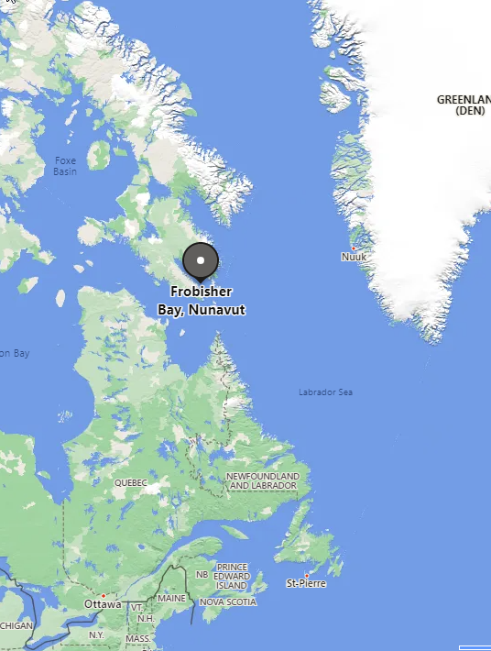
1. Thanks for Protection
The First (Canada) Thanksgiving
1578 (before the Pilgrims)
Made a National Holiday in 1872 (5 years after confederation)
Martin Frobisher
safe passage across the Atlantic Ocean.
Notes:
We can thank God for protection
But first a little bit of culture and Canadian history.
- Today is Canadian thanksgiving day – for my children this is a 4 day holiday: Friday, Saturday, Sunday and Monday. Schools and many stores are closed.
The first Canadian thanksgiving day was held in 1578.
This was about 70 years before the pilgrims landed in USA!
It was made a national holiday in 1872 – only 5 years after the confederation of the various colonies in British North America.
It was held by Martin Frobisher – an English explorer. The reason for thanksgiving was protection. He and his crew had safely travelling in ships from England to Newfoundland.
Write down times in you life you have seen God's protection. I will give you a few minutes to think..
- For myself, one incident stands out: As a 4 year old I scared and ran into the front of a speeding car. If I was one second earlier, I would have been run over by the car. However I was only quite shook up after the incident. Thank God for his protection
- I also thank God for his protection from serious injury in numerous accidents and near accidents riding my motorcycle and bike in Taiwan
Would anyone like to thank God now for an instance of his protection in your life?

Slide 9
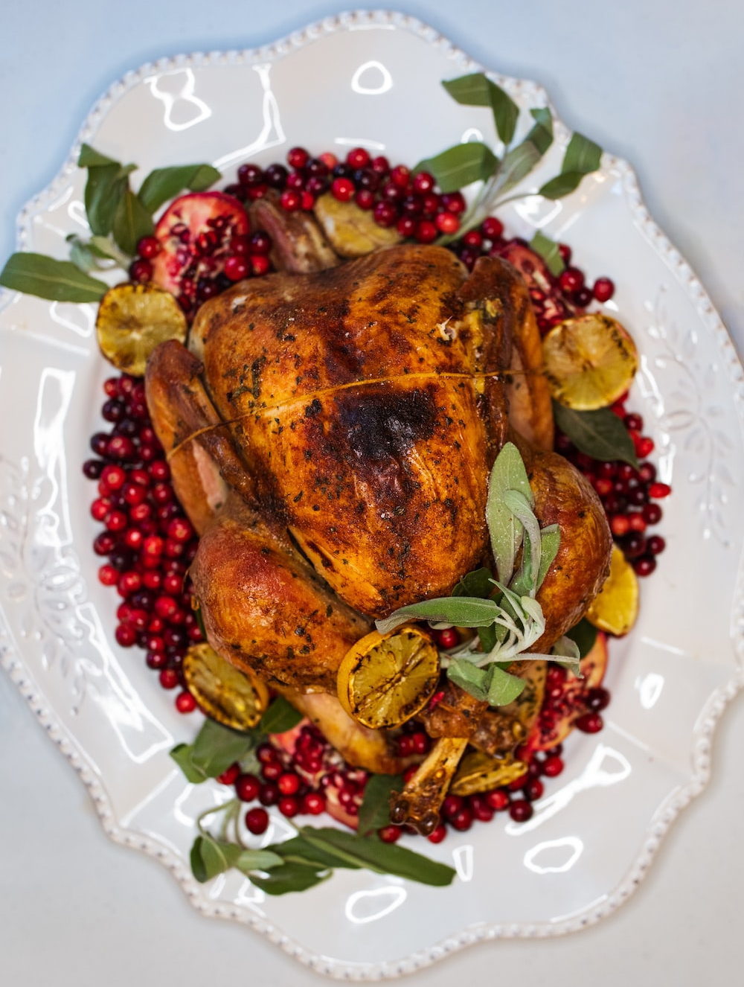
2. Thanks for Food
Eating is a BIG part of thanksgiving – especially for Americans
Most of us likely say a grace everyday.
But is it just a formality?
Do we even say thanks?
Notes:
Eating is a BIG part of both Canadian and American thanksgiving. I think this is especially the case for Americans as their first thanksgiving was for a harvest and surviving famine conditions.
Most of us likely say “grace” everyday.
But is it just a formality? Are we just repeating words, like the hippocrites without reflecting on the meaning?
A common grace is: "Bless this food to our bodies."
Not even a thanks for the food but a request from God! Do we even say thanks?
Another common grace: “Bless us, O God. Bless our food and our drink. ”
How does God bless food and drink? I don’t understand.
It is really amazing that we are not hungry but can go to store and buy food and eat so we are not hungry
(For some of us, a little hunger might be a good thing! My doctor said that due to my diabetes I need to loose 3 more kg.)
Lets reflect on our own prayers before we eat our meals.
Do we say thank you? Or are we just asking for God to bless us?

Slide 10
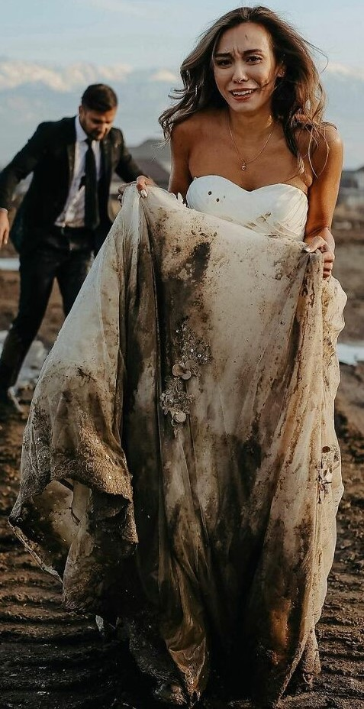
3. Salvation
at the cost of Jesus' life
at the cost of Jesus' humiliation
at the cost of separation with the Father
at the cost of His holiness being stained with sin
Notes:
3 Salvation and eternal security.
at the cost of Jesus' life
at the cost of Jesus' humiliation
at the cost of separation with the Father
at the cost of His holiness being stained with Sin
(Scene: CHina picture: a bride on her way to a wedding wearing a beautiful white dress. a child cries from a public toilet. She jumps into a outdoor toilet to rescue a baby soiling her dress -- and an awful smell as she struggles to clean the stains and not miss her wedding.

Slide 11
….
Cultivate a thankful heart!
An unthankful spirit is the first step away from God
Thank God daily for
  Protection
  Food
  Salvation
培養一顆感恩的心
不感恩的心是遠離上帝的第一步
每天感謝上帝
  保護
  食物
  救恩

