Slide 1

Turning Points 轉折點
A Study in the Life of Moses
摩西的生平
Speaker: Brother Jon
Translator: Sister Ruth
Date: Sept 4, 2022
Notes:
Turning Points.
We all have them.
Times in our life in which crucial decisions that change the trajectory of our whole lives.
Sometimes they are obvious
Sometimes we only see them when we look back.
When Anita said, “I do” to Joseph.
When Courtney broke with family and decided to follow Jesus. Who would know that that decision to leave USA and bring her to Taiwan?
Turning Points.
We all have them.
Times in our life in which crucial decisions are made that affect our whole life.
Sometimes turning points are due to decisions that we make
Sometimes turning points are due to decisions that others make
Sometimes turning points are direct interventions of God.
Turning Points
We all have them
Sometimes they are for the better
Sometimes they are for the worse
This evening we will look at turning points in the life of Moses,
I will reflect on turning points in my life
You will look at turning points in your life – you have a piece of paper and pen,
please feel free to diagram your life as I share

Slide 2
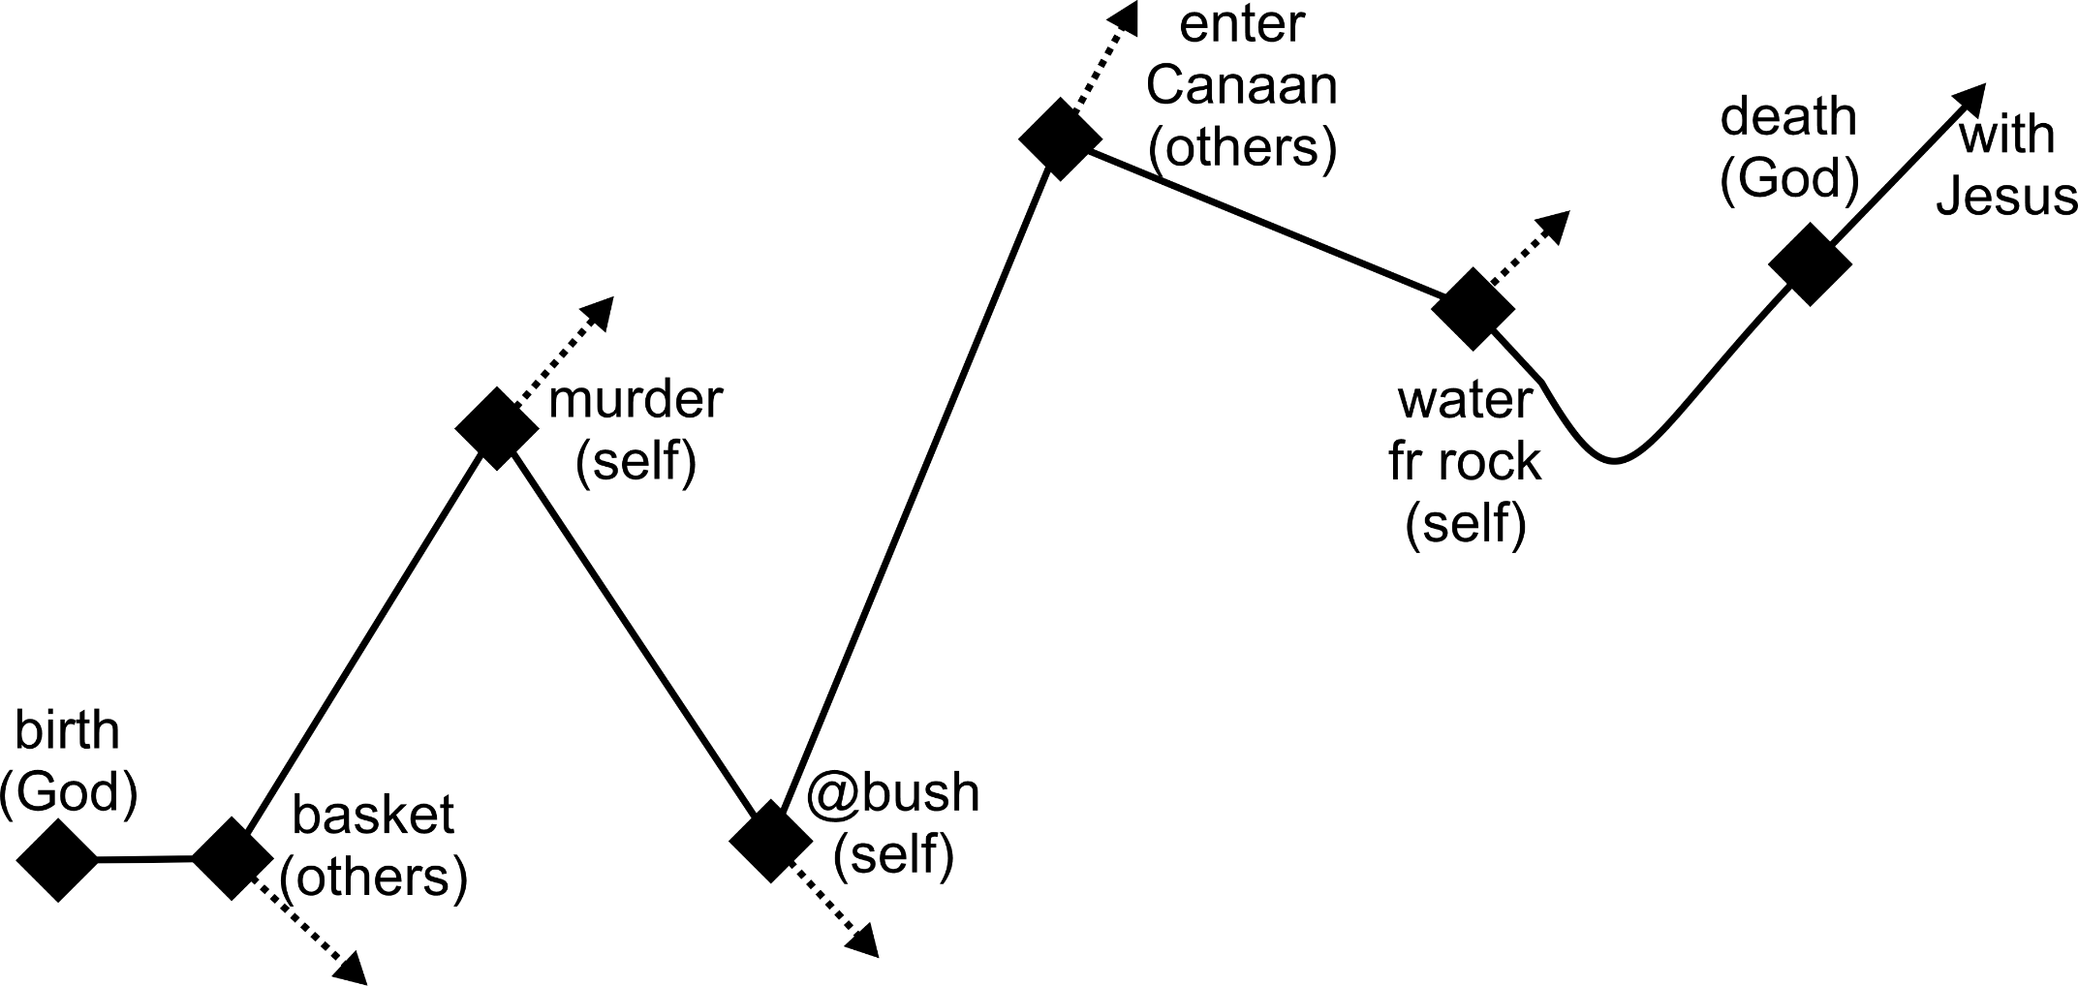
Turning Points in Moses’ Life
Notes:
Lets now look at the life of Moses
– a man respected by Jews, Christians and Moslems,
-- the man, chosen by god, to be the “law-giver”
-- the man, chosen by God, to lead the Israelites out of slavery….
-- the man, chosen by God, to form the Israelite nation
His life had many turning points.
His birth:
the time, location and family chosen by God → this would affect his whole life.
Born into a family of slaves. → in the world’s perspective: not a promising start
Born into a family that feared God. → in a spiritual perspective, a great start
Placed in a basket in river or let him be killed
A decision made by God fearing parents
A hard decision for his parents,
A decision that would have significant consequences for Moses: movement from slavery to royalty
A decision not made by him but rather by faithful parents who feared God.
Life went smoothly for 40 years, We don’t know about any key “turning point” decisions during these years.
Turning point decisions do not occur every day!
But at 40 Moses observed a slave being beaten…
A decision: he decided to murder the offender
The result: loss of his royal lifestyle, 40 years as a shepherd in the desert
40 more years past: Moses got married, had children, looked after sheep.
Then God appeared: “Bring my people out of Egypt.”
Moses was faced with another life changing decision
Continue in his nomadic life as a shepherd with wife and family
Go back to Egypt, in obedience to God, to do the impossible.
That is,
free the slaves in Egypt (impossible)
Lead a huge company across a desert (impossible, no water)
Overcome opposition in Canaan by their well trained armies (impossible)
Moses chose the 2nd
Moses’ decision brought him into close fellowship with God
Moses’ decision made him a leader
If he had chosen “Not to Obey” we would know nothing about this man’s life.
A few years passed and the impossible has happened
The slaves are free – due to God’s intervention
They have crossed the desert – due to God’s intervention
One thing remains: overcome opposition in Canaan.
12 men were sent to spy out the land:
2 said attack as God is with us
10 said: the enemy is too strong.
Moses decided to go
The people decided not to go
A decision was made that led to 40 years in the desert.
Others decisions had changed the direction of Moses life
He could not complete the mission God gave him due to other’s decisions
But there is still hope that he will be able to enter land – albeit 40 years late!
The Israelites demanded water.
God told Moses to talk to the rock.
Moses hit the rock
Seems like a minor decision
But from a leader, important
Result: Moses would not be allowed to complete God’s mission: leading into Canaan
But this did not break his relationship with God
The final turning point is decided by God: death
The timing: just before entering Canaan
The place: on the edge of Canaan

Slide 3
Turning Points in Moses’ Life
Decisions have
Consequences
Notes:
So what can we learn from Moses’ life.
Decisions have consequences:
decisions to reject God’s leading lead to negative consequences
Decisions to follow God’s leading lead to fulfilled life

Slide 4
Turning Points in Moses’ Life
Decisions have
Consequences
1. Father God (birth/death)
2. Ourself
  Good (@bush)
  Bad (@rock)
3. Others
  Good (basket)
  Bad (Canaan)
Notes:
2. Decisions that affect my life are not only made by me.
Identify 3 sources
God: our birth and death are God’s decision – or should be in the case of death.
E.g. Moses to a slave family in 1400BC
E.g. Aleta did not choose to be born in America. I am sure, if asked, she would have chosen Canada.
Ourself: how we respond to God’s calling – to accept or reject.
e.g. Moses made decisions to answer God’s call and to hit the rock
E.g. Aleta made a decision to marry Joseph:
I don’t think that anyone held a gun to her head. But then I am not an American.
I’ll let her tell you whether it was a good or bad decision.
But it has sure affected her life.
Others: how others, generally close to us, respond to God’s leading in their lives.
EG Moses’s parents in placing him in a basket and the Israelites’ decision not to enter Canaan
E.g. Joseph believed God called them to serve in Taiwan.
Aleta’s decision would affect this: If she refuse to go to Taiwan, what is Joseph going to do?
We know her decision.

Slide 5
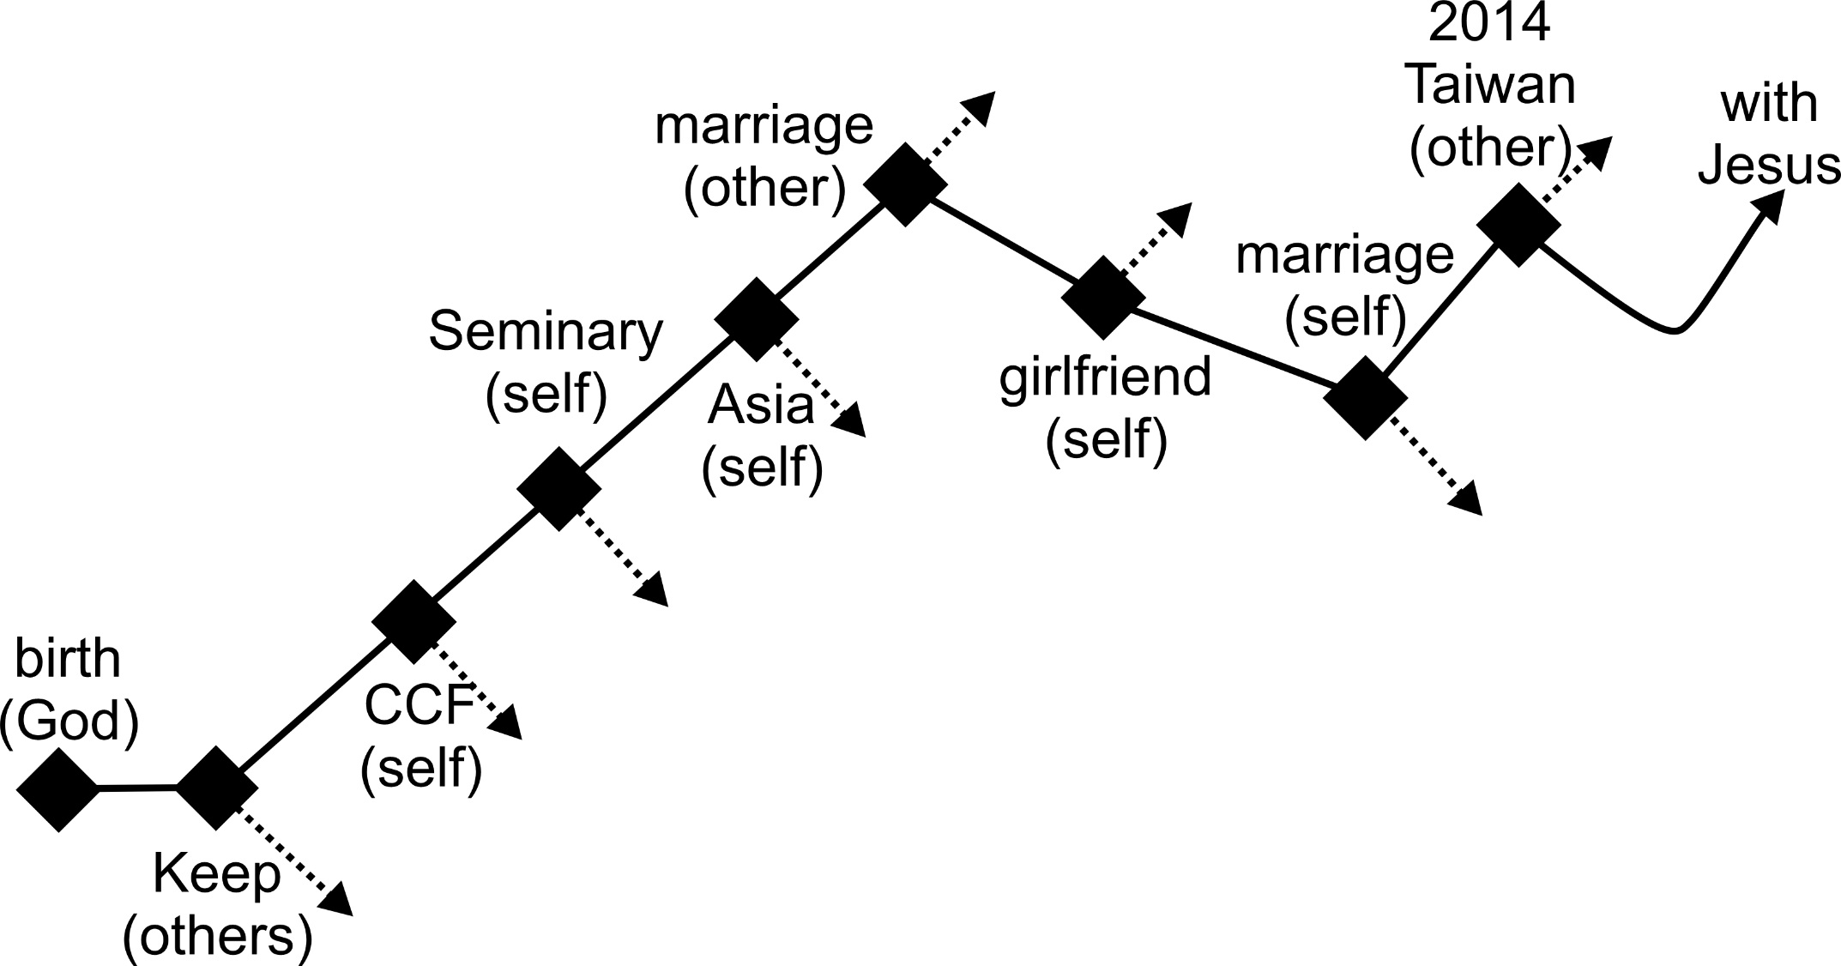
Turning Points in Brother Jon’s Life
Notes:
I have tried to reflect on my own life to see significant turning points…
God decided my birth
When I was born,
doctors suggested my life be terminated due to serious brain damage:
parents refused and prayed
doctors then suggested I be sent to a facility of severely brain damaged children (not to see parents again):
Parents refused and took me home from hospital a few months later
My mother was not allowed to touch me until I was 1 month old.
The Godly decision of my parents gave me life.
In University God’s calls
Join the Chinese Christian Fellowship.
After a struggle with God, yes
Go to seminary.
After bargaining with God, Yes
Go to Asia. OK as long as not Taiwan: China or Japan are OK
In Beijing, met the girl I believe God had prepared for me to marry. Everything compatable
But God said no, now not possible. Why?
She had studied Bible for 2 years with a sister and about 2 months before I arrived she made her decision, it cost too much to follow Jesus
Another person’s decision affected my life route
In Qingdao, became friends with a girl.
Other sisters warned me to break off quickly as she was not really interested in Jesus
I refused although I knew in my heart this sister was right.
As a result of this, God told me to leave China for a time.
God pointed out to me Wu Hsiuman and told me this is the one to marry
I argued at first: She is Taiwanese. Doctors say she is likely to die within 2 years. She does not get along with my mother. My mother hope I would marry a Chinese girl.
After a few months in prayer, I asked her and a few months later she agreed.
In 2014, I believe that God was leading my family to return to Canada. My wife refused.
Time of death: That will be God’s decision.
There are many other turning points but in looking at my life I think these are the most important.

Slide 6
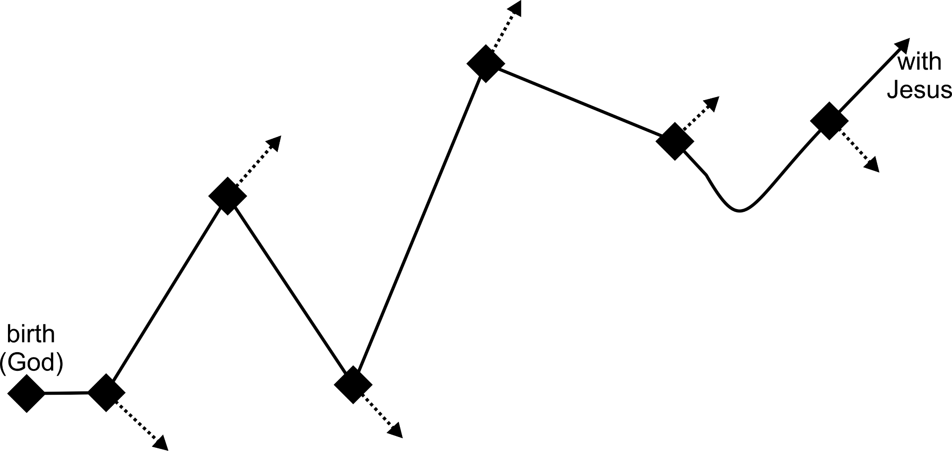
Turning Points in the Life of …
1 Take our your paper and pen
2 (now) Draw your life
3 (after) Share with someone else
1. Father God (birth/death)
2. Ourself
  Good (@bush)
  Bad (@rock)
3. Others
  Good (basket)
  Bad (Canaan)
Notes:
Now it is your turn,
Please take out your paper and pen if you have not already done so
Make the “turning points” in your life.
Were the changes due to your decisions or others?
Did the decision move you in a direction towards or away from our heavenly father?
After the service, find someone to share the turning points of your life story.

