Slide 1
Humble Yourself
John 13:1-5, 12-17
Key Verse: 13:12
Speaker: Brother Jon
Translator: Sister Ruth

Slide 2
Outline 大綱
1. A Living Parable (John 13:1-5,12a)
2. Handling Peter’s Interrupt (John 13:6-11)
3. Parable Explained and Call to Action (John 13:12b-17)
活出來的比喻（約翰福音 13:1-5）
處理彼得的打擾（約翰福音 13:6-11）
寓言解释和行动号召 （約翰福音 13:12-17）

Slide 3
A Really
Strange Story
And we will learn how strange it is!

Slide 4
Context: Timeline (John 13:1-3)
Look back in time
  Triumphant entry
  Clearing the Temple
  End of his public ministry
Look forward in time
  Betrayal by Judas
  Denial by Peter
  Death by Crucifixion
  Resurrection
Present: Evening Passover meal
Now before the feast of the Passover, Jesus, knowing that his time had come that he would depart from this world to the Father… After supper, the devil having already put into the heart of Judas Iscariot, Simon's son, to betray him, Jesus, knowing that the Father had given all things into his hands, and that he came forth from God, and was going to God,
Squished Between
Big Events

Slide 5
Thoughts of 13 men (John 13:1-3)
11 men are thinking power
  Matthew: Finance Minister
  Simon the Zealot: Special Forces
  General James & John
  Spokesman: Peter
2 men share a secret…
  Jesus
  Judas
Going to be no victory over Rome, no earthly kingdom tomorrow
Now before the feast of the Passover, Jesus, knowing that his time had come that he would depart from this world to the Father… After supper, the devil having already put into the heart of Judas Iscariot, Simon's son, to betray him, Jesus, knowing that the Father had given all things into his hands, and that he came forth from God, and was going to God,

Slide 6
Only John Records (John 13:1-3)
Matthew:
  Jesus as king narrative?
  Doesn’t fit
Mark: Peter would have remembered his denial
Luke
  Greek culture this action would not be commendable
  Teachers don’t do this
But John remembered clearly
  Big impact on his life
  His writings emphasize love demonstrated by service
Now before the feast of the Passover, Jesus, knowing that his time had come that he would depart from this world to the Father… After supper, the devil having already put into the heart of Judas Iscariot, Simon's son, to betray him, Jesus, knowing that the Father had given all things into his hands, and that he came forth from God, and was going to God,

Slide 7
Perfectly Normal Passover Meal
Standard ritual (yearly for 1500 years)
Celebrated every year since birth with their family (like our evening service order…)
3rd time with Jesus rather than theirown father leading.
Jesus leads ceremony in place of honor
Disciples know by heart each step
  what is coming next
  what will be said.
Now before the feast of the Passover, Jesus, knowing that his time had come that he would depart from this world to the Father… After supper, the devil having already put into the heart of Judas Iscariot, Simon's son, to betray him, Jesus, knowing that the Father had given all things into his hands, and that he came forth from God, and was going to God,

Slide 8
Suddenly Jesus goes off script…
John 13:4-5, 17
约翰福音13:4-5,17
arose from supper
laid aside his garments.
took a towel,
wrapped a towel around his waist.
poured water into the basin, began
  to wash the disciples' feet,
  to wipe them with the towel that was wrapped around him.
put his garment back on,
sat down again,
就離席站起來
脫了衣服、
拿一條手巾
束腰。
隨後把水倒在盆裡、
  就洗門徒的腳、
  用自己所束的手巾擦乾。
就穿上衣服、
又坐下、

Slide 9
Handling Peter’s Interrupt (Jh 13:6-11)
Disciples in shock
Due to time will not study this discourse.
But, Peter’s interruption shows how strange and unreal this scene is…
Peter said to him, "You will never wash my feet!“ (vs 8)
彼得說、你永不可洗我的腳。

Slide 10
Humility of Jesus
Servants wouldn’t want to do this
Only the lowest of the low to do
Students wouldn’t do this for their teacher…
But now
  a teacher doing this for students
  the master for his servants
  God incarnate doing for man
  Jesus for his betrayer
Aside: What Jesus has done for his closest followers, is a picture of what Jesus will soon do on the cross for the world!

Slide 11
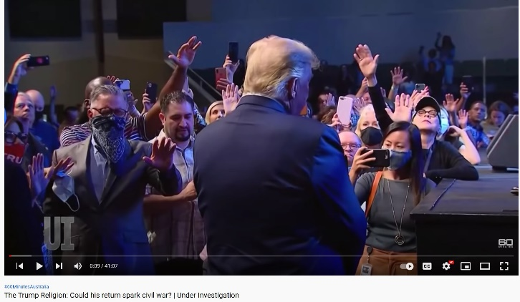
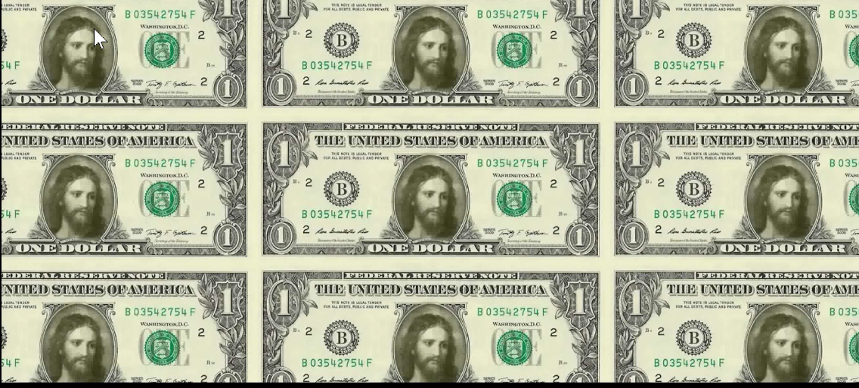
Contrast: Pride of North Ammerica Christianity
https://youtu.be/97a_s6aUI9M
https://youtu.be/cHxYATBjW7k
Is our mindset like Jesus?
Or do we worship power?

Slide 12
What should we do?
我們應該做什麼？

Slide 13
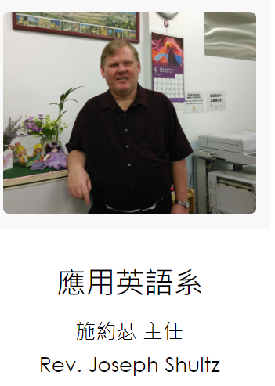
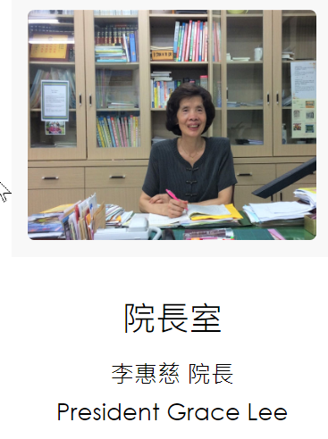

The Interpretation: John 13:12b-17
Jesus expected us to copy
But what?
The “easy” answer: Jesus wants us to have a servant’s heart.
Do we take this literally?
  Images…
  But you say…
    People’s response
    Culture
  Baptist Distinction
But before we go to Zhong Li train station…
^{12b}he said to them, "Do you know what I have done to you? ¹³You call me, 'Teacher' and 'Lord.' You say so correctly, for so I am. ¹⁴If I then, the Lord and the Teacher, have washed your feet, you also ought to wash one another's feet. ¹⁵For I have given you an example, that you also should do as I have done to you. ¹⁶Most certainly I tell you, a servant is not greater than his lord, neither one who is sent greater than he who sent him.
¹⁷If you know these things, blessed are you if you do them.

Slide 14
Clues to Implementation
Clues
Message to us
Where?
  private not a public place → lead to wrong ideas
  not 1:1 → could lead to wrong ideas
Who? (relationship)
  Not the crowds
  Not the Pharisees
  Not all followers
  only Jesus’s close disciples
  below him in hierarchy
  10 future leaders of church
Disciples did not wash Jesus’s feet
Where?
  Not Zhong-Li Train Station
  Not when alone
    with opposite sex
    with same sex
Who? (relationship)
  Not strangers
  Not those above us
  Not general church members
  e.g, family, small group
  Our children, our wives
  Future leaders: Our children, church young people
Not “I rub your back, you rub my back”

Slide 15
Implementation
Symbolic Only
  Humble before family members/children/small group members
  Not demanding to be served
  Serve our family members, our children, giving them an example of how to serve others
Cultural Equivalent of Feet Washing
  Tea ceremony
  Dish washing (husband → wife)
  Taking out the Garbage
  Toilet cleaning (husband → wife)
Literal interpretation of Feet Washing
  In a private but not 1:1 setting…
  Strip ourselves of clothes and wrap-up in towel
  Wash our spouse’s, children’s, cell group member’s feet
All cases: Not expecting anything in return.

Slide 16
A Really
Strange Story
But Implementation
Is Not Optional

