Slide 1
喜樂 Joy⁵
Joy¹ 2017-12-10
Joy² 2018-12-09
Joy³ 2019-12-08
Joy⁴ 2020-12-06
Joy⁵ 2021-12-05
χαρά / χαίρω
57/74

Slide 2
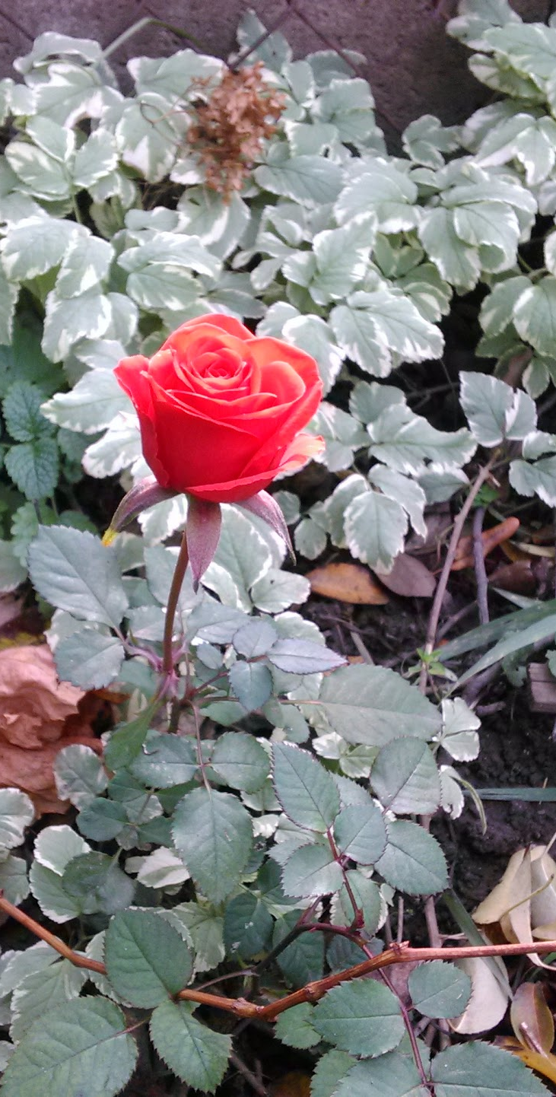
Joy
Joy is
  A Fruit of the Spirit
  A Mark of a Christian
We experience joy when:
  we face troubles
  the Gospel is preached
  we consider our future
  we receive concern of brothers/sisters
Joy’s Focus: The LORD
The Joy of Jesus

Slide 3
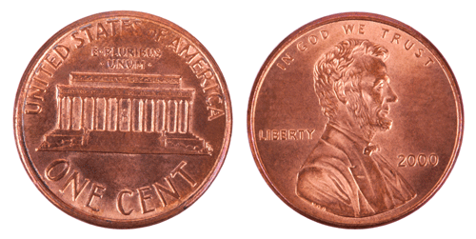
Joy²: Two Sides of a Coin
Suffering Joy
God gives Joy…
Satan gives suffering…
No Suffering → No Joy.
We get both or neither!

Slide 4

喜樂 Joy³
Preceded by Shame
Focused on the joy-giver
Blessing the world
Hannah, Mary, Zechariah, Joseph, David, Jesus…
先羞辱
專注在喜樂給予者
祝福世界
汉娜, 玛丽, 撒迦利亞，約瑟，大衛，耶稣
…who for the Joy set before him,
Endured the cross.

Slide 5
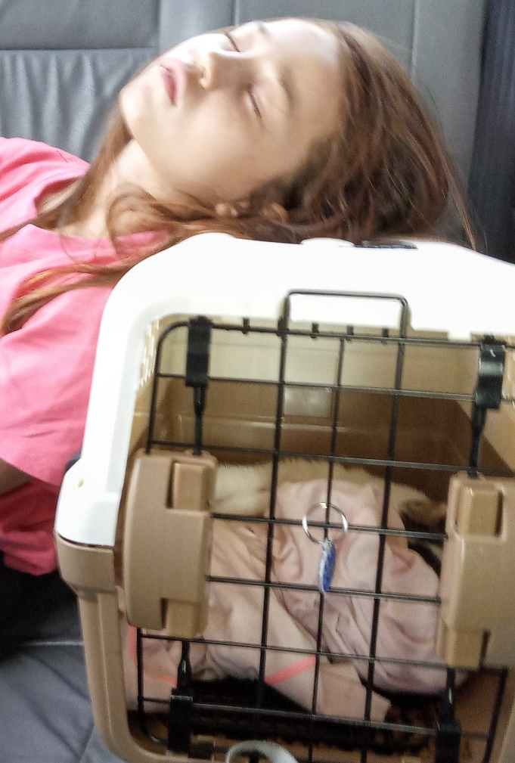
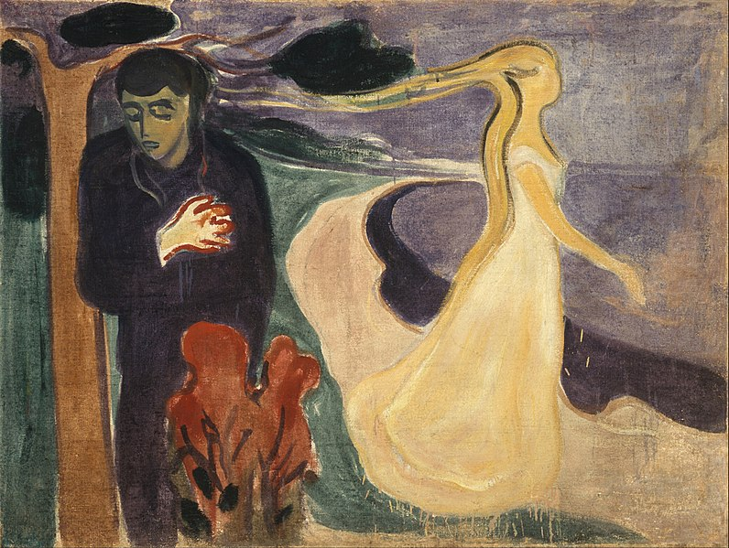
Joy⁴ (2020-12-06)
Joy (喜樂) found in
Relationship (關係)
Separation (距離)
→ Despair (絕望)
In the Garden
Moment of Decision
Eternity

Slide 6
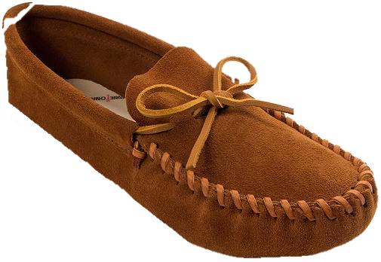
seph in the Old
seph in the Transition
seph in the New
seph of the Latter Days
Jo
y
And ou?

Slide 7
As the Ruin Falls (Reflect 思考)
By C S Lewis
Phil Keaggy
All this is flashy rhetoric about loving you.
I never had a selfless thought since I was born.
I am mercenary and self-seeking through and through:
I want God, you, all friends, merely to serve my turn.
Peace, re-assurance, pleasure, are the goals I seek,
I cannot crawl one inch outside my proper skin:
I talk of love – a scholar's parrot may talk Greek –
But, self-imprisoned, always end where I begin.
Only that now you have taught me (but how late) my lack.
I see the chasm. And everything you are was making
My heart into a bridge by which I might get back
From exile, and grow man. And now the bridge is breaking.
For this I bless you as the ruin falls. The pains
You give me are more precious than all other gains.

Slide 8
當廢墟崩塌時 Tr. David Chang
說愛你全是花言巧語
我生來就是自私自利
徹頭徹尾的功利思想
上帝、你們、朋友、全是我的利益所在
我追逐的是平順、 穩當、和快樂
從不為別人著想一分半毫
高談大愛—學者口裡總能吐出舌燦蓮花
然而到底是自說自話，百無用處
而如今你使我缺陷我認清了自己的缺失
（這樣的覺悟來得太晚）
我見到了一道鴻溝。一直以來你都設法在我心裡搭一座橋，
等待我能迷途知返，長大成人。而這座橋正在崩塌。
我為崩塌的廢墟感謝讚美。你是我經歷了痛苦，
這一切要比其他的收獲更加難能可貴。

Slide 9
Four Josephs
Joseph of the Old Testament – “son” of Jacob
Joseph of the transition – “father” of Jesus
Joseph from Arimathea – “undertaker” of Jesus
Joseph of the latter days – “represent” us
Pain/Sorrow
Joy

Slide 10
As the Ruin Falls (Reflect 思考)
By C S Lewis
Phil Keaggy
All this is flashy rhetoric about loving you.
I never had a selfless thought since I was born.
I am mercenary and self-seeking through and through:
I want God, you, all friends, merely to serve my turn.
Peace, re-assurance, pleasure, are the goals I seek,
I cannot crawl one inch outside my proper skin:
I talk of love – a scholar's parrot may talk Greek –
But, self-imprisoned, always end where I begin.
Only that now you have taught me (but how late) my lack.
I see the chasm. And everything you are was making
My heart into a bridge by which I might get back
From exile, and grow man. And now the bridge is breaking.
For this I bless you as the ruin falls. The pains
You give me are more precious than all other gains.

Slide 11
Joy to the World 普世喜樂 ！
1 Joy to the world!
The Lord is come;
Let earth re-ceive her King;
Let ev-'ry heart
pre-pare Him room,
And heav'n and na-ture
sing (2X),
And heav'n and heav'n
and na-ture sing.
1 普世喜樂 ！
救主下降,
大地接她君王；
惟願眾心預備地方,
諸天萬物歌唱, (2X)
諸天，諸天
萬物歌唱.

Slide 12
Benediction: Joy of Jesus
Now unto him that is able to keep you from falling, and to present you faultless before the presence of his glory with exceeding joy,
To the only wise God our Saviour, be glory and majesty, dominion and power, both now and ever. Amen. (Jude 1:24-25)
那能保守你們不失腳、叫你們無瑕無疵、歡歡喜喜站在他榮耀之前的我們的救主獨一的神， 願榮耀、威嚴、能力、權柄，因我們的主耶穌基督歸與他，從萬古以前並現今，直到永永遠遠。阿們。
(猶大1:24-25)
Notes:
We give Jesus Joy – when he presents us to his Father as those he has redeemed

Slide 13
Notes
Review: -Joy→Joy2→Joy3→Joy4 time flies: many years have looked at this lets now review.
-Joy5: Joy -- Joseph and You
-- 4 case studies -- "put yourself in their shoes.“ OR "walk a mile in Joseph's moccasins.” to paraphrase a Native American Proverb
But first some meditation... As the Ruin Falls poem by C S Lewis Author of the Narnia Series, put to music by Phil Keaggy (greatest rock guitarist of the 20th century)
It is track #3 from the album Love Broke Thru)
1. Joseph of the Old Testament
-- going to see your brothers (sure you have fights, what family doesn’t?). Suddenly thrown in a pit: "Is this a joke, Judah?" "Come-on Simeon, let me out"
-- "Finally...Thanks Guys. What? Why are you selling me?"
-- Separation from Father
- years in Egypt...
-- Joy of reunion and realization that through his suffering he has saved his family! Great Joy!
2. Joseph of the interim -- father of Jesus
-- Your pregnant?
-- In some cases, this is joyous news. But in others...
-- I picture Judy calling her husband in Singapore with the news. Can you interim imagine his reaction? Especially if she started to try to explain some seemingly crazy story about how this baby was unique -- no earthly father but from God.
-- What man would take a pregnant girl on a trip to Bethlehem? Only He needed to go. There must have been great pressure on the family.
-- But what joy to know that through his suffering the Messiah was coming to Israel.
3. Joseph of Arimathea -- we know little about him
Matthew 27:57 describes him simply as a rich man and disciple of Jesus, but according to Mark 15:43 Joseph of Arimathea was "a respected member of the council, who was also himself looking for the kingdom of God"; Luke 23:50–56 adds that he "had not consented to their decision and action".
According to John 19:38, upon hearing of Jesus' death, this secret disciple of Jesus "asked Pilate that he might take away the body of Jesus, and Pilate gave him permission." Joseph immediately purchased a linen shroud (Mark 15:46) and proceeded to Golgotha to take the body of Jesus down from the cross. There, according to John 19:39-40, Joseph and Nicodemus took the body and bound it in linen cloths with the spices that Nicodemus had bought.
The disciples then conveyed the prepared corpse to a man-made cave hewn from rock in a garden of his house nearby. The Gospel of Matthew alone suggests that this was Joseph's own tomb (Matthew 27:60). The burial was undertaken speedily, "for the Sabbath was drawing on".
-Lets put ourselves in Joseph's shoes. The man/teacher was now dead. In sorrow he has taken down the body and laid it in his own tomb. But mixed with sorrow there must be some joy that he can serve the LORD.
-- And what great joy when his tomb is found empty. And he sees the risen savior.
What do we see in common? Internal pain → Joy
4. Joseph of the latter days
-Joseph Shultz was born in 1964 in Ohio. We do not know what suffering he will go through in his life. We do not know if he will face the great tribulation. We do not know whether he will be alive when Jesus returns.
- What we do know is that the suffering we receive in this life is a blessing that will result in great joy.
- Joseph represents us.
---We don't know what suffering/pain we will face in the future. We don't know when Jesus will return -- but he will
Finally Lets reflect again for a few minutes on CS Lewis’ song which expresses gratitude for suffering. Sing Joy, Benediction

