Slide 1
Beyond Confucius:
Jesus’ Most Famous Parable
Luke 15
“超越孔子”
耶穌最著名的比喻
路加福音 15 章

Slide 2
Know Your Audience 了解你的聽眾
Now all the tax collectors and sinners were coming close to him to hear him.
The Pharisees and the scribes murmured, saying, "This man welcomes sinners, and eats with them.“
He told them this parable.
眾稅吏和罪人、都挨近耶穌要聽他講道。
法利賽人和文士、私下議論說、這個人接待罪人、又同他們吃飯。
耶穌就用比喻、說、
What is their worldview?
他們的世界觀是什麼？
Notes:
To understand the original meaning of the parable, we need to decide to whom he is speaking. The “them”. The target audience is the Pharisees. For most Westerners, the word Pharisee = hypocrite. But that is not their worldview. Paul was a Pharisee. Jesus was closest in thinking to the Pharisees. He did not disagree with their teaching. He disagreed with their inability to live up to their teaching. We need to understand their worldview. Then we can understand how they are reacting to Jesus’ message.

Slide 3
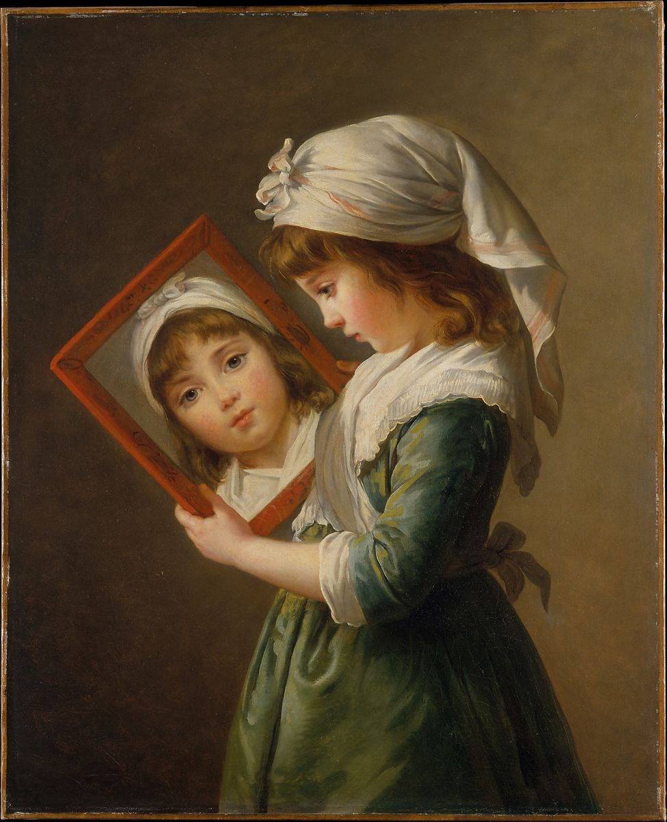
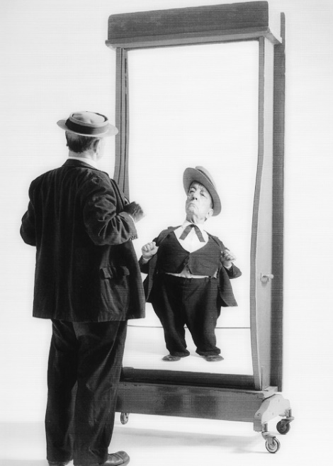
Object → Image
Look in a mirror
What do you see?
NO, not your face
Image of your face
You have never seen your face.
You have only seen the image of your face.
Plato:
  Unseen is the reality
  The image is not (it can be flawed)
Notes:
We need to step back and get some philosophy. 5. You have never seen your face. You have seen other people’s faces. But you have never seen your face. 8. Not the type of mirror that most ladies would like in their house!

Slide 4
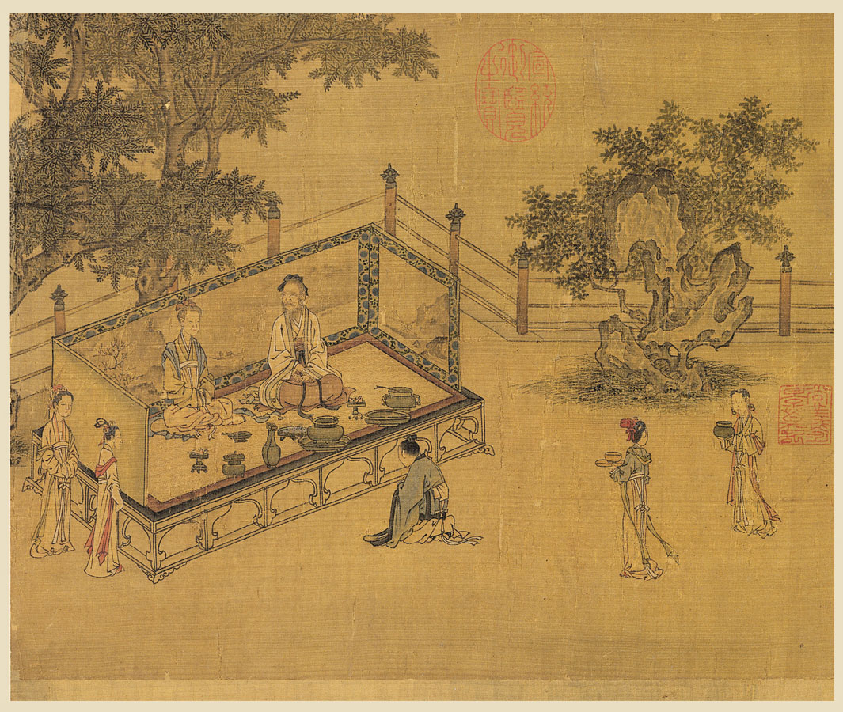
Mirrors in Creation 創造的鏡子
Spiritual Reality 精神現實
Earthly Image 地球形象
God ←→ Humans
Christ ←→ Church
Father ←→ Children
Husband ←→ Wife
關系
relationship
慈
愛
Love
孝
順
Filial
Piety

Slide 5
Filial Piety孝順 Pharisees (Confucius)
Bring Honor not Shame 帶來榮譽而不是恥辱
E.g. Garden(花園), 1st Family(第一家庭)
Seen in 10 Commandments 十誡
  Heavenly Father (First 3) 天父（上三）
  Earthly Father (Next 7) 地上的父親（下七）
Imagery throughout OT 整個舊約
  A son shows filial piety to his father. If I am a father, then where is my honor? (Malachi 6:1)
  「兒子應當孝順父親。我是你們的父親，但你們對我的孝順在哪裡呢？
Notes:
Filial piety. Filial Piety owed to your parents. Owed to God. Involves bring Honor not Shame to family. Honor, Do not murder. If I murder someone, I bring shame on my parents.

Slide 6
Filial Piety孝順 Pharisees (Confucius)
The Pharisees were proud of their filial piety! 法利賽人以他們的孝順為榮！
  Obey Heavenly Father’s Law 遵守天父的律法√
  Tithe 十一奉獻 √
  Sabbath安息日√
  Concerning the righteousness which is in the law, found blameless. 就律法上的義說、我是無可指摘的。 √
  Zeal for Father’s affairs 熱情 √
Now Jesus, as a fellow teacher…耶穌，現在…
Notes:
Filial piety. Filial Piety owed to your parents. Owed to God. Involves bring Honor not Shame to family. Honor, Do not murder. If I murder someone, I bring shame on my parents.

Slide 7
Jesus, as a fellow teacher, is addressing them directly
耶穌，現在直接對他們說話

Slide 8
Sheep 羊
⁴"Which of you men, if you had one hundred sheep, and lost one of them, wouldn't leave the ninety-nine in the wilderness, and go after the one that was lost, until he found it?
⁵When he has found it, he carries it on his shoulders, rejoicing. ⁶When he comes home, he calls together his friends and his neighbors, saying to them, 'Rejoice with me, for I have found my sheep which was lost!’
⁷I tell you that even so there will be more joy in heaven over one sinner who repents, than over ninety-nine righteous people who need no repentance.
⁴你們中間誰有一百隻羊、失去一隻、不把這九十九隻撇在曠野、去找那失去的羊直到找著呢。
⁵找著了、就歡歡喜喜的扛在肩上、回到家裡。⁶就請朋友鄰舍來、對他們說、我失去的羊已經找著了、你們和我一同歡喜罷。
⁷我告訴你們、一個罪人悔改、在天上也要這樣為他歡喜、較比為九十九個不用悔改的義人、歡喜更大。
Yes, Yes, Amen!
是的，是的，阿門！
Notes:
If you are a Pharisee, what are you thinking? Sheep—Yes I would do this. Yes, when I found my lost sheep I would be like this! Yes, Jesus, God is merciful. That is why I spend so much time teaching the people the law of God. They need knowledge of God. So they can get into heaven. Of course they won’t have any reward, like me, but they won’t be in hell.

Slide 9
Coins錢
⁸Or what woman, if she had ten drachma coins, if she lost one drachma coin, wouldn't light a lamp, sweep the house, and seek diligently until she found it?
⁹When she has found it, she calls together her friends and neighbors, saying, 'Rejoice with me, for I have found the drachma which I had lost.’
¹⁰Even so, I tell you, there is joy in the presence of the angels of God over one sinner repenting."
⁸或是一個婦人、有十塊錢、若失落一塊、豈不點上燈、打掃屋子、細細的找、直到找著麼。
⁹找著了、就請朋友鄰舍來、對他們說、我失落的那塊錢已經找著了、你們和我一同歡喜罷。¹⁰我告訴你們、一個罪人悔改、在 神的使者面前、也是這樣為他歡喜。
Yes, Yes, Amen!
是的，是的，阿門！
Notes:
If you are a Pharisee, what are you thinking? Coins—Yes I would do this. Yes, when I found my lost coin I would be like this!
Yes, Jesus, God is merciful. That is why I spend so much time teaching the people the law of God. So they can get into heaven. Of course they won’t have any reward, like me, but they won’t be in hell.

Slide 10
Son 兒
¹¹He said, "A certain man had two sons. ¹²The younger of them said to his father, 'Father, give me my share of your property.' He divided his livelihood between them. ¹³Not many days after, the younger son gathered all of this together and traveled into a far country. There he wasted his property with riotous living. ¹⁴When he had spent all of it, there arose a severe famine in that country, and he began to be in need. ¹⁵He went and joined himself to one of the citizens of that country, and he sent him into his fields to feed pigs. ¹⁶He wanted to fill his belly with the husks that the pigs ate, but no one gave him any.
¹⁷But when he came to himself he said, 'How many hired servants of my father's have bread enough to spare, and I'm dying with hunger! ¹⁸I will get up and go to my father, and will tell him, "Father, I have sinned against heaven, and in your sight. ¹⁹I am no more worthy to be called your son. Make me as one of your hired servants."'
¹¹耶穌又說、一個人有兩個兒子。¹²小兒子對父親說、父親、請你把我應得的家業分給我．他父親就把產業分給他們。¹³過了不多幾日、小兒子就把他一切所有的、都收拾起來、往遠方去了．在那裡任意放蕩、浪費資財。
¹⁴既耗盡了一切所有的、又遇著那地方大遭饑荒、就窮苦起來。¹⁵於是去投靠那地方的一個人．那人打發他到田裡去放豬。¹⁶他恨不得拿豬所吃的豆莢充飢．也沒有人給他。
¹⁷他醒悟過來、就說、我父親有多少的雇工、口糧有餘、我倒在這裡餓死麼¹⁸我要起來、到我父親那裡去、向他說、父親、我得罪了天、又得罪了你．¹⁹從今以後、我不配稱為你的兒子、把我當作一個雇工罷。
Scum, open rebellion, unforgivable!
人渣，開放叛亂，不可饒恕！
Make mess, cry to Dad…
弄得一團糟，哭著找爸爸……
Notes:
What a useless son is this younger boy. Taking money from his father. No filial piety at all. Going far from the family. Wasting his father’s hard earned money. THIS IS UNFORGIVABLE. It is one thing to get lost, this is open rebellion. Only when he is trouble, he thinks of father to bail him out. The useless scumbag. He should die. Thank God I am not like this useless creature.

Slide 11
Son 兒
²⁰"He arose, and came to his father. But while he was still far off, his father saw him, and was moved with compassion, and ran, and fell on his neck, and kissed him. ²¹The son said to him, 'Father, I have sinned against heaven, and in your sight. I am no longer worthy to be called your son.' ²²"But the father said to his servants, 'Bring out the best robe, and put it on him. Put a ring on his hand, and shoes on his feet. ²³Bring the fattened calf, kill it, and let us eat, and celebrate; ²⁴for this, my son, was dead, and is alive again. He was lost, and is found.' They began to celebrate.
²⁵"Now his elder son was in the field. As he came near to the house, he heard music and dancing. ²⁶He called one of the servants to him, and asked what was going on. ²⁷He said to him, 'Your brother has come, and your father has killed the fattened calf, because he has received him back safe and healthy.' ²⁸But he was angry, and would not go in. Therefore his father came out, and begged him. ²⁹But he answered his father, 'Behold, these many years I have served you, and I never disobeyed a commandment of yours, but you never gave me a goat, that I might celebrate with my friends. ³⁰But when this, your son, came, who has devoured your living with prostitutes, you killed the fattened calf for him.’
³¹"He said to him, 'Son, you are always with me, and all that is mine is yours. ³²But it was appropriate to celebrate and be glad, for this, your brother, was dead, and is alive again. He was lost, and is found.'"
²⁰於是起來往他父親那裡去。相離還遠、他父親看見、就動了慈心、跑去抱著他的頸項、連連與他親嘴。²¹兒子說、父親、我得罪了天、又得罪了你．從今以後、我不配稱為你的兒子。²²父親卻吩咐僕人說、把那上好的袍子快拿出來給他穿．把戒指戴在他指頭上．把鞋穿在他腳上．²³把那肥牛犢牽來宰了、我們可以吃喝快樂．²⁴因為我這個兒子、是死而復活、失而又得的。他們就快樂起來。
²⁵那時、大兒子正在田裡．他回來離家不遠、聽見作樂跳舞的聲音．²⁶便叫過一個僕人來、問是甚麼事。²⁷僕人說、你兄弟來了．你父親、因為得他無災無病的回來、把肥牛犢宰了。²⁸大兒子卻生氣、不肯進去．他父親就出來勸他。²⁹他對父親說、我服事你這多年、從來沒有違背過你的命．你並沒有給我一隻山羊羔、叫我和朋友、一同快樂．³⁰但你這個兒子、和娼妓吞盡了你的產業、他一來了、你倒為他宰了肥牛犢。
³¹父親對他說、兒阿、你常和我同在、我一切所有的、都是你的。³²只是你這個兄弟、是死而復活、失而又得的、所以我們理當歡喜快樂。
Not fair. Ok, Let him back. But no Party.
不公平。 好吧，讓他回來。不要派對。
Not fair. My filial piety is worthless.
不公平。 我的孝心一文不值。
Yes, I see the parallel. But…
是的，我看到了連接。但…
Notes:
Pharisee: struggling with my feelings. This is in line with previous stories. But what you are doing Father is not fair. I have demonstrated filial piety all my life. He has been the opposite. How can you reward him! 25 Now the elder son. That is me. The elder son is right. I am speaking now. This is like a slap in my face! 31 Yes but… but…

Slide 12
Correcting Confucius:
Filial Piety is not the whole story...
更正孔子：孝不是故事的全部...

Slide 13
Jesus reminds us…耶穌提醒我們……
Moses
Jesus
You shall love Yahweh your God with all your heart, with all your soul, and with all your might. (Dt 6:5)
You shall love your neighbor as yourself. (Lv 19:18)
You shall love the Lord your God with all your heart, with all your soul, and with all your mind. (Mt 22:37)
You shall love your neighbor as yourself. (Mt 22:39)
Love → Honor
愛→孝順
Notes:
Filial Piety is not the whole story. The image we see is honor. The reality behind the honor should be love. This is what the Pharisees missed. This is what Confucius missed. The reality that should exist behind the mirror. The basis of filial piety should be love.

Slide 14
I write no new commandment to you, but an old commandment which you had from the beginning. … I write a new commandment to you, …Love one another. (John)
Riddle: How can something be old and new at the same time?
… If it is forgotten.
Notes:
我給你寫的不是新誡命，而是你從一開始就有的舊誡命。 ……我給你們寫了一條新誡命，……彼此相愛。 （約翰）
謎語：新舊事物怎麼可能同時存在？
……如果被忘記了。

Slide 15
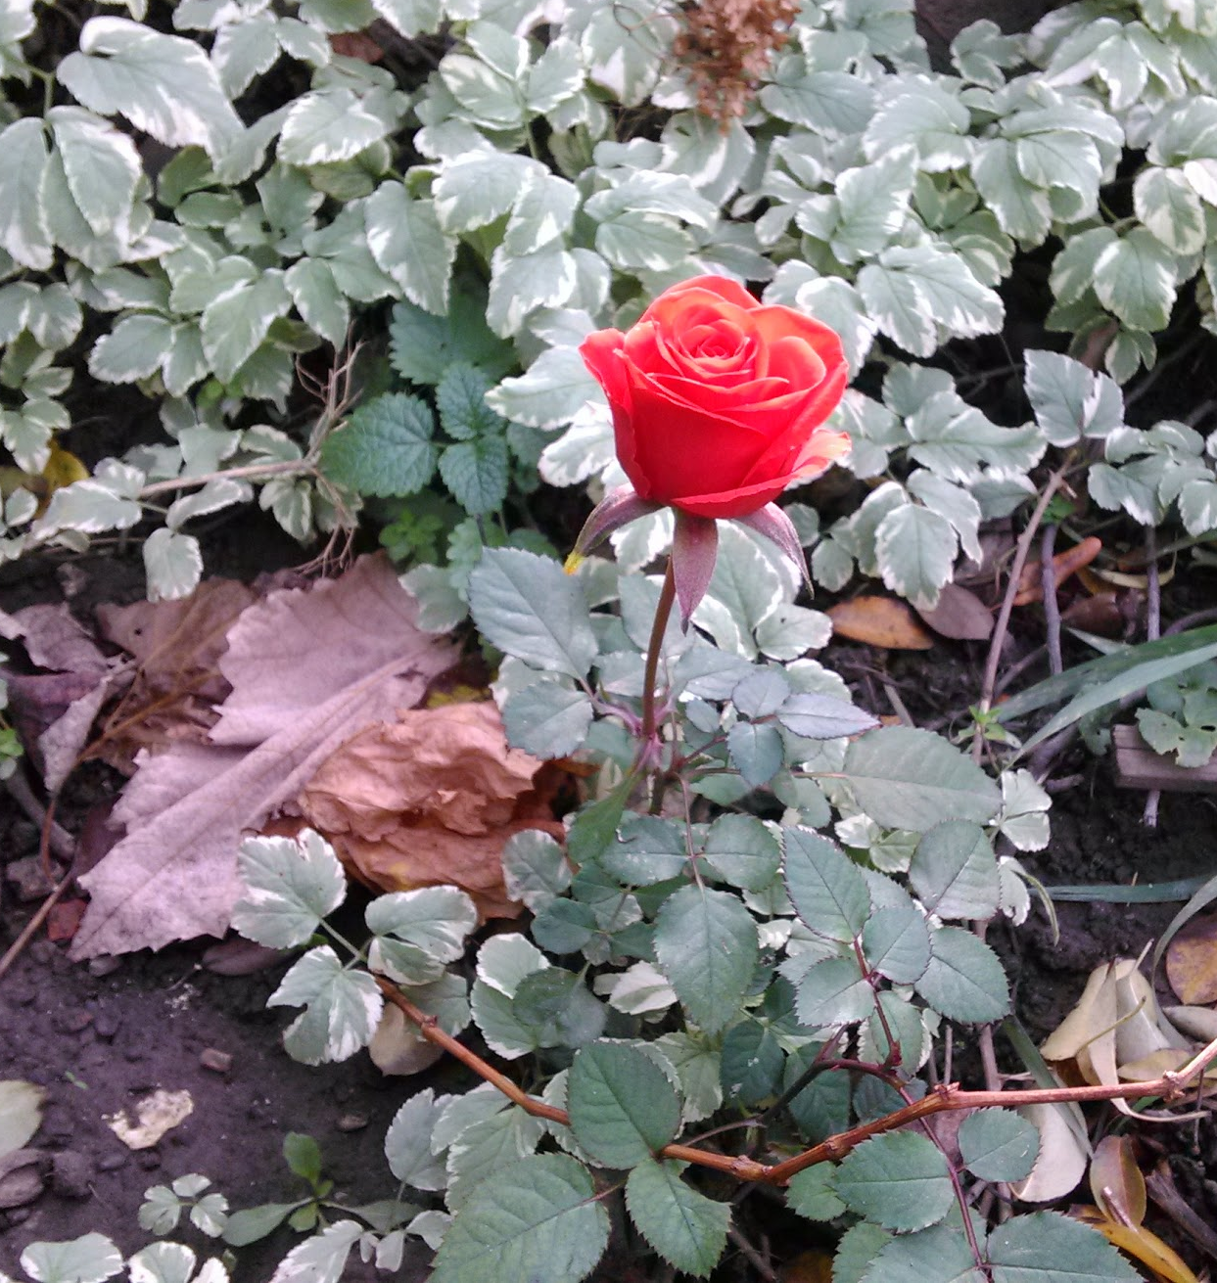
We outwardly demonstrate filial piety towards God. Is this underpinned by love?
(including to those closest to us!)
Notes:
We tithe like the Pharisees, We may go to other country to preach the gospel, like the Pharisees. We tithe We are outwardly good children. In short, we demonstrate filial piety. But is this based on our love for God. Do our hearts reflect the love of God for our fellow humans? Do our hearts reflect the love of God for our families?

