Slide 1
For we are God’s handiwork
“因為我們是他的傑作”
ποίημα

Slide 2
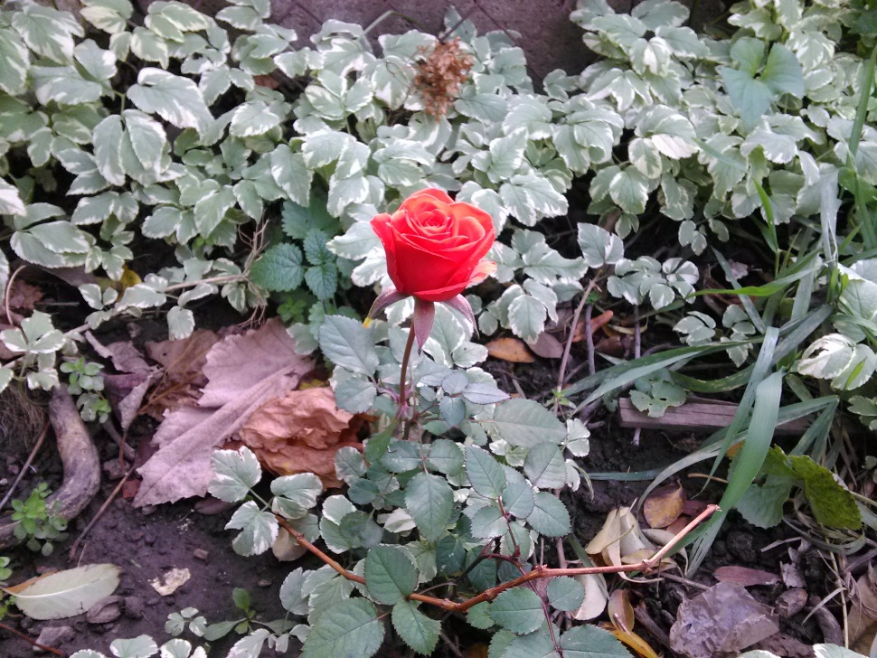
Ephesian 2: 8-10 (以弗所書2:8-10)
For we are God’s handiwork
因為我們是他的傑作
How so?
If so…
1. How should I see myself?
2. How should I see others?
我們是他的傑作嗎？
如果是這樣的話…
我如何看自己？
我如何看別人？

Slide 3
Ephesian 2: 8-10 (以弗所書2:8-10)
For it is by grace you have been saved, through faith
—and this is not from yourselves, it is the gift of God—
not by works, so that no one can boast.
For we are God’s handiwork,
created in Christ Jesus to do good works,
which God prepared in advance for us to do.
你們得救是靠恩典，憑信心。
這不是出於你們自己，而是上帝的禮物；
也不是由於你們的行為，以免有人自誇。
我們是上帝的傑作，
是在基督耶穌裡創造的，
為要叫我們做祂預先安排給我們的美善之事。ccbt

Slide 4
How so? Processing the Logic…
If we are God’s handiwork then…
  It can’t be by our works
    If by works then it is not God’s doing → it is our doing
      If it is our doing then how can if be God’s doing?
    If it is our doing we have a right to be proud!
      “If you weren’t so stubborn and proud you would follow Jesus like me” → see how humble and lovable I am!
      “If you had a brain you would see Jesus is obviously God.” → See how wise I am to follow Jesus
    If it is our doing, I have a right to demand compensation
      “I go to church, read my Bible, pray everyday” → God owes me.
      “I even listen to Brother Jon’s sermons’ → God owes me big time.
  It must be by grace.

Slide 5
If we are God’s handiwork…
There is a purpose for our calling…
  If I…
    go to a pottery shop and make a cup…
    make a chair…
    make a painting…
    spend time taking a mounting a picture…
  Similarly if God has created a masterpiece…
And the purpose is…
  Good works
  Not just any but that God had planned.

Slide 6

Reflecting...

Slide 7
Ephesian 2: 8-10 (以弗所書2:8-10)
For we are God’s handiwork
因為我們是他的傑作
How so?
If so…
1. How should I see myself?
2. How should I see others?
我們是他的傑作嗎？
如果是這樣的話…
我如何看自己？
我如何看別人？

Slide 8
How should I see myself?
我如何看自己？

Slide 9
Ephesian 2: 8-10 (以弗所書2:8-10)
For it is by grace that I, **** has been saved, through faith
—and this is not from **** him/her self , it is the gift of God—
not by works, so that I,****, can not boast.
For I,**** am God’s handiwork,
created in Christ Jesus to do good works,
which God prepared in advance for me,*** to do.
我***得救是靠恩典，憑信心。
這不是出於***自己，而是上帝的禮物；
也不是由於我***的行為，以免有我***自誇。
我***是上帝的傑作，
是在基督耶穌裡創造的，
為要叫我***做祂預先安排給我***的美善之事。ccbt
Notes:
Spend some time meditating on this putting in peoples name. Ask people to prayerfully read. (1) I have been saved by grace (2) I have no reason to boast (3) But I also have no reason to be ashamed. I am God’s handiwork (4) God has a purpose for my life -- that he has planned long ago.

Slide 10
How should I see others?
我如何看別人？

Slide 11
Ephesian 2: 8-10 (以弗所書2:8-10)
For it is by grace that --- have been saved, through faith
—and this is not from --- himself (herself), it is the gift of God—
not by works, so that --- can not boast.
For --- is God’s handiwork,
created in Christ Jesus to do good works,
which God prepared in advance for --- to do.
---得救是靠恩典，憑信心。
這不是出於---自己，而是上帝的禮物；
也不是由於---的行為，以免有---自誇。
---是上帝的傑作，
是在基督耶穌裡創造的，
為要叫--做祂預先安排給---的美善之事。ccbt
Notes:
Spend some time meditating on this putting in Christian’s names close to you Ask people to prayerfully read thinking of others. HOW NOT TO THINK (1) saved by grace: There is no way she could get inmake it without grace. Not of works: she sure doesn’t have any.. God’s Handiwork: She definitely is “a piece of work.” Western joke: Translate: “Jon made a joke. It is not funny in Chinese, so I don’t translate. Please laugh to make him happy.” HOW TO THINK: (1) My wife has been saved by grace just like me. (3) My wife, that Christian I don’t like, is God’s handiwork – how dare a criticize or look down on God’s handiwork. (4) God has a purpose for their life -- that he has planned long ago – how can I contribute to helping them fulfill God’s purpose in their life. (We too often think of MY purpose in life. What I want God to do through ME. This is self centered western thinking.

Slide 12
May we live in grace, showing grace to others
(including those closest to us!)

