Slide 1
God Doesn’t Want Me to Be Happy?
– 上帝不要我幸福嗎？–
Brother Jon
2021.01.10

Slide 2
Romans 羅馬書 8:29
For whom he did foreknow,
he also did predestinate
to be conformed to the image of his Son (KJV)
上帝預先知道誰是屬祂的人，
並預定這些人
要被塑造成祂兒子的形像 (CCVT)

Slide 3
Wrong Beliefs → Wrong Behaviour
Basic Belief:
  God wants us to be HAPPY!
  God’s main desire is for us to be HAPPY!
Where do you find this in Scripture?
Flawed Theology → Wrong Expectations
If God primarily wants me to be happy, then…
  Prosperity Gospel
  Case for Divorce
  Positive Thinking
What is God’s Prime Goal?

Slide 4
Romans 羅馬書 8:29
For whom he did foreknow,
he also did predestinate
to be conformed to the image of his Son (KJV)
For whom he foreknew,
he also predestined
to be conformed to the image of his Son (WEB)
上帝預先知道誰是屬祂的人，
並預定這些人
要被塑造成祂兒子的形像 (CCVT)
上帝在創世之前就知道那些人，
上帝決定了他們
將會像自己的兒子（耶穌）一樣 (ECV
Notes:
-To be conformed to the image of the Son
-Predestined is a strong word. Perhaps we better check a more modern translation

Slide 5
What is God’s Prime Goal for Us?
“to be conformed to the image of his Son (Jesus)”
Creation – Created in His Image
Rebellion – The Image is marred by Sin
Death of Jesus – Deal with sin
Restoration → Image of His Son

Slide 6
If this be true, So what?
To Be Happy
Conformed to Jesus’Image
Marital Status
Job Satisfaction
Church Life
Marital Status
Job Satisfaction
Church Life

Slide 7
Predestination is a Strong Word!
From the Greeks (Homer) – man cannot escape his destiny
To Shakespeare: Cassius: fate is not in our stars but in ourselves”
Many theological arguments about this word vs “free choice” but these are not our concern.
NOT “might”, “hope for”, “desire”
He will accomplish it!

Slide 8
Romans 羅馬書 8:29b
to be conformed to the image of his Son (KJV)
be not conformed to this world (Romans 12:2)
要被塑造成祂兒子的形像 (CCVT)
不要效法這個世界 (羅馬書 12:2)
Notes:
-To be conformed to the image of the Son
-Predestined is a strong word. Perhaps we better check a more modern translation

Slide 9
Attitude 態度 (James 雅各書 1:2-4)
My brethren, count it all joy when ye fall into divers temptations; Knowing this, that the trying of your faith worketh patience. But let patience have her perfect work, that ye may be perfect and entire, wanting nothing. (KJV)
我的弟兄姊妹，當你們遭遇各種磨煉的時候，都要認為是喜樂的事。 要知道你們的信心經過考驗會產生堅忍。 你們要堅忍到底，使你們纯全、完備、毫無缺欠。(CCVT)

Slide 10
He Will Accomplish It…
For whom he did foreknow,
he also did predestinate
to be conformed to the image of his Son (KJV)
上帝預先知道誰是屬祂的人，
並預定這些人
要被塑造成祂兒子的形像 (CCVT)
Notes:
-To be conformed to the image of the Son
-Predestined is a strong word. Perhaps we better check a more modern translation

Slide 11
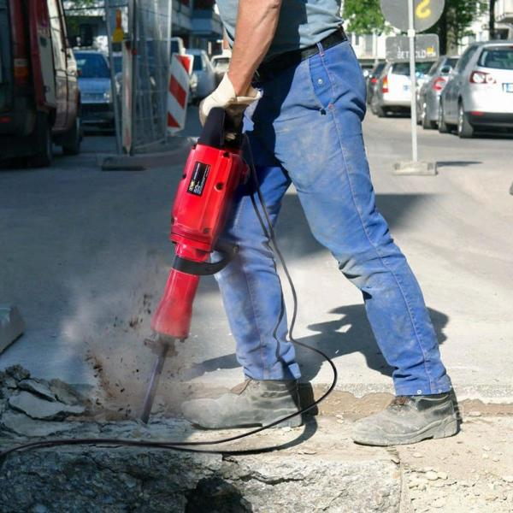
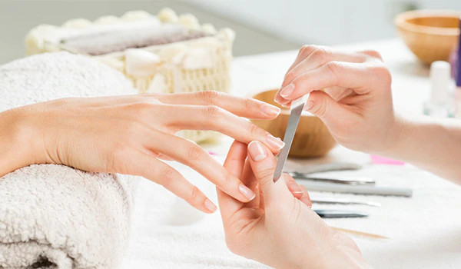
How will He accomplish it?`
With our Compliance
Despite our Objections

