Slide 1
喜樂 Joy⁴
Joy¹ 2017-12-10
Joy² 2018-12-09
Joy³ 2019-12-08
Joy⁴ 2020-12-06
χαρά / χαίρω
57/74

Slide 2
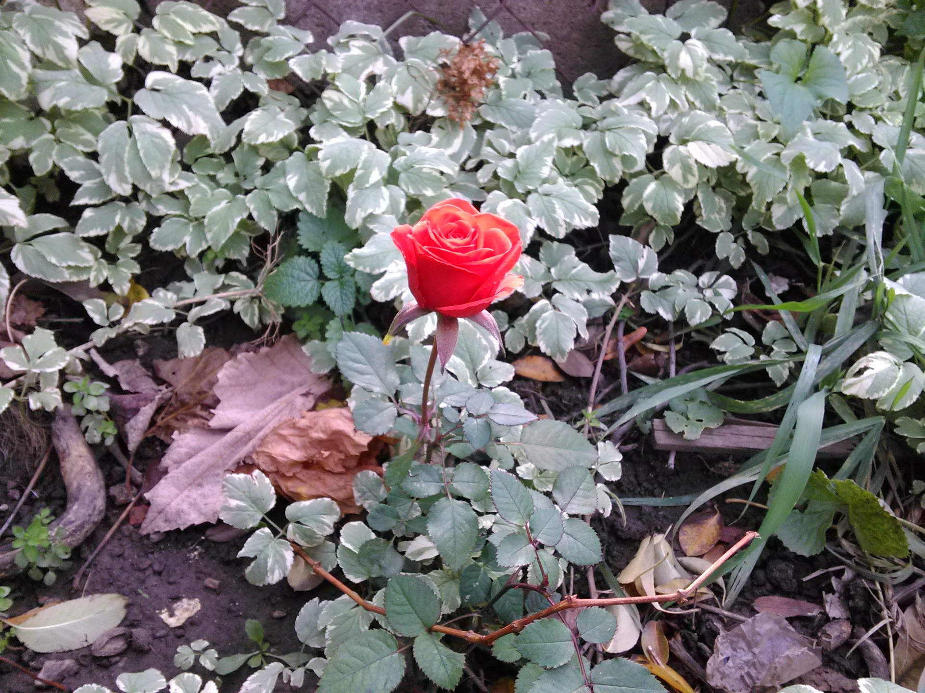
Reflecting 思考...

Slide 3

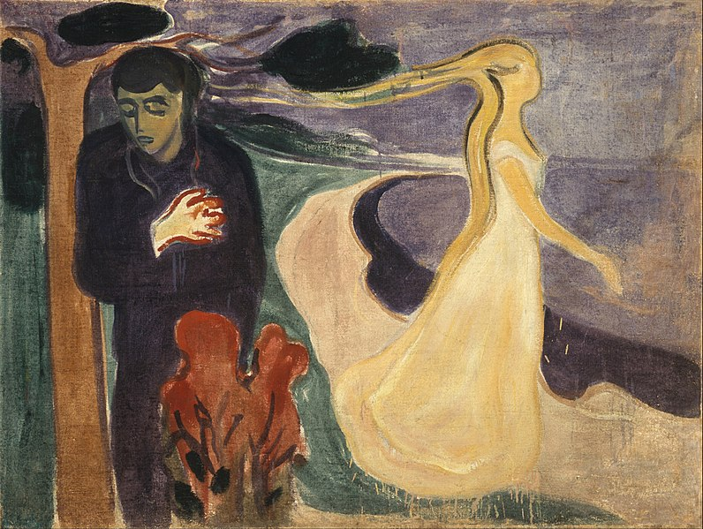
Reflecting 思考...
Joy (喜樂)
Despair (絕望)
Relationship (關係)
Separation (距離)

Slide 4
Times of Greatest 最大的...
In the Garden 在花園裡
  Walking with God (Genesis 3)
  Going our Own Way (Genesis 3)
The Moment of Decision 決定的時刻
  Entering into New Life (Luke 15:10)
  Rejecting the Call (Mark 10:22)
Eternity 永恆
  Heaven: entering into his presence (Revelation 21:4)
  Hell: Separation (Matthew 33:13)
Joy (喜樂)
Relationship (關係)
Despair (絕望)
Separation (距離)

Slide 5
How do I
Experience Joy⁴?
Joy (喜樂)
Relationship (關係)
Despair (絕望)
Separation (距離)

Slide 6
Build the Relationship 建立關係的決定
War is fought in the mind
  Have we each and all gone blind? Is the war inside your mind? (John Lennon, I believe)
Conscious decision 有意識
  to reject idle thoughts
  to focus on Jesus (Hb12:2)
In the now 在現在
  Sin separates (Isaiah 59:2)
  not just 1X/day devotions (necessary NOT sufficient)
Continuous 不斷
Joy (喜樂)
Relationship (關係)
Despair (絕望)
Separation (距離)

Slide 7
Benediction: Joy of Jesus
Now unto him that is able to keep you from falling, and to present you faultless before the presence of his glory with exceeding joy,
To the only wise God our Saviour, be glory and majesty, dominion and power, both now and ever. Amen.
(Jude 1:24-25)
那能保守你們不失腳、叫你們無瑕無疵、歡歡喜喜站在他榮耀之前的我們的救主獨一的神， 願榮耀、威嚴、能力、權柄，因我們的主耶穌基督歸與他，從萬古以前並現今，直到永永遠遠。阿們。
(猶大1:24-25)
Notes:
We give Jesus Joy – when he presents us to his Father as those he has redeemed

Slide 8
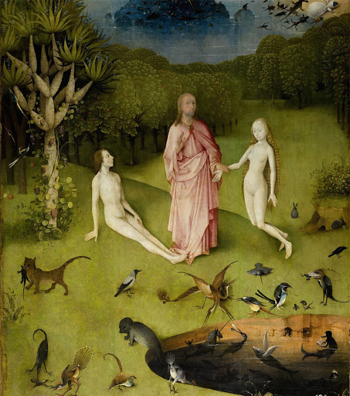
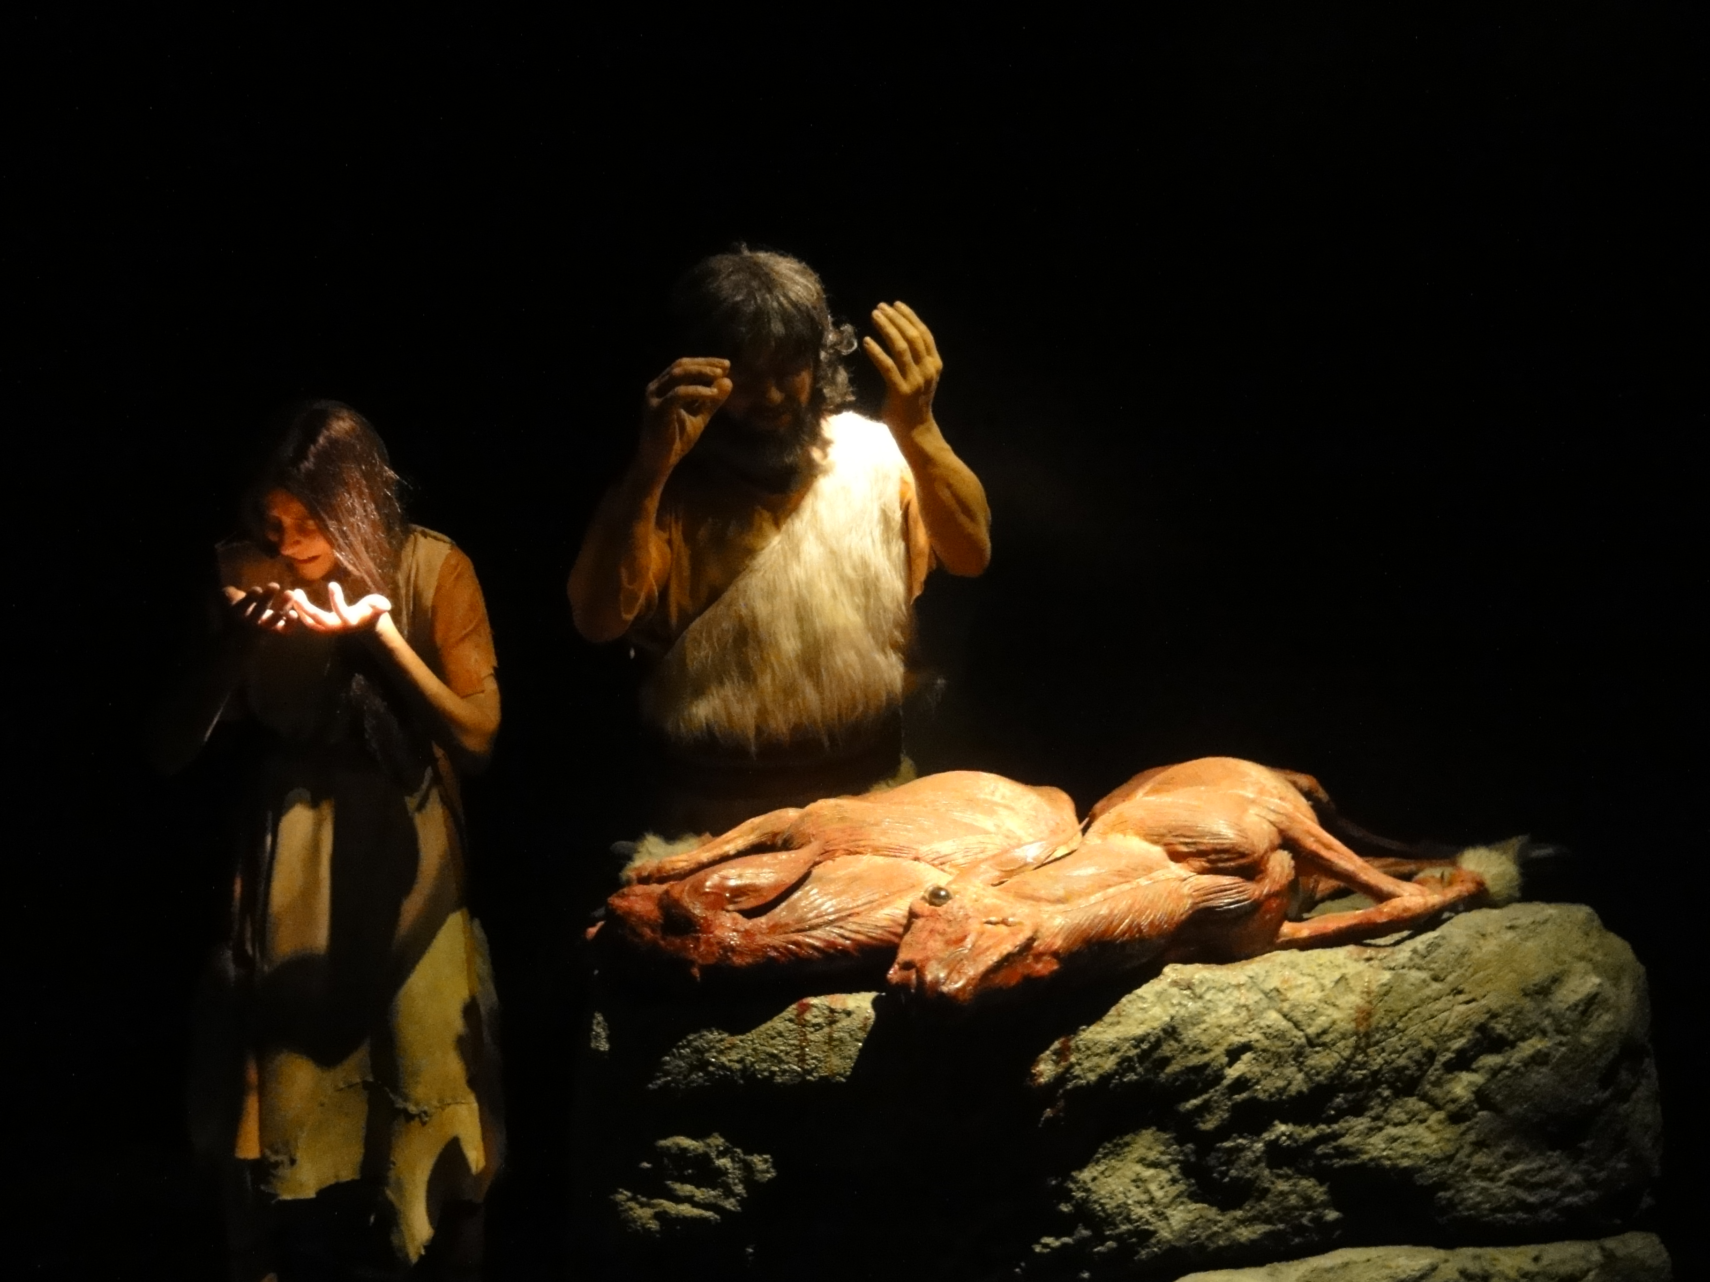
In the Garden 在花園裡
http://weiseracademy.com/wp-content/uploads/2014/07/DSC01784.jpg
Ref: http://thecatholictalks.com/articles_post.asp?id=19

Slide 9
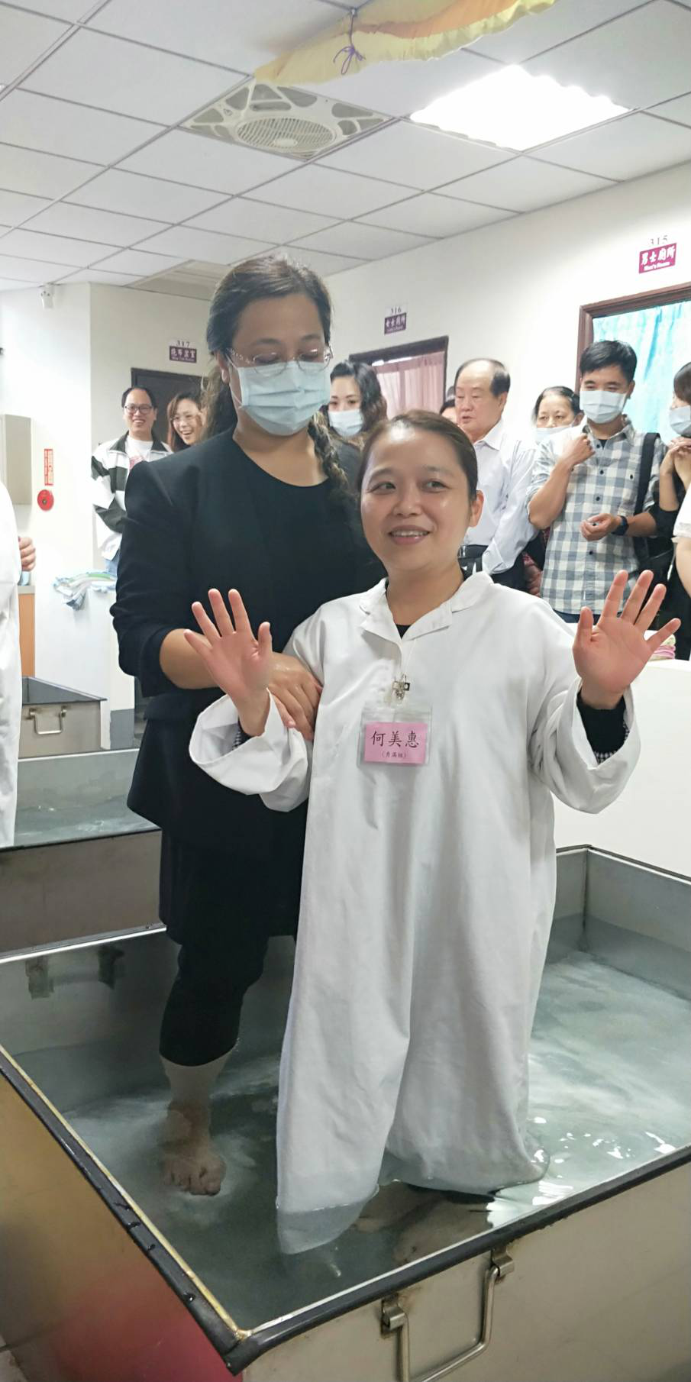
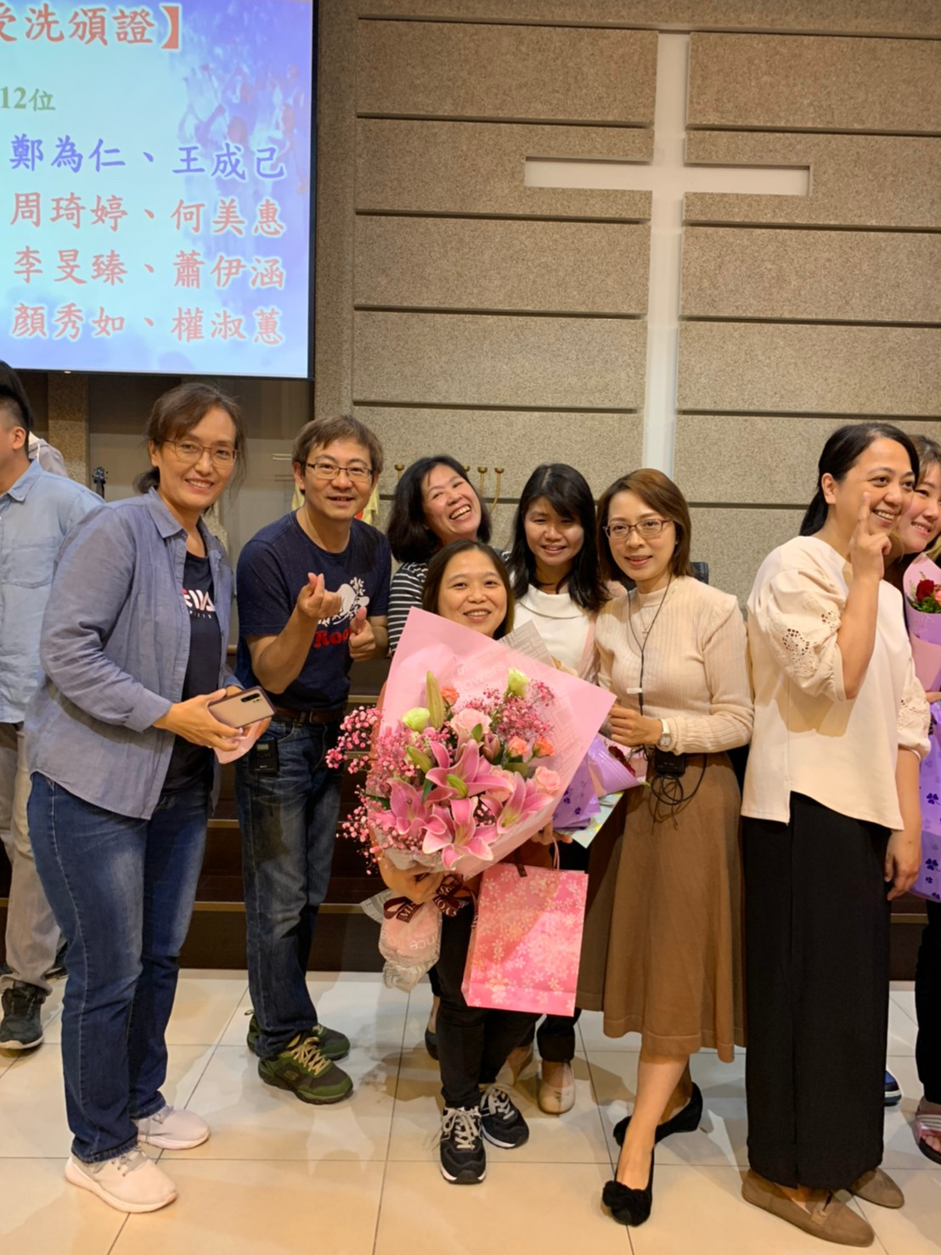
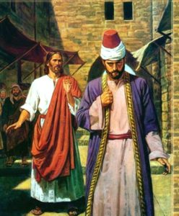
The Moment of Decision 決定的時刻

Slide 10
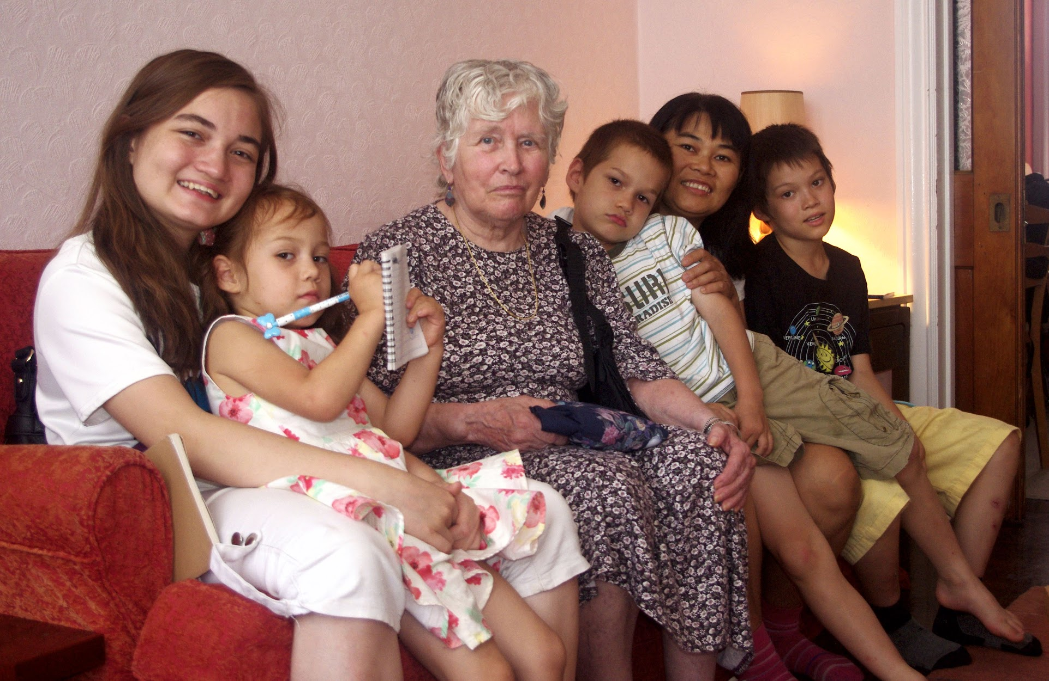
Eternity 永恆
Hell

Slide 11
Notes (1)
Title: Joy4
Reflecting...
- What does God want Justin and me to learn? This is the 4th time I am been given this week!
- The wellspring of Joy: Flowers
-- receive a flower from Significant Other --> JOY
-- receive a 1000 flowers from Signicant Other --> 100x JOY?
-- receive 1 flower from an Insurance Salesman --> same JOY as from your Significant Other
-- CONCLUSION: JOY is based in relationship!
OPPOSITES
- Joy (喜樂) VS Despair (絕望)
If we want to talk about Joy we also need to consider its opposite
- Relationship (關係) VS Separation (距離) : the basis of Despair is separation.

Slide 12
Notes (2)
2 Times of Greatest... 最大的...
2a In the Garden 在花園裡
- walking with God
- going our own way.
2b The Moment of Decision 決定的時刻
- entering into eternal life (we rejoiced, angels rejoice: night to day)
2c Eternity 永恆
- Heaven: no crying (Revelation 21:4), relationship with God, with others
- Hell: outer darkness, separationweeping knashing of teath (Matthew 22:13)
3 How to Experience Joy?
Decide to Build the Relationship 建立關係的決定
- War is fought in the mind
: Have we each and all gone blind? Is not the war inside your mind? (John Lennon)
- conscious decision 有意識
: to reject idle thoughts
: to focus on Jesus (Hb12:2)
- in the now 在現在
: Sin separates (Isaiah 59:2)
: not just once a day devotions (necessary NOT sufficient)
: easy to slip away as the sin is in the mind.
4 O come of come emanuel
: joy relationship (coming emanuel)
: despair of separation (exile...)
--
presentation sequence : 1 joy - despair 2 choice 3 despair-joy

Slide 13
Notes (3) -- Outline
1 Reflecting 思考...
- Joy (喜樂) VS Despair (絕望)
- Relationship (關係) VS Separation(距離)
2 Times of Greatest... 最大的...
2a In the Garden 在花園裡
2b The Moment of Decision 決定的時刻
2c Eternity 永恆
3 How to Experience Joy?
Decide to Build the Relationship 建立關係的決定
- in the now 在現在
: Have we each and all gone blind is the war inside your mind?
: Sin separates
- conscious decision 有意識
: decide to focus on Jesus and reject idle thoughts
- continuous 不斷
: not just once a day devotions (necessary NOT sufficient)

