Slide 1
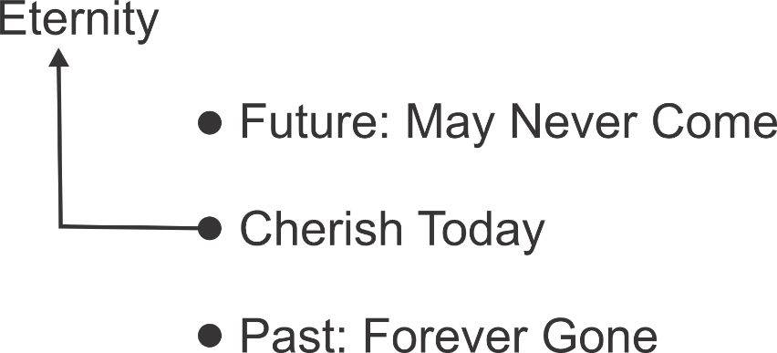
Cherish Today
– 珍惜今天 –
σήμερον
Brother Jon
2020.10.04

Slide 2
Today 今天
Moses said, “Consecrate yourselves today to Yahweh, yes, every man against his son, and against his brother; that he may give you a blessing today.” [Ex 32:29]
Jesus said to him, “Assuredly I tell you, today you will be with me in Paradise.” [Lk23:43]
摩西說：「今天你們要自潔，歸耶和華為聖，各人攻擊他的兒子和弟兄，使耶和華賜福與你們。
耶穌對他說：「我實在告訴你，今日你要同我在樂園裏了。」
Notes:
Not tormoo

Slide 3
Perhaps you (or a friend)…
Live in the Past
  If only I had…
  When I was young I led…
Live in the Future
  Next year I will... serve Jesus
  After I retire, I want to read the Bible...

Slide 4
Past Regrets
2 Cor 5:17 Therefore if anyone is in Christ, he is a new creation. The old things have passed away. Behold, all things have become new.
若有人在基督裡，他就是新造的人，舊事已過，都變成新的了。
No possibility to change it → stupid to hold on
FCRRR
New creatures
Don’t have to be enslaved by past

Slide 5
Future Plans
Pro 27:1 Don’t boast about tomorrow; for you don’t know what a day may bring.
Jas 4:13 Come now, you who say, “Today or tomorrow let’s go into this city, and spend a year there, trade, and make a profit.” Whereas you don’t know what your life will be like tomorrow. For what is your life? For you are a vapor that appears for a little time, and then vanishes away.
不要為明日自誇，
因為一日要生何事，
你尚且不能知道。
嗐！你們有話說：「今天明天我們要往某城裡去，在那裡住一年，作買賣得利。」 其實明天如何，你們還不知道。你們的生命是什麼呢？你們原來是一片雲霧，出現少時就不見了。

Slide 6
The Bible also speaks to…
Past Glories
Future Fears

Slide 7
Solution: Cherish Today

Slide 8
Why Important? Satan’s methodology
Jesus has defeated Satan – but he still seeks to ruin what God has created – Just as Saruman in the Tolkien’s Lord of the Rings.
Attack based on future possibility →
  He is not stupid, he can see at least vaguely God’s plans.
  He knows God better than we do – even though he has rejected God.
Uses your past sins to condemn you (even though forgiven)
He attacks today.
But as in the Lord of the Rings → from the valley of dead cannot hurt you but only fear.

Slide 9
Today affects tomorrow (Jos 22#18)
… that you must turn away today from following Yahweh?
It will be, since you rebel today against Yahweh,
that tomorrow he will be angry with the whole congregation of Israel.
你們今日竟轉去不跟從耶和華嗎？
你們今日既悖逆耶和華，
明日他必向以色列全會眾發怒。

Slide 10
God Promise of Care (Lk 12:24)
Consider the ravens: they don’t sow, they don’t reap, they have no warehouse or barn, and God feeds them.
How much more valuable are you than birds!
你想烏鴉，也不種也不收，又沒有倉又沒有庫，神尚且養活他。
你們比飛鳥是何等的貴重呢！

Slide 11
Lord’s Prayer is for today (Mt 6:11)
Give us today our daily bread.
們日用的飲食，今日賜給我們。

Slide 12
Cherish Today: Connect with Eternity

Slide 13
Response? (Ph 3:13)
Ph 3:13 but one thing I do. Forgetting the things which are behind, and stretching forward to the things which are before, I press on toward the goal for the prize of the high calling of God in Christ Jesus. 我只有一件事，就是忘記背後，努力面前的，向著標竿直跑，要得神在基督耶穌裡從上面召我來得的獎賞。
1. Break the Power of the Past (FCRRR)
2. Stretch forward to the future
3. CHERISH TODAY

Slide 14
Cherish Today: Respond Today
Exhort one another day by day, so long as it is called “today”; lest any one of you be hardened by the deceitfulness of sin.
“Today if you will hear his voice, don’t harden your hearts, as in the rebellion.”
總要趁著還有今日，天天彼此相勸，免得你們中間有人被罪迷惑，心裡就剛硬了。
「你們今日若聽他的話，就不可硬著心，像惹他發怒的日子一樣。」

Slide 15
Cherish Today
So ma-ny to-days have pass'd,
Didn't know how to cher-ish,
Deep re-gret, I long to turn back all the years.
But that time's long gone a-way, ne'r to re-turn
The days of youth, forev-er gone
Now the sky is clear and blue
with clouds fluf-fy and white
Let me feel the was-ted days are
blown far a-way
I will firm-ly grasp to-day
each min-ute, each se-cond
While it's to-day, I'll shine forth
the bea-con of hope
May God come and lead,
set-ting on fire wis-dom's light
So that I will, a-long life's path,
cher-ish to-day.
失去多少个今天
不知道去珍惜
真后悔我多想
再 倒 退 几 岁
可 时 光 已 经 走 过
不 再 复 返
光 阴 一 去 永 不 回
此 时 我 面 向 蓝 天
面 向 白 云 长 叹
让 过 去 的 无 知 愚 昧
随 风 飘 远
我 要 把 握 着 今 天
每 一 分 每 一 秒
让 它 真 正 闪 耀 出
希 望 的 光 点
让 神 来 指 引
把 智 慧 明 灯 点 燃
知 道 在 人 生 的 路 上
珍 惜 今 天

