Slide 1
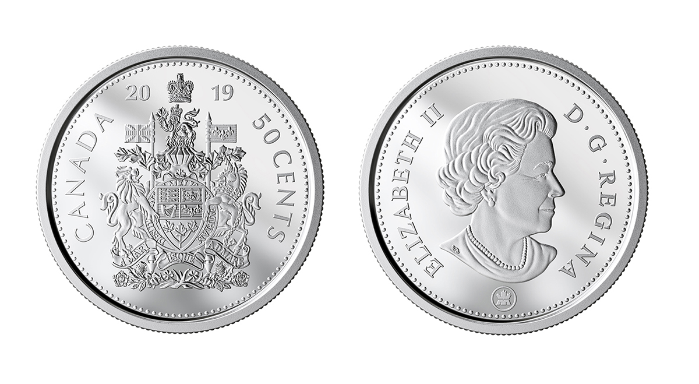
A Tale of 2 Coins
– Modern Parable Series –
Brother Jon
2020.06.21

Slide 2
不要把聖物給狗，也
不要把你們的珍珠丟在豬前，
恐怕他踐踏了珍珠，
轉過來咬你們。」馬太福音七章六節
Don’t give that which is holy to the dogs,
Don’t throw your pearls before the pigs,
lest perhaps
they trample them under their feet,
and turn and tear you to pieces.
(Matthew 7:6 WEB)
Notes:
Example: My son

Slide 3
耶穌對銀庫坐著，
看眾人怎樣投錢入庫。
有好些財主往裡投了若干的錢。
有一個窮寡婦來，
往裡投了兩個小錢，
就是一個大錢。馬可福音福音十二章四十一節
Jesus sat down opposite the treasury, and saw how the multitude cast money into the treasury.
Many who were rich cast in much.
A poor widow came, and she cast in two small brass coins.
(Mark 12:41-42 WEB)
Notes:
Example: My son

Slide 4
耶穌叫門徒來，說：「我實在告訴你們
這窮寡婦投入庫裡的，比眾人所投的更多。
因為，他們都是自己有餘，
拿出來投在裡頭；
但這寡婦是自己不足，
把他一切養生的都投上了。」。馬可十二章四十三節
He called his disciples to himself, and said to them,
“Most certainly I tell you,
this poor widow gave more than all
those who are giving into the treasury,
for they all gave out of their abundance,
but she, out of her poverty,
gave all that she had to live on.”
(Mark 12:43-44 WEB)
Notes:
Example: My son

