Slide 1
Who Am I? 我是誰？
– What Is My Identity? 我的身份是什麼？–
Brother Jon
2020.06.21

Slide 2
In A Nutshell…
Key Verse: Colossians 3:11
Key Passage: Matthew 23:6-12
Topics:
  Nationality
    Romans 10:12
    Galatians 3:28
    Colossians 3:11
  Secular (Philippians 3:8)
  Sacred (Matthew 23:8-10)

Slide 3
Reflections
Myself: Pride of Nationality and Background
  I am a Canadian. I have a British background.
  My family is RED not BLACK.
  My mother’s side are UELs. I am not an American.
Brother from South Korea confronted me:
  “You cannot be a Canadian and a Christian. There is no such thing as a Canadian Christian or a Christian Canadian. You are one or the other: you cannot be both. You cannot have two allegiances. You either a Christian or a Canadian. You must choose.”
Must I Really Choose? What does the Bible say?
Notes:
Introduction
- Very proud to be a Canadian. NOT American
- South Korean Friend: Cannot be a Canadian and a Christian --> you must choose. of the world or of the God.
- is this true?
- What about being a Christian American? or and American Christian? Or a Chinese Christian? Or a Christian Chinese?
-What is my identity?

Slide 4
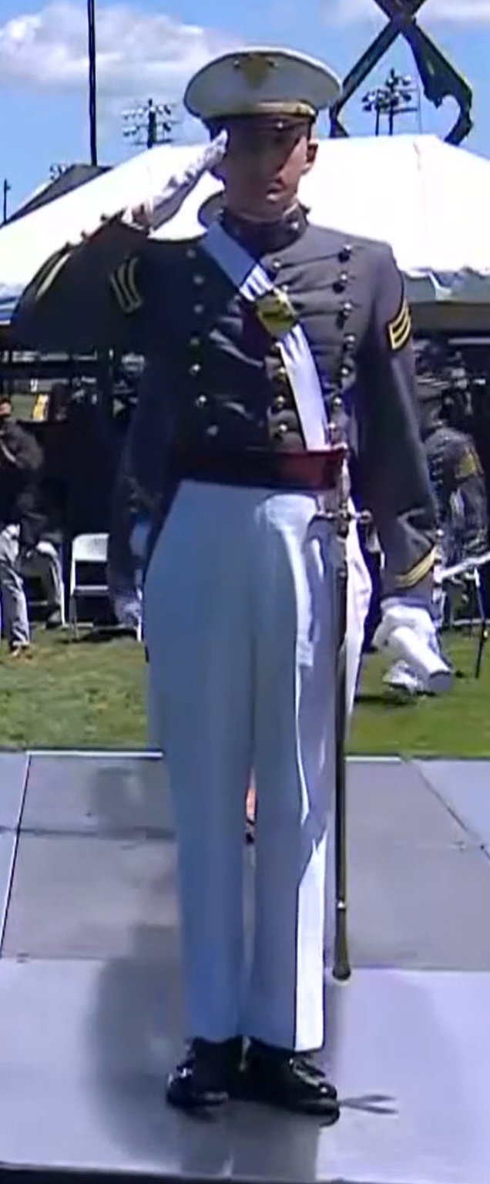
2020 Graduation West Point, USA
https://www.dvidshub.net/video/756087/usma-graduation-ceremony-part-3-4 (Rowan Crawley 4:34)
Trump Address Video
  2:19
  6:30~9:20
Transcript
Notes:
jonathondavid@gmail.com;JesusLovesUs/77

Slide 5
2020 Graduation West Point, USA
(02:30) the mighty forces who sent tyrants, terrorists, and sadistic monsters running scared through the gates of hell. No evil force on Earth can match the noble power and righteous glory of the American warrior.

Slide 6
2020 Graduation West Point, USA
(06:46) The members of this class have come from every state in our union. You have come from the farms and the cities, from states big and small, and from every race, religion, color, and creed. But when you entered these grounds, you became part of one team, one family, proudly serving one great American nation. You became brothers and sisters pledging allegiance to the same timeless principles, joined together in a common mission to protect our country, to defend our people, and to carry on the traditions of freedom, equality, and liberty that so many gave their lives to secure. You exemplify the power of shared national purpose to transcend all differences and achieve true unity. Today, you graduate as one class, and you embody one noble creed, duty, honor, country

Slide 7
2020 Graduation West Point, USA
(8:03) you chose to devote your life to the defense of America... you know the truth, America is the greatest country in human history. And the United States military is the greatest force for peace and justice the world has ever known. The survival of America and the endurance of civilization itself depends on the men and women, just like each of you, depends on people who love their country with all their heart and energy and soul

Slide 8
2020 Graduation West Point, USA
(19:58) It is not the duty of US troops to solve ancient conflicts in faraway lands that many people have never even heard of. We are not the policemen of the world. But let our enemies be on notice. If our people are threatened, we will never, ever hesitate to act, and when we fight, from now on, we will only fight to win… We are building new ships, bombers, jet fighters, and helicopters by the hundreds, new tanks, military satellites, rockets, and missiles, even a hypersonic missile…

Slide 9
1. Nationality

Slide 10
1. Nationality
Rom 10:12 There is no difference between the Jew and the Greek: for the same Lord over all is rich unto all that call upon him.
Gal 3:28 There is neither Jew nor Greek, there is neither slave nor free man, there is neither male nor female; for you are all one in Christ Jesus.
Col 3:11 There can’t be Greek and Jew, circumcision and uncircumcision, barbarian, Scythian, bondservant, freeman; but Christ is all, and in all.
Rm 10:12 猶太人和希利尼人並沒有分別，因為眾人同有一位主；他也厚待一切求告他的人。
Gal 3:28 並不分猶太人、希利尼人，自主的、為奴的，或男或女，因為你們在基督耶穌裡都成為一了。
Col 3:11 在此並不分希利尼人、猶太人，受割禮的、未受割禮的，化外人，西古提人，為奴的、自主的，惟有基督是包括一切，又住在各人之內。

Slide 11
2. Secular Vocation

Slide 12
2. Secular Vocation
我也將萬事當作有損的，因我以認識我主基督耶穌為至寶。我為他已經丟棄萬事，看作糞土，為要得著基督；
I count all things but loss
for the excellency of the knowledge of Christ Jesus my Lord:
for whom I have suffered the loss of all things, and
do count them but dung (ordure),
that I may win Christ (Philippians 3:8)

Slide 13
3. Sacred (church)

Slide 14
3. Sacred (church)
But don’t you be called ‘Rabbi,’ for one is your teacher, the Christ, and all of you are brothers. Call no man on the earth your father, for one is your Father, he who is in heaven. Neither be called masters, for one is your master, the Christ. (Mat 23:8-10)
你們不要受拉比的稱呼，因為只有一位是你們的夫子；你們都是弟兄。 也不要稱呼地上的人為父，因為只有一位是你們的父，就是在天上的父。 也不要受師尊的稱呼，因為只有一位是你們的師尊，就是基督。 (馬23:8-10)

Slide 15
So, What is My Identity? 我的身份是什麼？
Apart from God: A Sinner destined for hell
But now…
  A Slave of Jesus Christ,
  A Son of God.
  A Friend of Jesus.
  A Citizen of the kingdom of God
Our identity is wrapped up in Jesus.
  Includes our salvation
  Includes our standing before God
  Includes our God given spiritual gifts
  Includes our "natural" God given abilities
除了上帝：要下地獄的罪人
但現在…
  耶穌基督的奴隸，
  神的兒子。
  耶穌的朋友。
  神國的公民
我們的身份在耶穌裡
  包括我們的救恩
  包括我們在上帝面前的地位
  包括我們的屬靈恩賜
  包括我們的“自然”上帝給的才能

