Slide 1
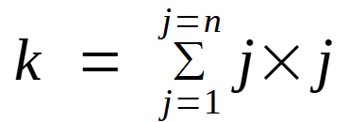
Program Flow:
Sequence, Decision, Repetition
Ref: SDBA §7.2
Understanding Loops with VP diagrams
Operation Counts for Sum of Squares
One Operation Count
= + - * / ++ --

Slide 2
while(){ }
k ← k + j*j;
j ← j + 1;

Slide 3
while(){ }
main()
j
1
k
k=0
0
1
j=1
n
j<=n
1
+
fscanf()
=
j*j
6
5
4
3
2
1

Slide 4
while(){ }
main()
j
2
k
1
n
8
j<=n
fprintf()
1
7
j++
6
5
4
3
2
1
(n,k) = (1,1)

Slide 5
for( ; ; ;){ }
main()
j
1
k
k=0
0
1
j=1
j<=n
n
+
j*j
=
1
fscanf()
6
5
4
3
2
1

Slide 6
for( ; ; ;){ }
main()
j
2
k
1
n
8
j<=n
j++
1
7
1
fprintf()
6
5
4
3
2
1
(n,k) = (1,1)

Slide 7
do{… }while( );
main()
j
1
k
k=0
0
1
j=1
n
1
+
=
j*j
fscanf()
5
4
3
2
1

Slide 8
do{… }while( );
main()
j
2
k
1
n
1
7
fprintf()
j++
6
j<=n
5
4
3
2
1
(n,k) = (1,1)

