Slide 1
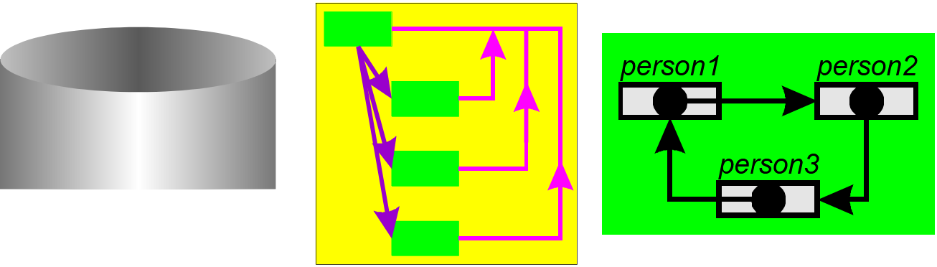
§1.4 Variables, Pointers, & Functions

Slide 2
Objectives 學習目標
In this module we will:
  Explore the different behavior of variables and pointers as related to functions
After this module you should be able to distinguish:
  When to pass the value of variable and when to pass its address (memory location)
  When to use a variable in a function and when to use a pointer
在這個單元我們將學會:
  瞭解在函數下變數與指標的不同
在這個單元之後學生應該能夠分辨:
  何時傳遞變數的值以及何時傳遞他的位置 (記憶體區域)
  在一個函數之下,何時使用變數,何時使用指標器

Slide 3
This Module’s Code...
Declares and initializes two variables in the function main()
Passes the address of one variable and the value of the other to function func()
Uses a pointer and a variable in the function
Prints the value of each before, during and after the function call

Slide 4
(Preview) Questions
How can I visualize with VP diagrams?
How can I change the value of a variable in a function?
Can I change the location a pointer points to within a function?
Can I change the value of a variable without passing its address?

Slide 5
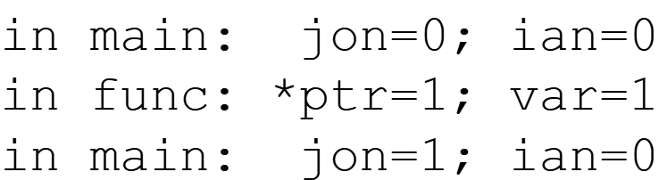


Code: vpfunc.c
/* vpfunc.c: demo vars, ptrs & functions */
/* (c)2001 J. D. White */
#include <stdio.h>
void func(long *ptr,long int var);
int main(void){
long jon=0,ian=0;
fprintf(stdout,"main(): jon=%ld; ian=%ld\n",jon,ian);
func(&jon,ian);
fprintf(stdout,"main(): jon=%ld; ian=%ld\n",jon,ian);
return(0);
}
void func(long *ptr, long var){
var++;
(*ptr)++;
fprintf(stdout,"func(): *ptr=%ld; var=%ld\n",*ptr, var);
}
Function prototype: input data
stored in 1 variable and 1 pointer
address of jon and value in ian passed to func()
value stored in var and value
pointed to by ptr are changed
value of ian not changed in main()
but value of jon is changed.

Slide 6
Changing Contents in a Function
From main(), you must pass the location (address) that the variable occupies in memory.
  int var;
  func(&var);
Within the called function, you must declare a pointer to accept the address that is being passed
  func(int *ptr);
main()
var
func()
ptr

Slide 7
Changing Contents in a Function
From main(), you must pass the location (address) that the pointer occupies in memory.
  int *ptr;
  func(&ptr);
Within the called function, you must declare a pointer to accept the address that is being passed
  func(int **ptr2);
main()
ptr
func()
ptr2

Slide 8
Changing Variable w/o Pointers
/* varfunc.c : changing var w/o pointers */
/* (c)2001 J. D. White */
#include <stdio.h>
long func(long var);
int main(void){
long jon=0;
jon=func(jon);
return(0);
}
long func(long var){
var++;
return(var);
}
Function prototype: input data
stored in 1 variable and 1 pointer
value in jon sent to func(), after
func() jon takes value returned
value stored in var changed
value stored in var returned
Better Style then using pointers!
It is clear you are changing the variable!

Slide 9
Summary 總結
The difference between pointers and variables are clear when one works with functions:
  “Call by reference” (uses pointers)
  “Call by value” (makes a copy)
“call by value” and using the function return to change the variable avoids “functional side-effects”
All data structures are based on combining pointers and variables
當使用函數時,變數和指標器有明顯的不同:
  “呼叫藉由關連” (使用指標器)
  “呼叫藉由數值” (產生一份複製)
“呼叫藉由數值” , 使用函數傳回值去改變變數,避免“函數副作用”

Slide 10
Suggested Homework
Write a main program calling functions to calculate the volume of a sphere. V= 4/3 pi * r^3.
Make two versions of the function: one
  “call by reference”
  “call by value.”
Use the following prototypes
  void volSphereRef(double *v, double r);
  double volSphereValue(double r);
Upload your work via the internet

