Slide 1
§5 Variables
Pre-Reading:
I. Chai, Structuring Data & Building Algorithms §1.2, p. 3-16
25.02.12

Slide 2
Variables Lesson 1
M2_UML Try 2
  Try 2 (20’)
  Walk through Solution (10’)
Break (10’)
Take-up UML → Pseudo-code (10’)
Variables (40’) – Pt 1 Basics and VP diagrams
You Turn: Observe the value in a container change.
Break (10’)
Variables – Pt 2
  Calculations: How the computer calculates
  Output: Using fprintf()
Your Turn: Discern Common Variable Errors
Go Home
General Concepts §3 Variables pg 24

Slide 3
Variables Lesson 2
M2_UML Try 3
  Try 3 (30’)
  Walk through Solutions (20’)
Break (10’)
Review Variables (20’)
E.g. Cup of Tea: Variables & Functions call-by-value (10’)
Apply: Live Coding Demo: Falling Objects
Break (10’)
Apply Optics
  Your Turn
  Live Coding Demo
Go Home
Homework (Your Turn): Root Finding
§3 C-Code
(g_var.c) pg 30
§3 Simple Lens Formula
(o_var.c) pg 38
§3 Core Code
(r_var.c) pg 50

Slide 4
Variables Lesson 3
Applications: Code Analysis (x3var.pptx)
Root: Rule Breaking
Optics: Need for Coordinate System
Break (10’)
You Try to Modify Coordinate System Code
Taking up the Coordinate System Code
Break (10’)
Retry M2_UML-T4 || M3_Basic C Try 1
Go Home
§3 Simple Lens Formula
(o_coord.c) pg 39

Slide 5
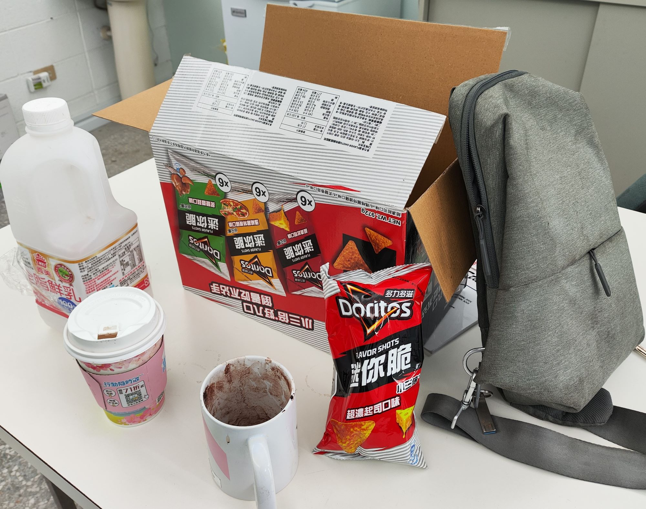
Outline of the Lesson
Type
  Fixed point
  Floating Point
Size (Memory)
Declaring, Initializing & Using
  Sample code & VP diagrams
  Questions from code
Application: Tutorial

Slide 6

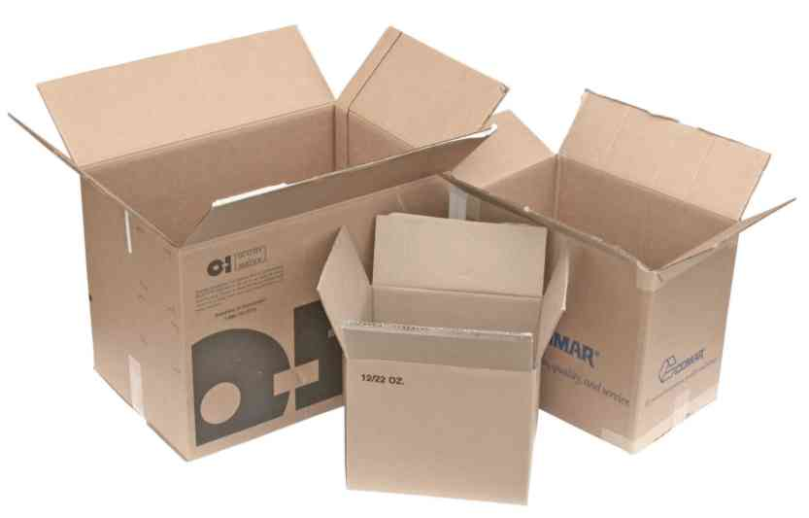
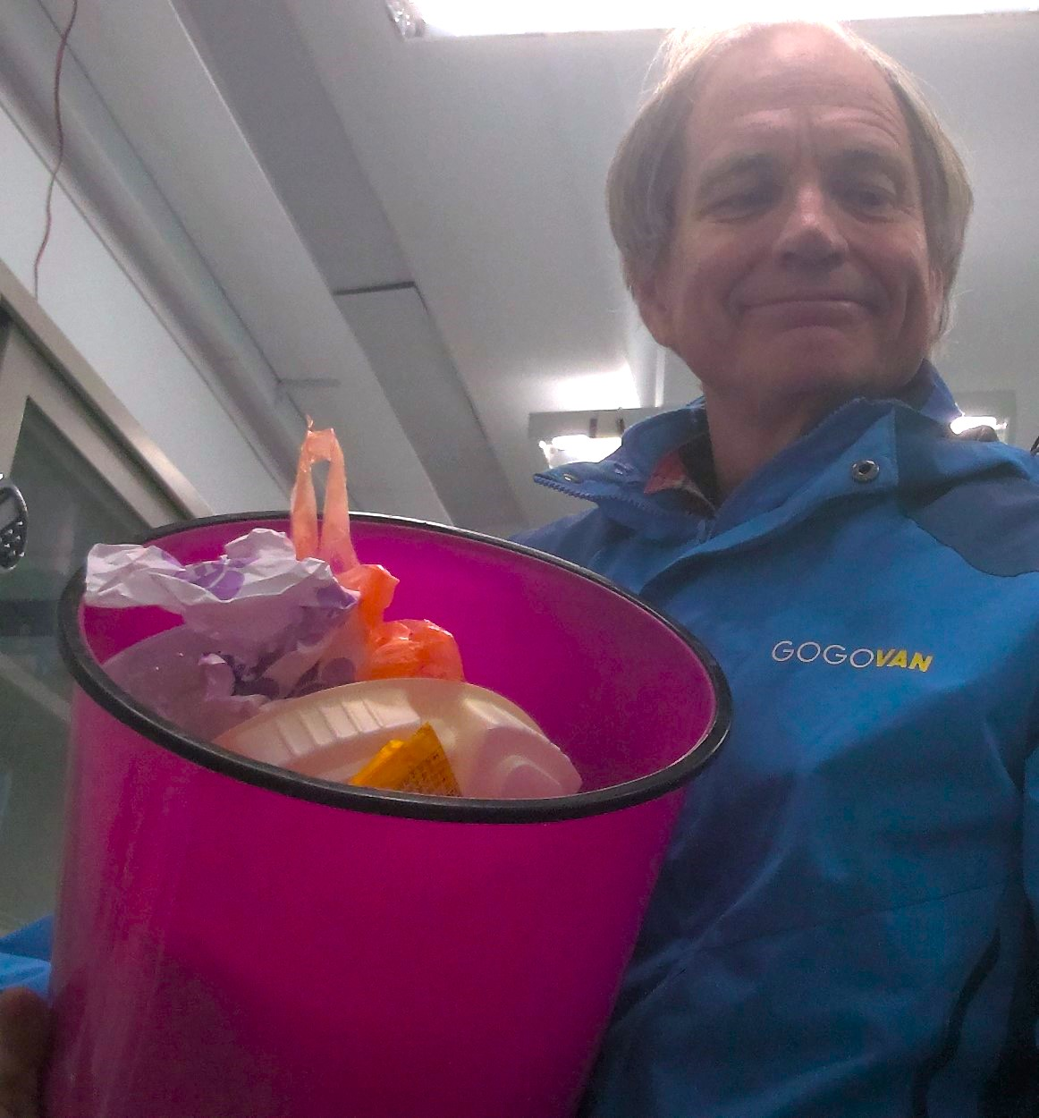
A Variable is a Container
http://unitedcontainer.com/images/used_box_group_web.jpg
Choose a container
for its contents!
https://www.mironglass.com/thumbnail/07/ec/4e/1646396189/EN_404%20NEW_800x800.png
Container: Garbage Can
Contents: Garbage

Slide 7
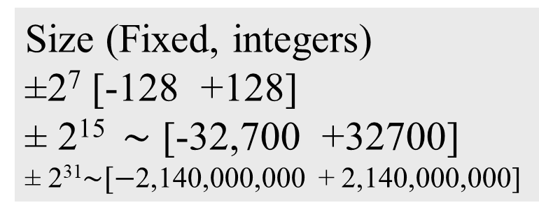
Size & Types of Containers
Size |  | Type
Bytes | Bits | Fixed | Floating
1 |  | char
2 |  | short int | float
4 |  | long int | double
8 |  |  | long double
Size (Fixed, integers)
±2⁷ [-128 +128]
± 2¹⁵ $\sim$ [-32,700 +32700]
± 2³¹$\sim [−$2,140,000,000 + 2,140,000,000]
Float (radix)
0.4 2
4
2
40

Slide 8
Declare → Initialize → Use
main()
ann
6
To Pre-processor: Location of function prototype
sue
65
Put the value 6 (0110) in the fixed-point container named ann
D
jim
0.53e-1
I
Put the value 65 (0100 0001) in the fixed-point container named sue
U
Put the value 0.53 (0.1000011) in the floating-point container named jim
C

Slide 9
Declare → Initialize → Use
Multiply the value in the container ann by 2
Add the value stored in container sue to result
Store the final value in container ann
77

Slide 10
Declare → Initialize → Use
fprintf()
77
77
65
0.53e-1
stdout
77,65,0.530000

Slide 11
Declare → Initialize → Use
Enter this code (notepad++)
Compile (gcc)
Link (gcc)
Run or execute the code
Step through the code (gdb)
Save as… c:/sdba/var1.c
Click on ANSI-C Icon
gcc –c –Wall –g var1.c
gcc –o var1.exe var1.o
var1
gdb var1.exe
b main
r
display ann
n
q

Slide 12
Questions
What steps are involved in using variables?
How do we declare variables?
How do we initialize?
How does the computer calculate?
How do we do basic arithmetic?
How do we express precedence?
What is fprintf()?

Slide 13
Q1. Three Steps To Use Variables
Variables
Declare
D
Initialize
I
U
Use

Slide 14
Q2. Declaring Variables
Type name;
Bytes | Fixed | Floating
1 | char sue;
2 | short int jim; | float kim;
4 | long int kim; | double sue;
8 |  | long double jim;

Slide 15
Q3. Initializing Variables
after declaration
with declaration
long int ann;
ann=6;
long int ann=6;
double jim;
jim=0.053;
double jim=0.053;

Slide 16
Q4. Computer Calculations (1)
Copy the contents of container ann into container R1
6
6

Slide 17
Q4 Computer Calculations (2)
2. Double the value in R1(Registry 1)
12
6
2*

Slide 18
Computer Calculations (3)
3. Copy the contents of sue to R2
12
6
65

Slide 19
Computer Calculations (4)
4. Add R1 and R2, then save result in R1
77
6
+R2
65

Slide 20
Computer Calculations (5)
5. Copy the contents of container R1 into container ann
77
77
65

Slide 21
Q5. How to do Basic Arithmetic?
a = b + c; addition
a = b – c; subtraction
a = b * c; multiplication
a = b/c; division
a = a%c; remainder
a++; increment
a--; decrement

Slide 22
Q6. Expressing Precedence
a = (b + c) * d;
a = (b + c) * d;
1.Inside brackets, add
a = (b + c) * d;
2.Multiply result by contents of d
a = (b + c) * d;
3.Place result container a

Slide 23
Q7. fprintf(): std output function
Where to write?
Where info?
function name
Prototype in
<stdio.h>
What to write?
Small “L” (as in long)
…not the number “1” (one)
stdout (display on monitor)
long fixed decimal point number (long int)
fixed decimal point number (int || char)
long floating point number (double)

Slide 24
General Concepts §3 Variables pg 24
Modify var1.c to help answer tutorial questions
Add declarations
Add Initializations
Observe error messages
Discuss with TA

Slide 25
Summary: A Cup of Tea
main()
calcMaketea()
cup
water
0.74e1
0.60e1
teabag
1
sugar
0.40e0
cup
0.74e1
0.70e1

Slide 26
Summary: A Cup of Tea
main()
cup
Variables
Functions
0.74e1
Declare
Prototype
Initialize
Call
Use
Definition

