Slide 1
ANSI-C
A Language of Functions

Slide 2
Today’s Class: Functions
Milestone 2
  Try 1 (30’)
  Walk through Solution (15’)
Break(10’)
Theory of Functions (30’)
  Purpose
  Types
  Anatomy
  Connecting
Fr Human → Machine Language: Compile → Link → Run → Debug (10’)
Write and Compile a Program (10’) General Concepts §2 Tools pg 23
Break (10’)
Application: From UML to Deciding Functions
  Falling Objects (10’): Demo Falling objects §2.2 Pseudo-Code pg 29
  Optics (20’): You Try + Demo Optical Ray Tracing §2.2 Pseudo-Code pg 37
Go Home
Homework: Root Finding (10’) Root Finding §2.2 Pseudo-Code pg 49

Slide 3

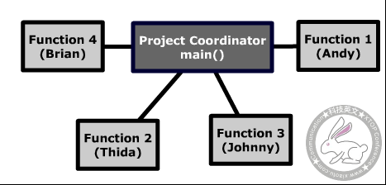
1. Purpose of Functions
One Function: One Task
Divide & Conquer (e.g. British)
  Split into smaller independent tasks
  Split work between people (e.g. restaurant)
Avoid repeating work
https://upload.wikimedia.org/wikipedia/commons/2/21/Malaysia-CIA_WFB_Map.png

Slide 4

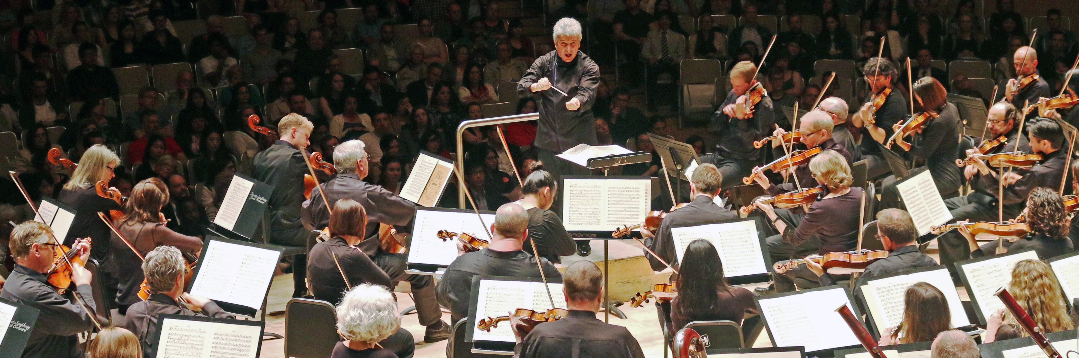
2. Types of Functions
3rd party
hardware
main() is unique!
Called by OS
Returns control to OS
OS
main()
own
standard
OS
https://commons.wikimedia.org/wiki/File:Peter_Oundjian_-_Conductor_of_Toronto_Symphony_Orchestra_2014.jpg

Slide 5
3. Function Anatomy
Comment Lines
/*…*/
For human not computer
to tell human about program
Compiler ignores
2 lines
  purpose
  date
  author

Slide 6
3. Function Anatomy
Opening Statement
Name of function
Name of the function
Info the caller must give the function
Info the function gives back to the caller
main() unique
  Gets info from OS
  Returns info to OS
Receive nothing
Give integer (fixed point)
back to calling function

Slide 7
3. Function Anatomy
Inside Function
Tasks for this function to complete

Slide 8
3. Function Anatomy
Ending/Return
Give info back to calling function
Here, the integer 0

Slide 9
3. Function Anatomy
Grammar
Brackets{ }
  Beginning
  End
  Matched
Semicolon [;]
  Ends each statement
  (not carriage return)
  White space ignored

Slide 10
4. Connecting Functions
Overview
To connect:
  With your own
  With others
  With C standard
Require:
  Prototype
  Call
  Definition
3rd party
hardware
OS
main()
own
standard
OS

Slide 11
4. Connecting Functions
/* fown.c: connect self*/
/* 2009 by J D White */
long myfunc(long);
int main(void) {
myfunc(6);
return(0);
}
long myfunc(long j){
j++;
return(j);
}
…to Own
Function Prototype (Message to compiler)
  Function in this file
  Requires a long integer from caller
  Gives long integer back
Function Call
  Transfer control to function myfunc()
  Give ‘6’ to myfunc()
Function Definition
3rd party
hardware
OS
main()
own
standard
OS

Slide 12
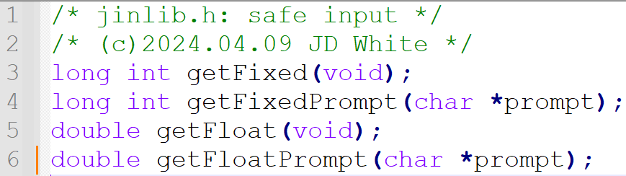
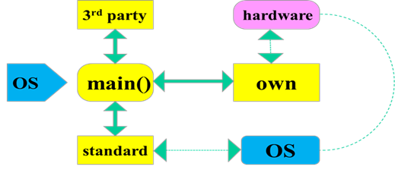
4. Connecting Functions
/*foth.c:connect other*/
/*2009 by J D White*/
#include “jinlib.h”
int main(void){
long k;
k=getFixed();
return(0);
}
….with 3rd party
To Pre-processor:
  Location of function prototype file: jinlib.h
Function Call
  Transfer control to function getFixed()
Function definition
  Elsewhere
  Not here
  Need jinlib.o when use linker

Slide 13
4. Connecting Functions
/*fstd.c:connect std*/
/*2009 by J D White*/
#include <stdio.h>
int main(void){
  fprintf(stdout,”Hi”);
  return(0);
}
File: C:\sdba\include\stdio.h
…fprintf(…);
…with standard
To pre processor:
  Location of function prototype
  standard C file <stdio.h>
Function Call
  Transfer control to fprintf()
  Give fprintf() two pieces of data: stdout, “Hi”
Function definition
  Not here
  Need stdio.o when link

Slide 14
4. Connecting Functions
/* foth.c: connect self*/
/* 2009 by J D White */
long myfunc(long);
int main(void) {
myfunc(6);
return(0);
}
long myfunc(long j){
j++;
return(j);
}
Every Function needs…
Prototype
  Except main()
  If don’t write, need to tell processor where it is (#include)
Call
  Except main()
Definition
  If don’t write, need to give an object (.o) file with function defn to linker.

Slide 15
5. Compiling (your own functions)
Own:
gcc –c –Wall myprog.c

Slide 16
5. Compiling (3rd party functions)
Others:
gcc –c –Wall otherprog.c
If other files not compiled, compile (i.e. no .o file)
NB: Each file compiles independently

Slide 17
5. Compiling (Standard functions)
Standard:
gcc –c –Wall myprog.c
Standard library files already compiled

Slide 18
6. Linking (Your own functions)
Own
gcc –o myprog.exe myprog.o
Nothing to link: only one file
Rename .o(object) → .exe

Slide 19
6. Linking (3rd Party functions)
Others
gcc –o myprog.exe mprog.o jinlib.o
Connect all .o(object) files together →.exe file
Linker needs names of files to connect, i.e., location of compiled function definitions

Slide 20
6 .Linking (Standard functions)
Standard
gcc –o myprog.exe myprog.o
Connect all .o(object) files together → .exe file
Linker gets standard functions’ definitions automatically (not necessary to name files)

Slide 21
7. Running
myprog.exe || myprog

Slide 22
Summary
Remember
  Functions allow divide and conquer to simplify our tasks
  Functions facilitate code re-use
Every program requires a function main() || (setup() if Arduino)
Every Function requires
  Prototype
  Call
  Definition
Each file is compiled independently
  gcc -c -Wall f1.c
  gcc -c -Wall f2.c
  One file must contain function
  main()
All files must be linked together
  gcc -o m.exe f1.o f2.o
Running: m || m.exe

Slide 23
Up Next
GOTO Falling Object Example (16-23)
GOTO Optics Example (10-14)
GOTO Root Finding Example (11-12)

