Slide 1
§2 Problem Statement
25.02.12

Slide 2
Today’s Class
Reviewing the Tools (10’)
Importance of Problem Statements (15’)
Underlying Concepts for Sample Problems– A brief Intro (Raheem) (20’)
Break (10’)
E.g. 1 Automated Data Processing – Falling Objects (40’)
  Introduction of concepts
  Working through sample Problem
  Your Turn
E.g. 2 Simulation – Optical Ray Tracing (40’)
  Introduction of concepts
  Working through sample Problem
  Your Turn
Break (10’)
E.g. 3 Numerical Analysis – Finding a Root (40’)
  Introduction of concepts
  Working through sample Problem
  Your Turn
If(!pass Milestone 1) Retry Milestone 1;
Go Home

Slide 3
Why software projects fail?
#1 Not Understanding The Needs Of The Business
  requirements not clearly articulated in detail.
  i.e. poor problem definition
#4 Not Starting With The End Customer
  Great software written that solves a problem
  BUT the problem solved is not the customer’s problem
  i.e. poor problem definition
#5 Unclear requirements
  lack of a detailed explanation
  i.e. poor problem definition
#8. Thinking That Scope Can Be Defined Upfront
  Original problem understood and solved
  BUT many cases do not fit the case solved → failure to adapt model.
  See this need to adapt in the Optics example.
Ref: https://www.forbes.com/councils/forbestechcouncil/2020/03/31/14-common-reasons-software-projects-fail-and-how-to-avoid-them/

Slide 5
Today’s Class
Reviewing the Tools (10’)
Importance of Problem Statements (15’)
Underlying Concepts for Sample Problems– A brief Intro (Raheem) (20’)
Break (10’)
E.g. 1 Automated Data Processing – Falling Objects (40’)
  Introduction of concepts
  Working through sample Problem
  Your Turn
E.g. 2 Simulation – Optical Ray Tracing (40’)
  Introduction of concepts
  Working through sample Problem
  Your Turn
Break (10’)
E.g. 3 Numerical Analysis – Finding a Root (40’)
  Introduction of concepts
  Working through sample Problem
  Your Turn
If(!pass Milestone 1) Retry Milestone 1;
Go Home

Slide 7
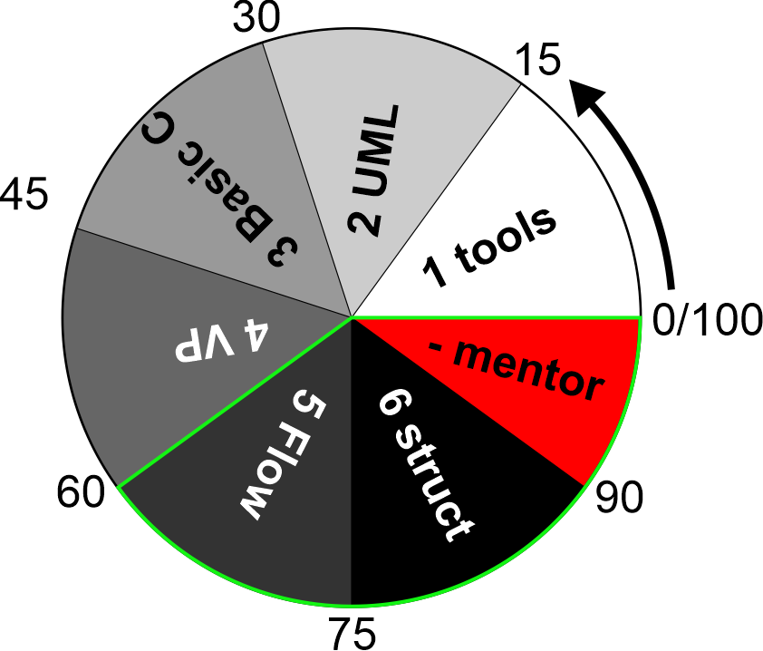
Milestone 1 Try 2
Sit using alternate computers
Turn off your computer
Reboot using Windows-SAS
Install Notepad++, compiler linker
Compile and Link welcome.c
Show the TA
Go Home

