Slide 1
§1 Introduction
25.02.12

Slide 2
Today’s Class
Course Objectives
Contents
Grading
Guidebook
Introducing the Tutors
Survey
Break (10’)
Why UML?
Why C?
Video Permission Form
Installing Compiler, Editor, a first program
  How To Video featuring Raheem
  Your Turn
Break (10’)
Guidebook
Milestone 1 first attempt: Install and Run
Go Home when successful

Slide 3
Course Objectives 課程目標
To clearly specify the problem to be solved
To diagram the solution of a problem using Universal Modelling Language [UML] Activity Diagrams.
To convert a UML activity diagram into a structured program in the ANSI-C language
明確要解決的問題
使用通用建模語言 [UML] 活動圖來繪製問題的解決方案。
將UML活動圖轉換為ANSI-C語言的結構化程序

Slide 4
What am I expected to Know?
Research Communication
Computer Programming
Decide on the topic
Organize your thoughts with a cluster diagram(mind map) and Linear Outlining
Determine the optimum language to express
Express in English
Edit
Understand problem
Organize your solution with an UML (Universal Modelling Language) diagram
Determine the optimum language to implement
Express in C
Debug

Slide 5
At course end, you will be able…
To diagram in UML and implement in C-language three types of flow:
  Linear,
  Conditional, and,
  Repetition
  Parallel Processing (need for GPU, AI programming)
To compile, link, run and debug a C program
To prototype, call and define functions in ANSI-C
To declare, initialize and use basic data types:
  double
  long int
To use standard C functions
  fscanf() for input
  fprintf() for output

Slide 6
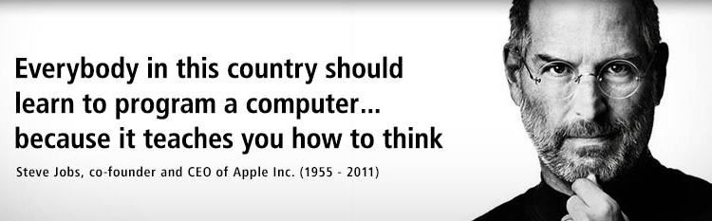
Course Delivery
You learn programming by doing.
I cannot “teach” you how to program.
We (tutors and I) can only guide you…
Only you can become a good programmer
(Short cuts do not help you in long term)

Slide 7
Course Outline
Problem Specification and course introduction
Tools of the Trade: Installing an Editor and Compiler, Linking, Running and Debugging
Diagramming the flow of the solution: UML
Divide and Conquer: Employing Functions
Structuring Data in C: Variables
Under the hood in C: Understanding Pointers
Flow in C: Repetition, Decisions and Linear Flow
Structuring Data in C: Arrays, Records, Strings
問題說明與課程介紹
專業工具：安裝編輯器和編譯器，連結、運行和調試
繪製解決方案流程圖：UML
分而治之：運用職能
C 中的結構化資料：變量
C 內部原理：理解指針
C 中的流程：重複、決策與線性流程
C 中的結構化資料：陣列、記錄、字串

Slide 8
Workbook & Website Contain
Tutorials
Example solutions
Listing of all UML symbols and C-functions that you need to use in the course.
May use as reference during tests.
Grading Information
Must Purchase workbook
Only NT$150

Slide 9
How do I “Ace” the course?
Passing milestones (♦)
  Each is worth 15 points
  Repeat a milestone until successful (100%)
  You may only test the next milestone (go up a level) after you pass previous milestone (level).
  If you complete all 6 milestones, then you receive 90 points
Mentor others for a 10 points
  Once you pass a Milestone (♦) you can become a mentor to others who have not passed.
  If they pass, you receive 1 points!
Completing the workbook for bonus points

Slide 10
FAQ
Am I graded for class attendance?
  NO, if…
  You pass all the milestones
Am I deducted marks for being late?
  NO, if…
  You pass all the milestones
Am I deducted marks for leaving early?
  NO, if…
  You pass all the milestones
Can I try milestone ∞ times?
  NO, but…
  there are a limited number of times one can write milestones!
  IF you need 12 tries to pass milestone 1,
  THEN you will not have time to do the later milestones.
If I pass all milestones in 8 weeks, do I need to attend the rest of the course?
  NO, but…
  I hope you will come to help other students!
  It will improve your C-language

Slide 11
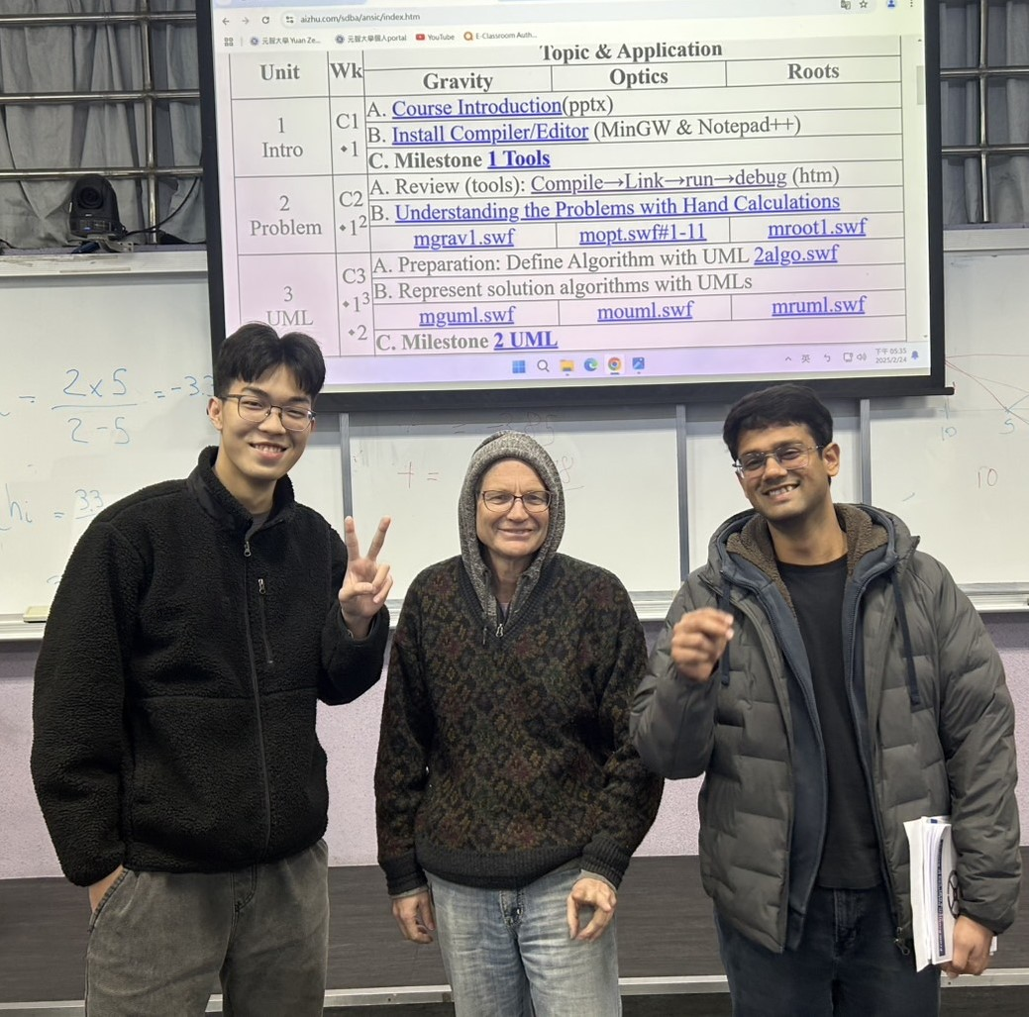
Teaching Team – At Your Service

Slide 12

Let me know your background….

Slide 14
Why UML?
Standard format for graphically specifying a solution.
Aid your thinking on how to efficiently solve the problem
Allows your to separate
  Macro concerns – algorithm (UML)
  Micro concerns – implementation (coding)
Check for logic errors before coding…
AI may be able to generate your code from UML

Slide 15
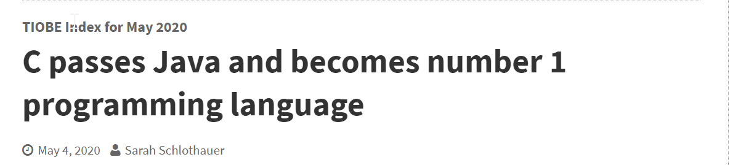
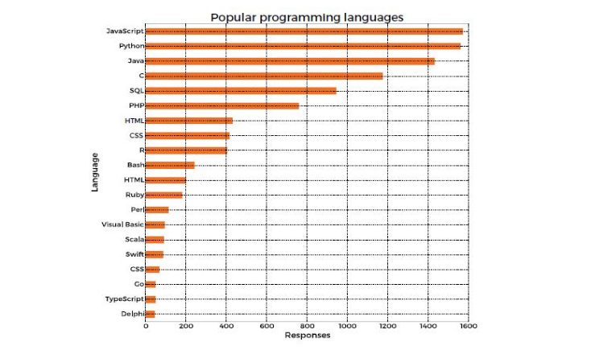
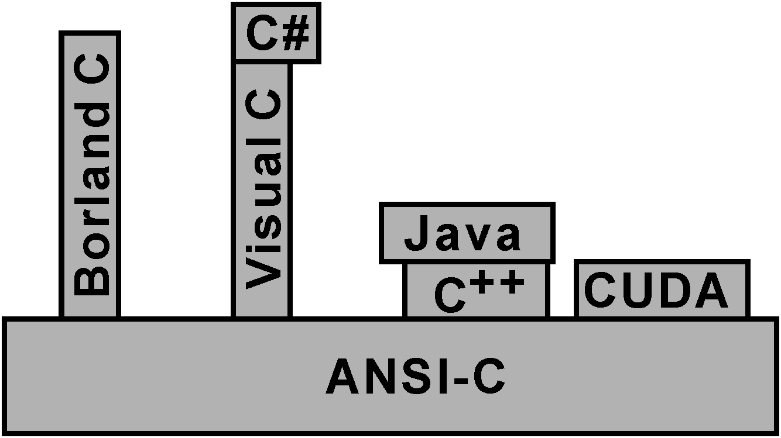
Why C?
C, although old (1972), is not obsolete
  Used for device control/drivers
  Used for IoT devices
  Used when speed is prime concern
  Most common language used for writing OS (i.e. Linux)
  It has stood the test of time (almost 60 years old!)
C++, Java, C#, javascript have C at the heart

Slide 16
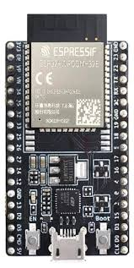
Why ANSI-C?
Your program will compile with any compiler
Your program will run on any OS
Your program can be used on any microprocessor (i.e. ARM, Intel, Arduino, Expressif ESP)

Slide 17
Why ANSI-C? Your Program Will…
Compile with any compiler
Run on any OS
Can be used on any microprocessor (i.e. ARM, Intel, Arduino, Expressif ESP)
Will be fast (90 times faster than Python)
Will use 90 times less energy than Python to complete a task (Limit to AI is energy efficiency)

Slide 18
Find differences: C vs javascript!
/* ANSI-C */
double absolute(double a){
if (a < 0) return -a;
else return a;
}
/* javascript */
function absolute(a) {
if (a < 0) return -a;
else return a;
}

Slide 19
Find the differences: C vs python
/* ANSI-C */
double absolute(double a){
if (a < 0) return -a;
else return a;
}
# python
def absolute(a):
if a < 0: return -a
else: return a

Slide 20
Find the differences!
/* ANSI-C */
void checkValue(int a, int b) {
if (a == 1) {
if (b == 2) {
fprintf(stdout,"a = 1,b is 2");
}
} else {
fprintf(stdout, "a is not 1");
}
}
/* javascript */
function checkValue(a, b) {
if (a == 1) {
if (b == 2) {
console.log("a = 1,b is 2");
}
} else {
console.log("a is not 1");
}
}

Slide 21
Find the differences!
/* ANSI-C */
void checkValue(int a, int b) {
if (a == 1) {
if (b == 2) {
fprintf(stdout,"a = 1,b is 2");
}
} else {
fprintf(stdout, "a is not 1");
}
}
# python
def checkValue(a, b):
if a == 1:
if b == 2:
print("a = 1,b is 2")
else:
print("a is not 1")

Slide 22
Why gcc compiler? Notepad++?
Free!
Open Source!
Standard!

Slide 23
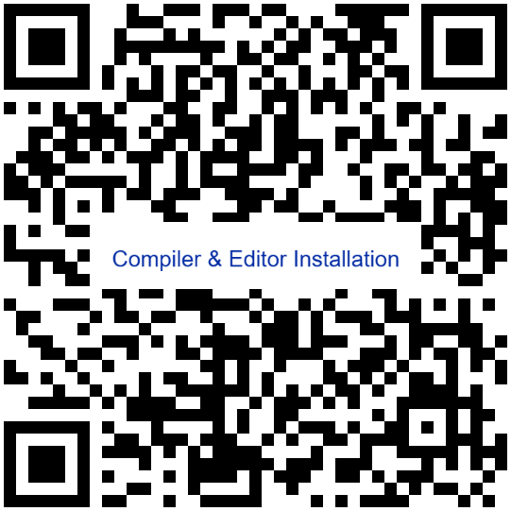

Editor and Compiler Installation
Watch the Video that shows how to install the compiler and editor
Now You Try!
SDBA

Slide 25
Looking at the Workbook.

Slide 26
Permission Forms

Slide 27
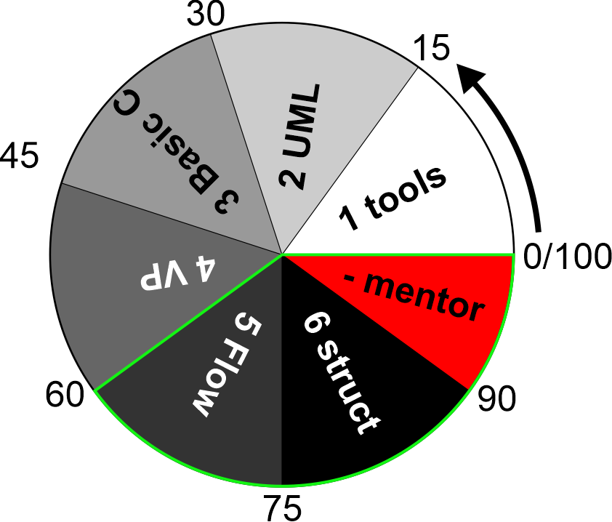
Milestone 1 Try 1
Sit using alternate computers
Turn off your computer
Reboot using Windows-SAS
Install Notepad++, compiler linker
Compile and Link welcome.c
Show the TA
Go Home

