Slide 1
From Problem Definition to Solution

Slide 2
Using Pointers
[Calling fscanf() from your function]

Slide 3
Using Pointers to Get Input
Download r_var.c
Replace getFloatPrompt()
Write your own function to get both xs and xb with 1 call
Include
  Prototype
  Call
  Definition
Make use of
  fscanf(), fprintf()
  Pointers to return
Here is a prototype to start:
void getXsXb(double *xs, double *xb);

Slide 4
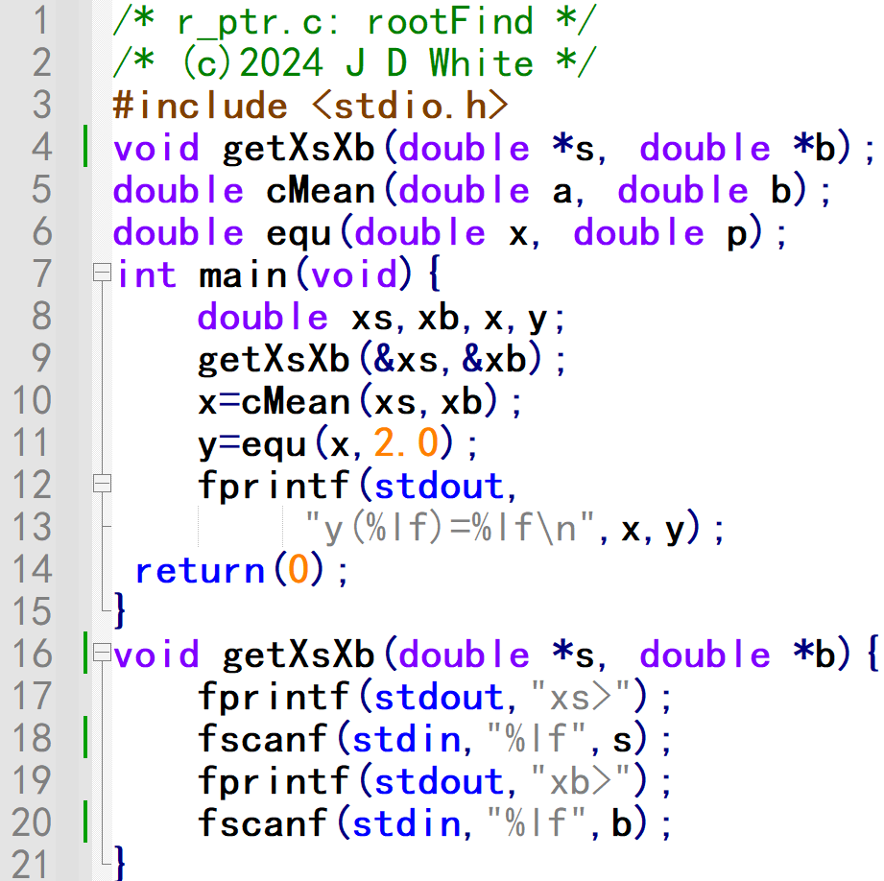
Using Pointers to Get Input
→ Modify Code

Slide 5
Run the Code
gcc –c –Wall -g xxx.c
gcc –o y.exe xxx.o
y
→ Run Code (gdb?)

Slide 6
Analyse Code (VP Diagram)
Info for Human Reader
Info Pre-processor: Prototype Location
Function prototypes (this file)

Slide 7
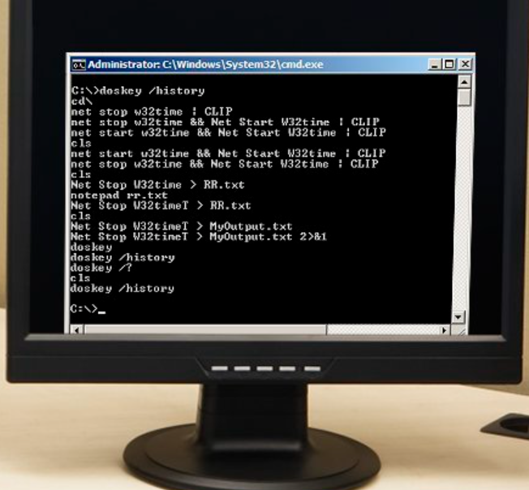
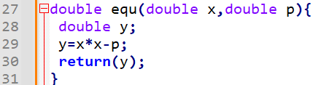
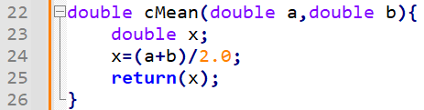
Analyse Code (VP Diagram)
main()
getXsXb()
xs
s
0.100e1
xb
b
0.200e1
x
fscanf()
fscanf()
fprintf()
fprintf()
0.150e1
⌨
⌨
y
xb>
xs>
%lf
%lf
0.25e0
equ()
cMean()
fprintf()
1
xs>
xb>
2
y(1.50000)=0.25000

