Slide 1
From Problem Definition to Solution

Slide 2

– Breaking the Rules –

Slide 3
Following the Rules
Solving Variables Functions
Hand
Declare
Prototype
UML
Initialize
Call
C Code
Use
Definition

Slide 4
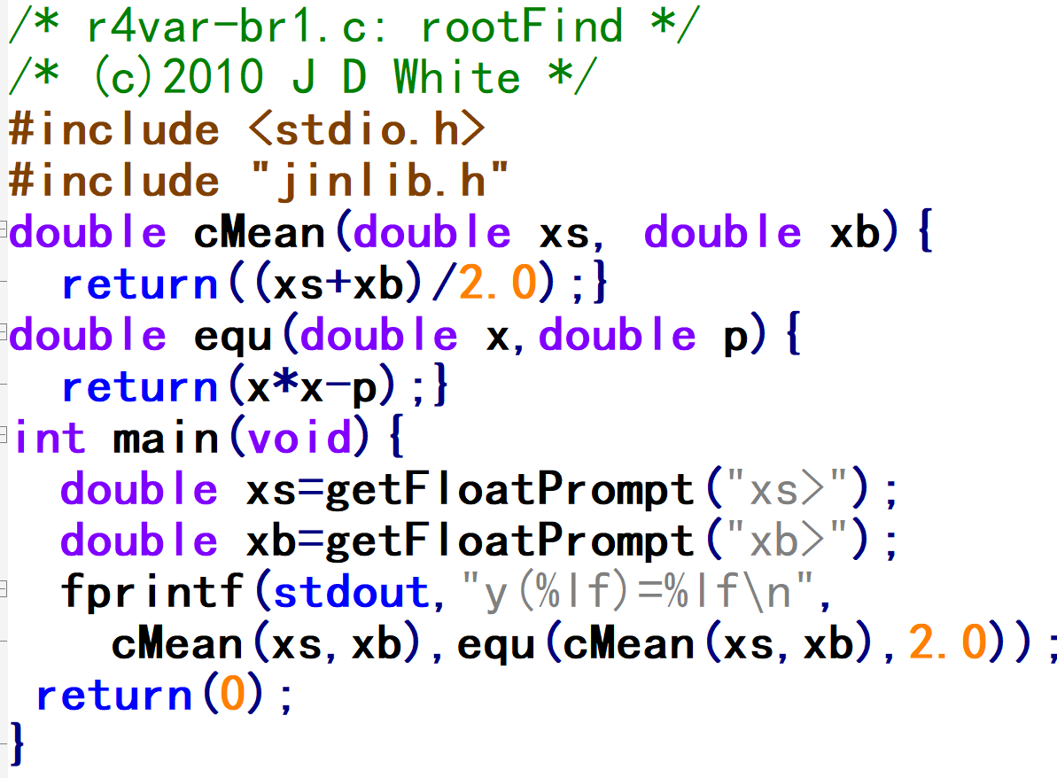
Rule Breaking: Skip Steps
Functions: Skip proto, Define before Call
Variables: Declare + Initialize (One-Step)
In function:
No variable declaration
Return calculated value
Functions: Call Functions in Function Call!
Still understandable…

Slide 5
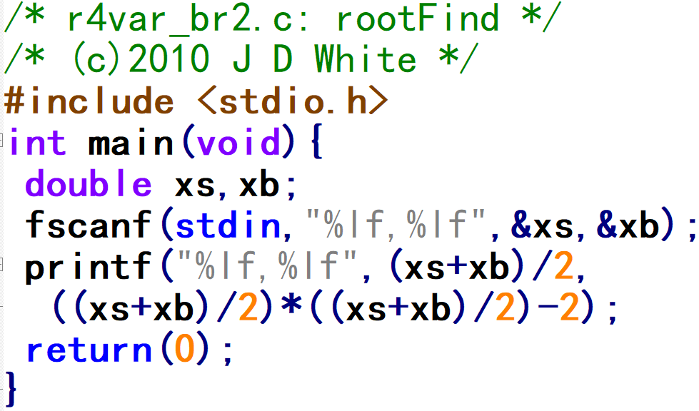
Rule Breaking: Skip Functions
Functions: main() for all user code
Input: use stdio.h – fscanf()
  No error checking
  No user prompts → The User should know what to input and the format!
Output: printf()
  Use OS default always → assume never need to output anywhere else
  Let the user guess what is output (no labels)
Use fixed 2 NOT float 2.0 → Hope compiler knows I want float

Slide 6
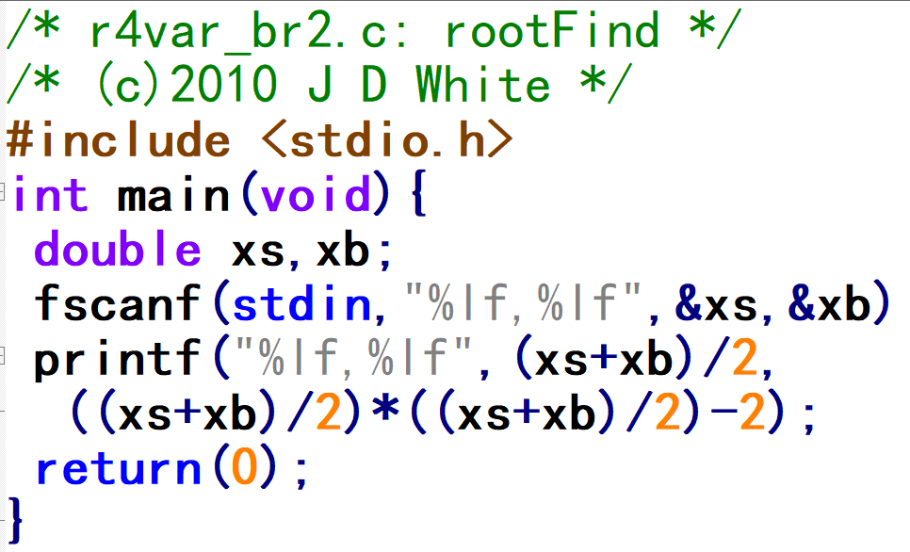
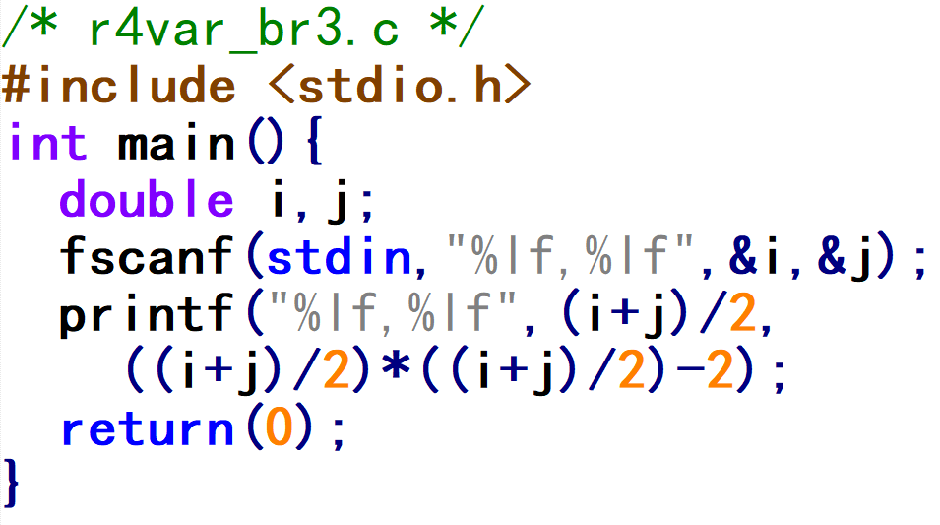
Rule Breaking: Comment/Variable
Comments: none, waste of time → confuse readers
Variables:
  meaningless names
  one letter, faster to write
  i, j commonly used for fixed

Slide 7
Rule Breaking: Forget Formatting
Put your whole code on one line!
(Try that in Python!)

Slide 8
Following the Rules
Solving Variables Functions
Hand
Declare
Prototype
UML
Initialize
Call
C Code
Use
Definition

