Slide 1
From Problem Definition to Solution

Slide 2
Implementing in ANSI-C

Slide 3
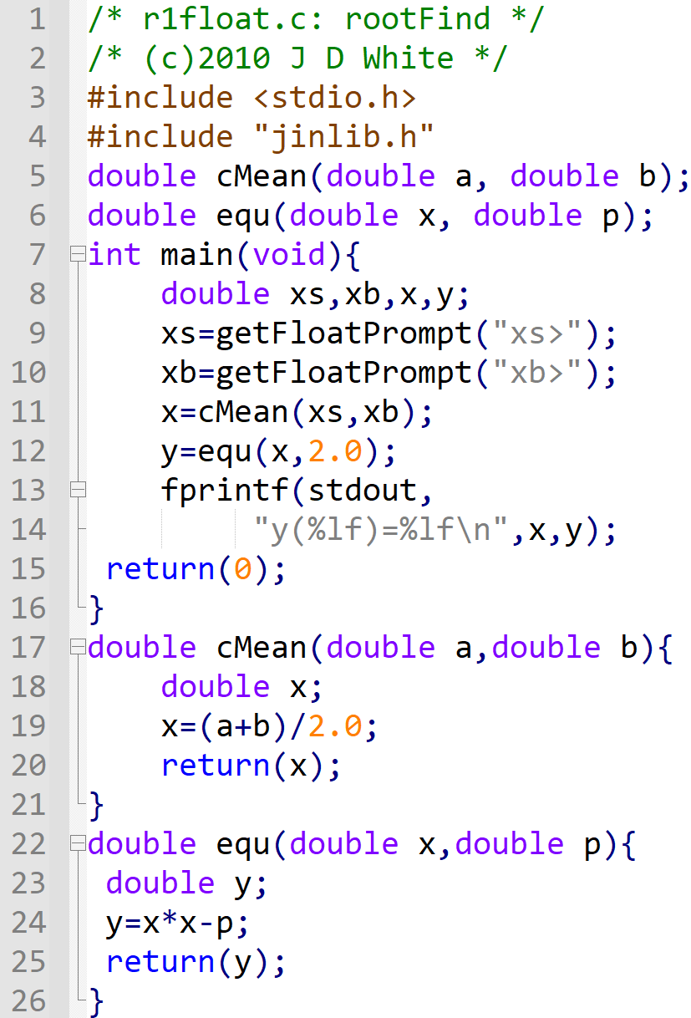
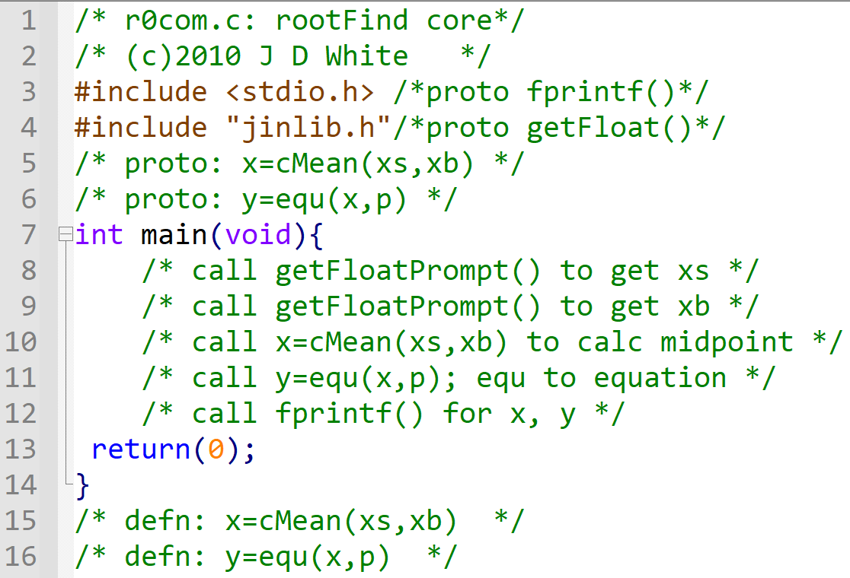
Pseudo-code → ANSI-C
→ Write ANSI-C Code

Slide 4
Run the Code
gcc –c –Wall -g xxx.c
gcc –o y.exe xxx.o jinlib.o
y
→ Run Code (gdb?)

Slide 5
Analyse Code Front
Info for Human Reader
Info Pre-processor:
Function prototype Location
Function prototypes (this file)

Slide 6
Analyse Code (VP Diagram)
main()
cMean()
equ()
xs
a
x
0.100e1
0.100e1
0.150e1
xb
b
p
0.200e1
0.200e1
0.200e1
x
x
y
0.150e1
0.150e1
0.250e0
y
0.250e0
fprintf()
getFloatPrompt()
xs> 1
xb> 2
y(1.50000)=0.250000

