Slide 1
Implementing the UML
- Choosing the Functions -

Slide 2
UML → Functions (1st Program)
getFloatPrompt()
(3rd party)
cMean()
(own)
3rd party
OS
main()
own
OS
main()
standard
fprintf()
(standard)
equ()
(own)
→Decide Functions

Slide 3
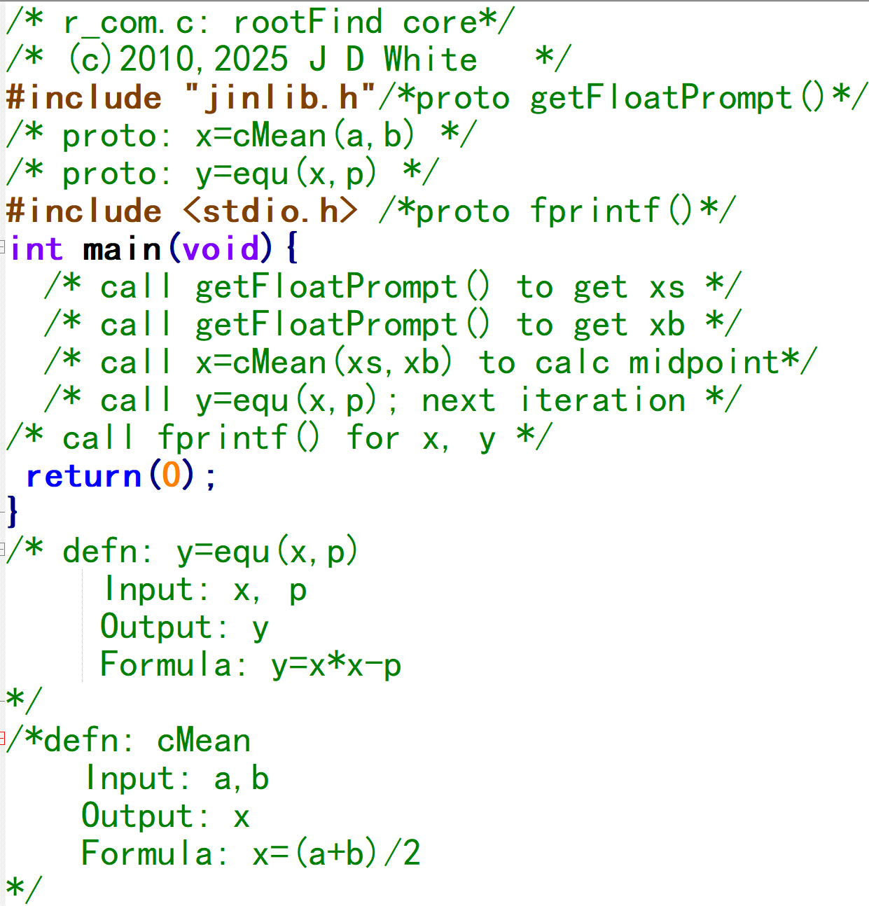
Functions → Pseudo-code
getFloatPrompt()
(3rd party)
cMean()
(own)
OS
main()
fprintf()
(standard)
equ()
(own)
→ Write Pseudo Code

Slide 4
Review
Prototype
Call
Definition

