Slide 1
Understanding the Problem

Slide 2
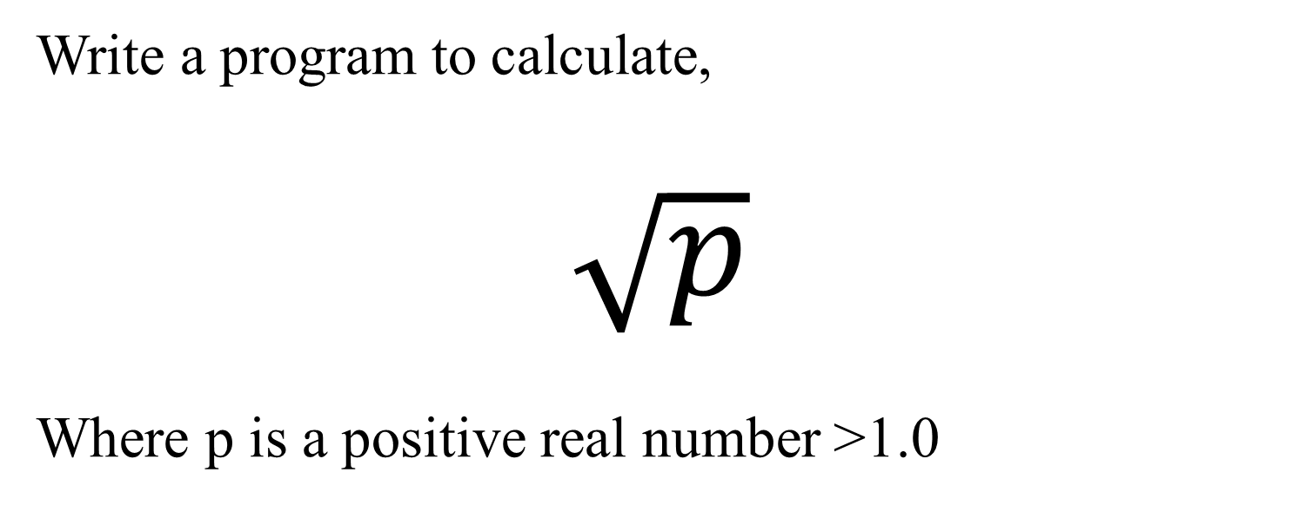
Problem Statement
Write a program to calculate,
$$\sqrt{p}$$
Where p is a positive real number >1.0

Slide 3
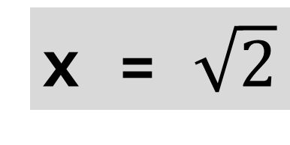

Hand Calculation (eg. $\sqrt{2}$)
y = f(x) = x² – 2 → 0
x = $\sqrt{2}$
x² = 2
→ Solve for x

Slide 4
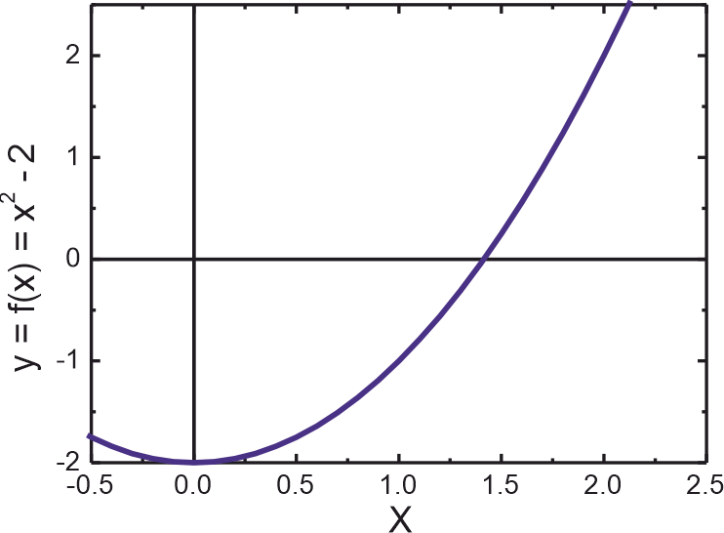
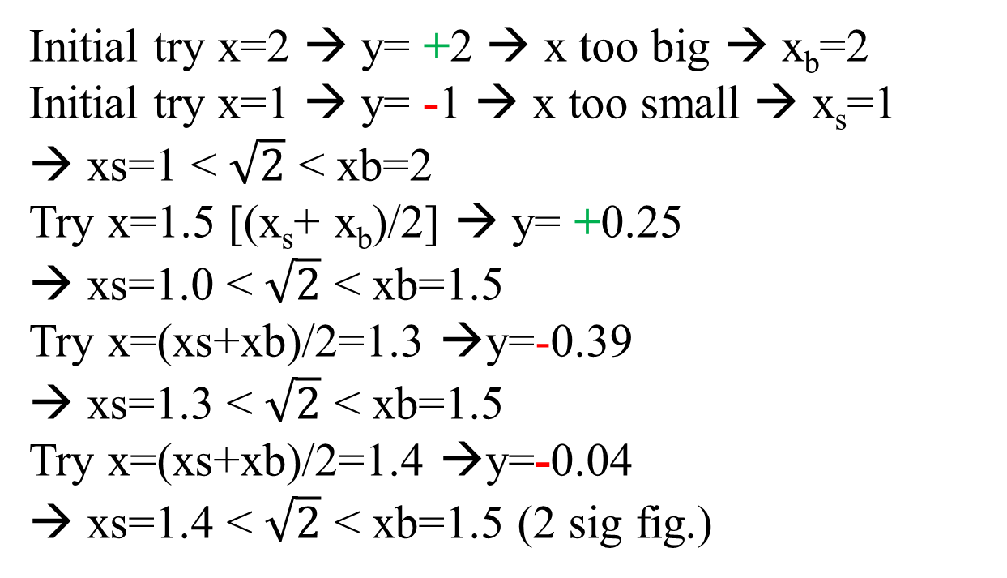
Hand Calculation (eg. $\sqrt{2}$)
y = f(x) = x² – 2 → 0
Initial try x=2 → y= +2 → x too big → x_{b}=2
Initial try x=1 → y= -1 → x too small → x_{s}=1
→ xs=1 < $\sqrt{2}$ < xb=2
Try x=1.5 [(x_{s}+ x_{b})/2] → y= +0.25
→ xs=1.0 < $\sqrt{2}$ < xb=1.5
Try x=(xs+xb)/2=1.3 →y=-0.39
→ xs=1.3 < $\sqrt{2}$ < xb=1.5
Try x=(xs+xb)/2=1.4 →y=-0.04
→ xs=1.4 < $\sqrt{2}$ < xb=1.5 (2 sig fig.)
→Lec3 Draw UML Pg 49

Slide 5
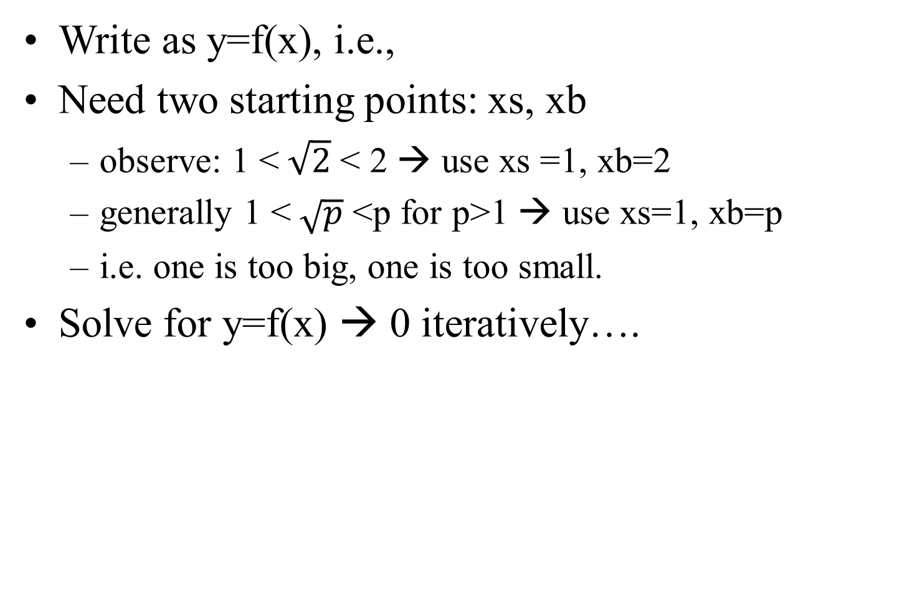
Generalize From Hand Calculation
Write as y=f(x), i.e.,
Need two starting points: xs, xb
  observe: 1 <$\sqrt{2}$ < 2 → use xs =1, xb=2
  generally 1 <$\sqrt{p}$ <p for p>1 → use xs=1, xb=p
  i.e. one is too big, one is too small.
Solve for y=f(x) → 0 iteratively….
y = f(x) = x² - p
y = f(x) = x² – p → 0

