Slide 1
Optical Ray Tracing
Motivation | Repetition
Single Lens | Arrays
Pointers | Records
Conditional | Files

Slide 2
Optical Ray Tracing
Split Input, Calculation, Output Phases
Using Arrays

Slide 3
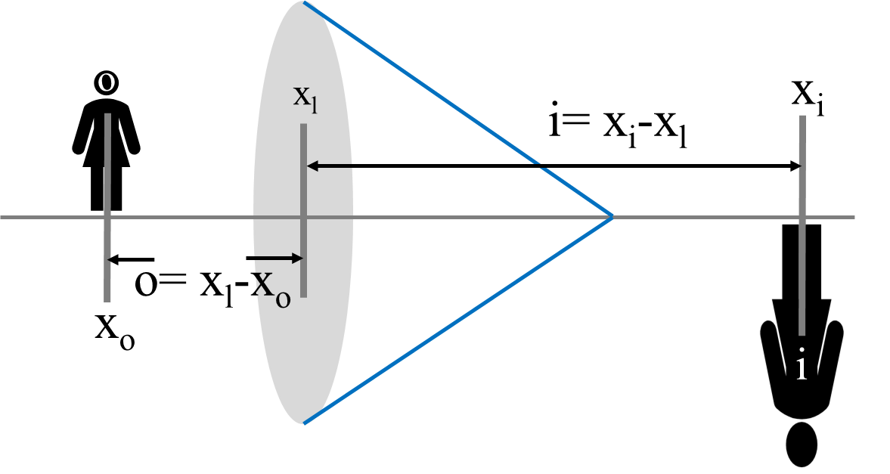
Separating Program Phases
Loop code works fine….
But we could separate
    Input,
    Processing, and
    Output phases.
Input Lens
f
Input Obj.
xo, h
Input Lens
xl, f
Input Lens
xl, f
f!=0
o =xl-xo
xo=xi
ARRAYS
thin lens
i=g(o,f)
xi=xl+i
h=-(i/o)h
Output
xi, h
Do{ }while()

Slide 4
Modify UML to use Arrays
k=0;
nlens=-1;
k<nlens
k<nlens
o=xi[k]-xl[k]
printf
xi[k],h[k]
Input
xi[0], h[0]
thin lens
i=g(o,f)
k++;
nlens++;
In xl[nlens],
f[nlens]
xi[k+1]
=xl[k]+ i
h[k+1]=
-(i/o)*h[k]
f!=0
k=0;
k++;
Exit when no
more lens
Do{ }while() for() for()

Slide 5
k=0;
nlens=-1;
k<nlens
k<nlens
o=xi[k]-xl[k]
printf
xi[k],h[k]
Input
xi[0], h[0]
thin lens
i=g(o,f)
k++;
nlens++;
In xl[nlens],
f[nlens]
xi[k+1]
=xl[k]+ i
h[k+1]=
-(i/o)*h[k]
f!=0
k=0;
k++;
Exit when no
more lens

Slide 6
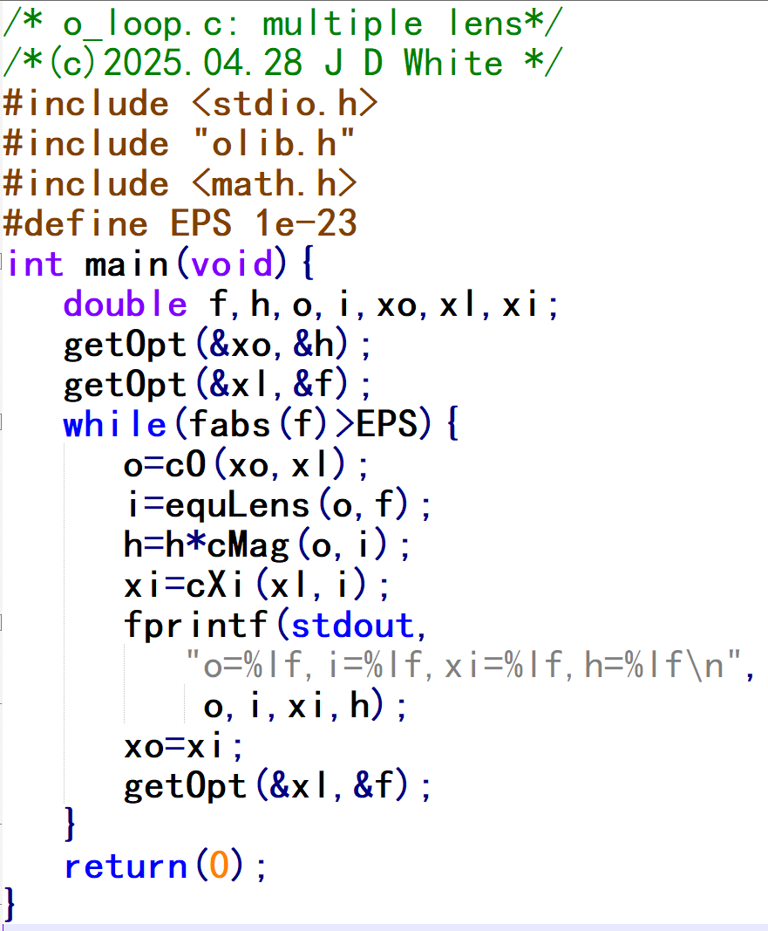
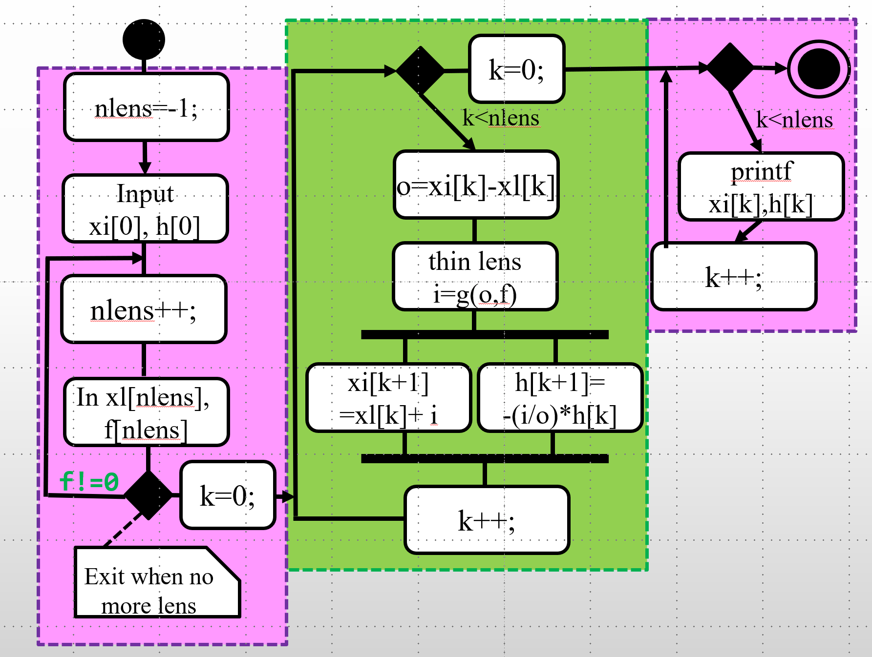
UML → ANSI-C
Use arrays (+loops) to split
input, calculation, and printing phases.
while()/do{}while()
for()
Steps:
Download
  o7loop.c,
  olib.c
  olib.h
Complete Tutorial 8
→ Write C Code

Slide 7
Compile, Link, Run
gcc –c –Wall o8arr.c
gcc –c –Wall olib.c
gcc –o o8arr.exe o8arr.o olib.o
o8arr.exe

Slide 8
Array Code Analysis (Head)
Info for Human Reader
To Pre-processor: Prototype Location
To preprocessor:
Replace EPS with 10⁻²³
To preprocessor:
Replace M with 4

Slide 9
Array Code Analysis (Declaration)
j
nlens
main()
-1

Slide 10
Array Code Analysis (Declaration)
o
i
-1
xl
f
xo
h
0
0
0
.00e0
.00e0
0
.00e0
.10e1
1
1
1
1
.00e0
.00e0
.00e0
.00e0
2
2
2
2
.00e0
.00e0
.00e0
.00e0
3
3
3
3
.00e0
.00e0
.00e0
.00e0

Slide 11
Array Code Analysis (Input)
-1
0
.20e2
.50e1
.00e0
.00e0
.00e0
.10e1
.00e0
.00e0
.00e0
.00e0
.00e0
.00e0
.00e0
.00e0
.00e0
.00e0
.00e0
.00e0
fabs(f[nlens])=1>10⁻²³ is true, do…

Slide 12
Array Code Analysis (Input)
2
1
0
.10e2
.50e1
.00e0
.10e1
.35e2
.00e0
.00e0
.10e2
.00e0
.00e0
.00e0
.00e0
.00e0
.00e0
.00e0
.00e0
.00e0
.00e0
fabs(f[nlens])=0<10⁻²³ is false
fabs(f[nlens])=1>10⁻²³ is true, do…

Slide 13
Array Code Analysis (Calc)
30
15
10
0
10
1
2
2
.10e2
.50e1
.00e0
.10e1
.35e2
.10e2
.00e0
-.10e1
.20e2
.00e0
.00e0
.00e0
.00e0
.20e1
.65e2
.00e0
.00e0
.00e0
.00e0
.00e0
j<nlens is false, exit loop
j<nlens is true, enter loop
x , h

Slide 14
Aray Code Analysis (printf)
0
15
30
1
2
3
2
.10e2
.50e1
.00e0
.10e1
.35e2
.10e2
.20e2
-.10e1
.00e0
.00e0
.65e2
.20e1
.00e0
.00e0
.00e0
.00e0
j<nlens is false, exit loop
j<nlens is true, enter loop
x , h
0.000000,1.000000
20.000000,-1.000000
65.000000,2.000000

Slide 15
x , h
0.000000,1.000000
20.000000,-1.000000
65.000000,2.000000

