Slide 1
Optical Ray Tracing
Motivation | Repetition
Single Lens | Arrays
Pointers | Records
Conditional | Files

Slide 2
Optical Ray Tracing
Large Project Maintenance
Splitting into Multiple Files

Slide 3
Split Program Motivation
⸪ code is long & called functions static
(they run correctly, we will not change)
⸫ split into 3 files
Header (olib.h)
Main function (o_split.c)
Static functions (olib.c)
Input
(3rd party)
calcI
(own)
OS
main()
Output
(standard)
calcH
(own)

Slide 4
Architecture
Header (olib.h)
Main function (o_split.c)
Static functions (olib.c)

Slide 5
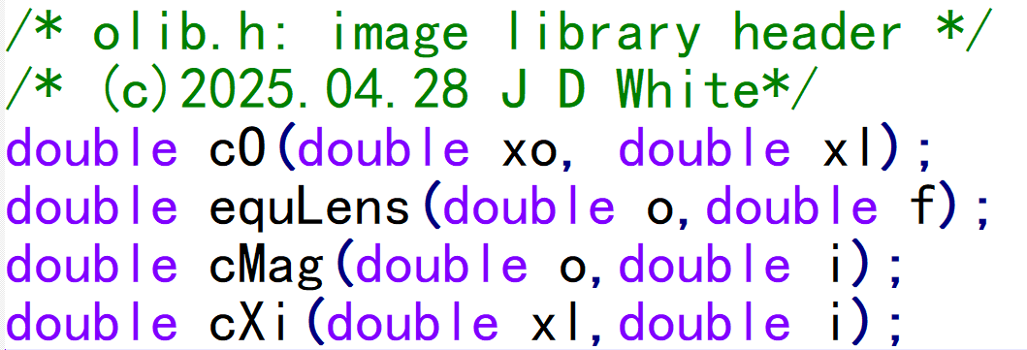
Header File (olib.h)

Slide 6
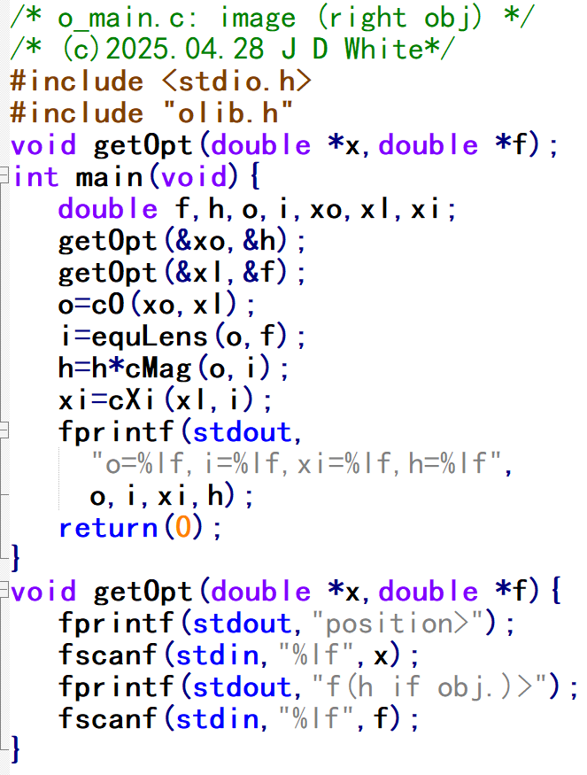
Main Program
main() function has its own file
getOpt() with main() because we will modify for records)
Note #include “olib.h”
  (quotation marks)

Slide 7
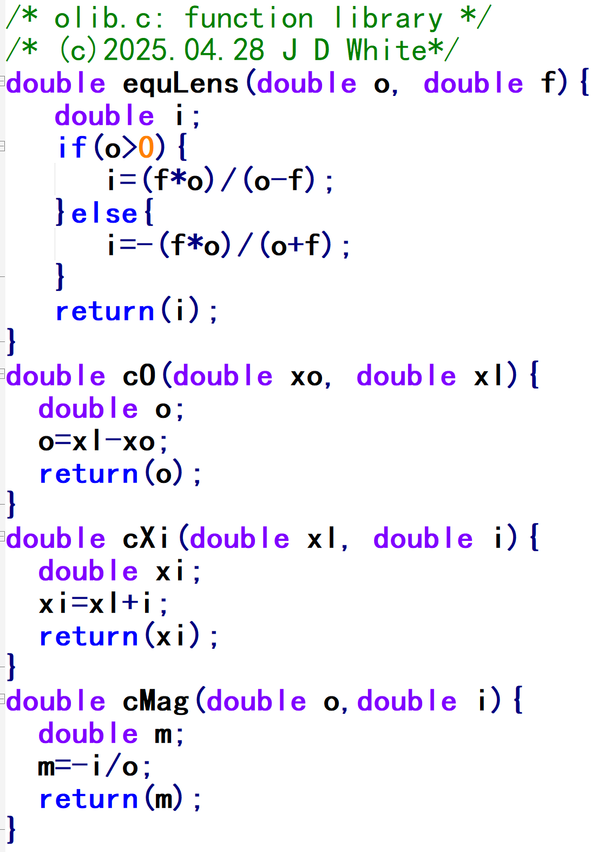
‘Library’ Functions (olib.c)
These functions are all working properly.
We will not change again so we can forget them!
So, they are in separate file.

Slide 8
Compile, Link, Run
gcc –c –Wall o7main.c
gcc –c –Wall olib.c
gcc –o m.exe o7main.o olib.o
m.exe

