Slide 1
Optical Ray Tracing
Motivation | Repetition
Single Lens | Arrays
Pointers | Records
Conditional | Files

Slide 2
Optical Ray Tracing
Multiple Lens

Slide 3

UML to Include Repetition
Input Obj.
xo, h
Input Lens
f
Input Obj.
o, h
Input Lens
xl, f
f=0
o =xl-xo
!
Not Good, i.e., HORRIBLE,
Programming Style!
i = $\frac{(of)}{(o−f)}$
xi=xl+i
h=-(i/o)h
xo=xi
Output
xi, h

Slide 4
UML to Include Repetition
Input Obj.
xo, h
Input Lens
f
Input Obj.
o, h
Input Lens
xl, f
Input Lens
xl, f
f!=0
o =xl-xo
i = $\frac{(of)}{(o−f)}$
xi=xl+i
h=-(i/o)h
xo=xi
Output
xi, h

Slide 5
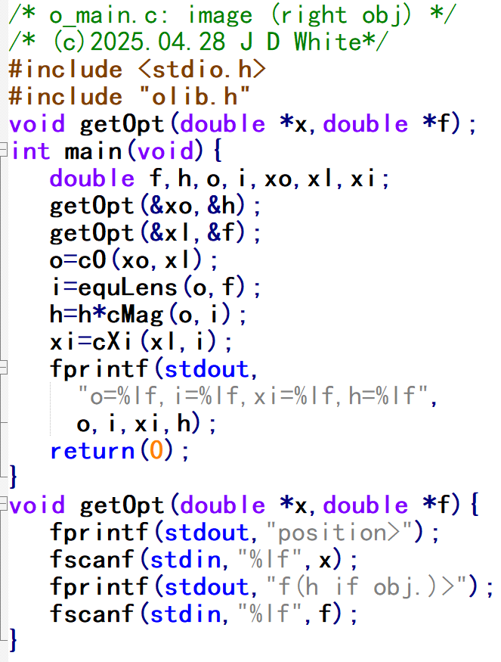
UML → ANSI-C
Input Obj.
xo, h
Input Lens
f
Input Obj.
o, h
Input Lens
xl, f
Input Lens
xl, f
f!=0
o =xl-xo
i = $\frac{(of)}{(o−f)}$
xi=xl+i
h=-(i/o)h
→ Write C Code
xo=xi
Output
xi, h

Slide 6
Compile, Link, Run
gcc –c –Wall o7loop.c
gcc –c –Wall olib.c
gcc –o m.exe o7loop.o olib.o
m.exe

Slide 7
Repetition Code Analysis (Head)
Info for Human Reader
To Pre-processor: Prototype Location
Our functions are in olib.c
fabs()
To Pre-Processor: Replace
EPSILON with 10⁻²³
Good Style

Slide 8
Repetition Code Analysis

Slide 9
Repetition Code Analysis
cO()
0.10e2
0.10e2
equLens()
0.10e2
0.50e1
getOpt()
0.10e1
getOpt()
0.00e1
>EPS→ enter loop
position>0.0
f(h if obj.)>1.0
position>10.0
f(h if obj.)>5.0

Slide 10
Repetition Code Analysis
getOpt()
0.35e2
0.10e2
cXi()
0.20e2
-0.10e1
cMag()
0.20e2
fprintf()
position>10.0
f(h if obj.)>5.0
o=10.0,i=10.0,xi=20.0,h=-1.0
position>35.0
f(h if obj.)>10.0

Slide 11
Repetition Code Analysis
cO()
0.15e2
0.30e2
equLens()
>EPS→ enter loop
position>10.0
f(h if obj.)>5.0
o=10.0,i=10.0,xi=20.0,h=-1.0
position>35.0
f(h if obj.)>10.0

Slide 12
Repetition Code Analysis (Exit)
cXi()
0.00e2
0.00e2
getOpt()
0.65e2
0.20e1
cMag()
0.65e2
fprintf()
<EPS→ exit loop
o=10.0,i=10.0,xi=20.0,h=-1.0
position>35.0
f(h if obj.)>10.0
o=15.0,i=30.0,xi=65.0,h=2.0
position>0.0
f(h if obj.)>0.0

Slide 13
Repetition Code Analysis (Rtn)
o=10.0,i=10.0,xi=20.0,h=-1.0
position>35.0
f(h if obj.)>10.0
o=15.0,i=30.0,xi=65.0,h=2.0
position>0.0
f(h if obj.)>0.0

