Slide 1
Optical Ray Tracing
Motivation | Repetition
Single Lens | Arrays
Pointers | Records
Conditional | Files

Slide 2
Optical Ray Tracing
Using Pointers
[Calling fscanf() from your function]

Slide 3
Using Pointers to Get Input
Download o_coord.c
Replace getFloatPrompt() with your own function to get (ox,h) and then (lx,f)
Include
  Prototype
  Call
  Definition
Make use of
  fscanf(), fprintf()
  Pointers to return
Sample prototype…
void getOpt(double *x, double *f);

Slide 4
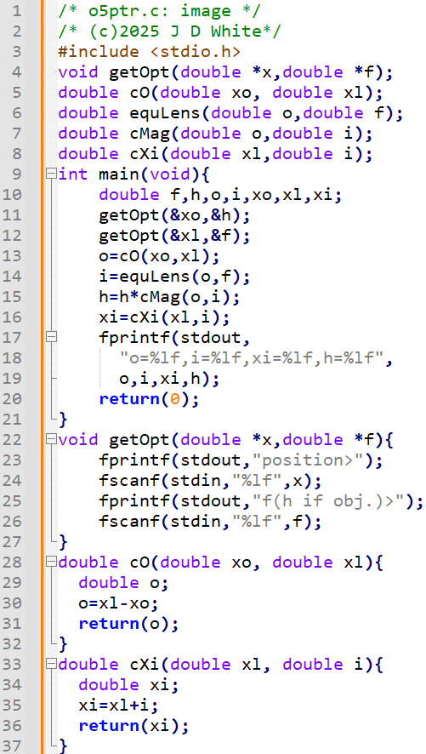
Using Pointers to Get Input
→ Modify Code

Slide 5
Run the code
gcc –c –Wall -g xxx.c
gcc –o y.exe xxx.o
y
→ Run Code (gdb?)

Slide 6
Code Analysis (Header)
Info for Human Reader
Info Pre-processor: Prototype Location
Function prototypes (this file)

Slide 7
Pointer Code Analysis
getOpt()
x
0.00e0
f
fscanf()
⌨
%lf
fprintf()
position>
0.0

Slide 8
Code Analysis
getOpt()
x
0.00e0
f
0.50e1
fscanf()
⌨
%lf
fprintf()
f(h if obj.)>
5.0

Slide 9
Pointer Code Analysis
getOpt()
x
0.00e0
f
0.50e1
0.20e1
fscanf()
⌨
%lf
fprintf()
position>
2.0

Slide 10
Pointer Code Analysis
getOpt()
x
0.00e0
f
0.50e1
0.20e1
fscanf()
0.10e2
⌨
%lf
fprintf()
f(h if obj.)>
10.0

Slide 11
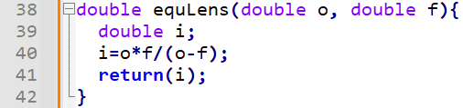
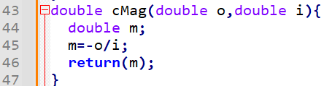
Code Analysis
0.0e1
-0.50e1
0.40e2
0.5e1
0.20e2
0.20e2
0.20e2
0.10e2
cO()
equLens()
cMag()
cIX()
fprintf()
o=20.00000,i=20.0000,xi=-5.00000,h=40.00000

