Slide 1
Optical Ray Tracing
Motivation | Repetition
Single Lens | Arrays
Pointers | Records
Conditional | Files

Slide 2
Optical Ray Tracing
Implementing in ANSI-C

Slide 3
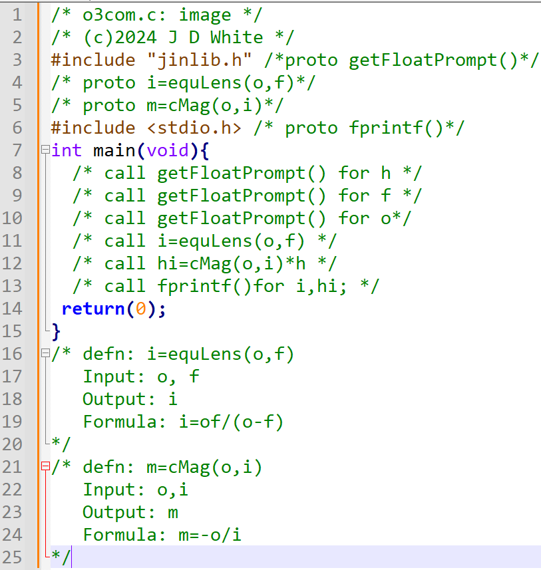
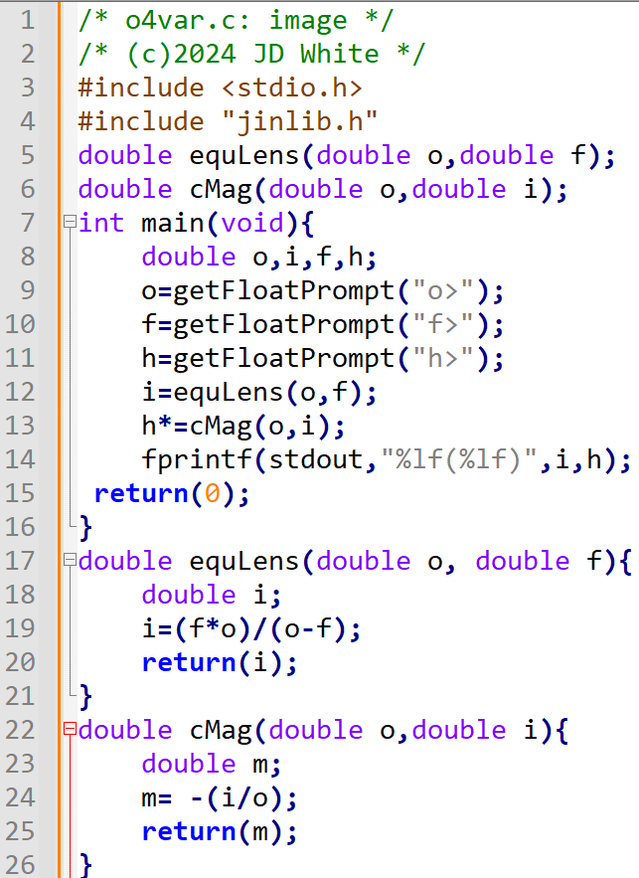
Pseudo-code → ANSI-C
→ Write C Code

Slide 4
Compile, Link, Run
gcc –c –Wall -g xxx.c
gcc –o y.exe xxx.o jinlib.o
y
→ Run Code (gdb?)

Slide 5
Single Lens Code Analysis
Info for Humans: program name, purpose, author, version
To Pre-processor: Location of function prototypes (standard & others)
Function Prototypes (my own)

Slide 6
Single Lens Code Analysis (Part 1)
main()
o
0.200e1
f
0.500e1
i
h
0.100e1
getFloatPrompt()

Slide 7
Code Analysis (equLens)
main()
equLens()
o
o
0.200e1
0.200e1
f
f
0.500e1
0.500e1
i
i
-0.330e1
-0.330e1
h
0.100e1

Slide 8
Code Analysis (cMag)
main()
cMag()
o
o
0.200e1
0.200e1
f
i
0.500e1
0.330e1
i
m
-0.330e1
0.165e1
h
0.100e1
0.165e1

Slide 9
Single Lens Code Analysis (Part 4)
main()
o
fprintf()
0.200e1
f
-0.330e1
0.500e1
i
0.165e1
-0.330e1
h
0.165e1
-3.300000(1.650000)

Slide 10
Single Lens Code Analysis (After)
0.200e1
0.500e1
-0.330e1
0.165e1
-3.300000(1.650000)

