Slide 1
Optical Ray Tracing
Implementing the UML
- Choosing the Functions -

Slide 2
UML → Functions
My suggestion
getFloatPrompt()
(3rd party)
3rd party
OS
main()
OS
main()
own
i=equlens
(own)
standard
cMag
(own)
fprintf()
(standard)
→ Decide: Functions

Slide 3
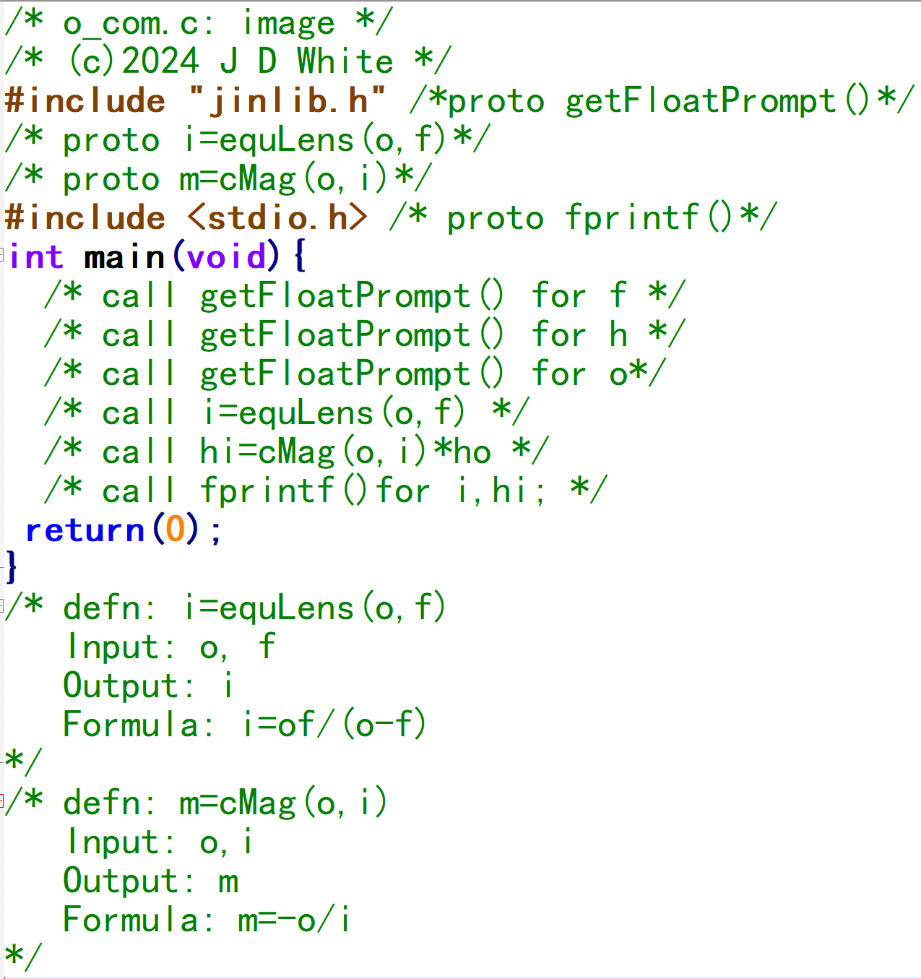
Functions → Pseudo-Code
My suggestion
getFloatPrompt()
(3rd party)
OS
main()
i=equlens
(own)
cMag
(own)
fprintf()
(standard)
→Write Pseudo-code

Slide 4
Review
Prototype
Call
Definition

