Slide 1
Optical Ray Tracing
Generalizing the Solution → UML

Slide 2
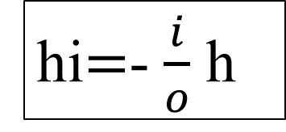
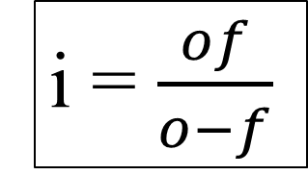

Formalize → UML (Basic)
?
h
+i
Input o, f, h
+f
+o
i = $\frac{(of)}{(o−f)}$
h_{i}
hi=-(i/o) h
?
i = $\frac{of}{o−f}$
Output hi, i
hi$=$- $\frac{i}{o}$ h

