Slide 1
Optical Ray Tracing
Understanding the Problem

Slide 2


Problem Definition
Determine the location and size of the final image formed by an imaging system composed of multiple lens

Slide 3
Optics Review: Single Lens
o i
ho
hi
f f

Slide 4
Problem Simplify: Single Lens
?
h_{o}
+i
+f
+o
h_{i}
?

Slide 5
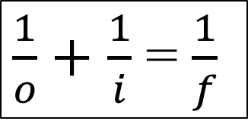
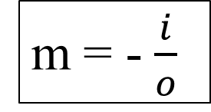
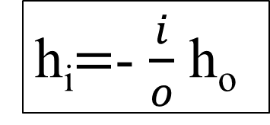
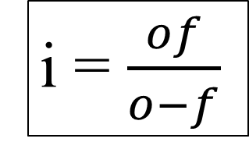
Literature Search: Single Lens
?
h_{o}
+i
+f
+o
h_{i}
?
$\frac{1}{o}+$ $\frac{1}{i}$ = $\frac{1}{f}$
i = $\frac{of}{o−f}$
m = - $\frac{i}{o}$
h_{i}$=$- $\frac{i}{o}$ h_{o}

Slide 6
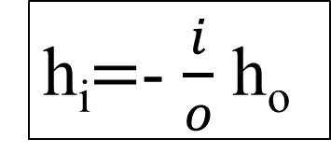
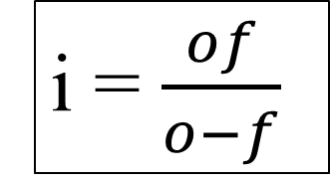
Hand Calculation
o | f | i | hi | Picture
10 | +5
2 | +5
2 | -5
10 | -5
i = $\frac{of}{o−f}$
h_{i}$=$- $\frac{i}{o}$ h_{o}
Assume ho = 1

