Slide 1
Falling Objects
From Problem Definition to Solution

Slide 2
Falling Objects
Making Use of Arrays

Slide 3
Beyond Repetition
Code Works: Problem Solved
Minor Limitations
Run program twice
Input/Calc/Output together
Can’t format as one table
One Solution (Not the Best): Arrays
Single run of program
Separate: Input/Calc/Output
Format output as one table
uml

Slide 4

UML Repetition, Run Twice, Files)
Read
v₁, t₁
Read
v₂, t₂
t₂ < 0.0
Read
v₂, t₂
[False]
t_{avg}=(t₁+t₂)/2
$$v=\frac{∆v}{∆t}=\frac{(v2−v1)}{(t2−t1)}$$
v₁ ₌ v₂
t₁₌ t₂
Save
a, t_{avg}
Acceleration
Input is v not h
Velocity

Slide 5
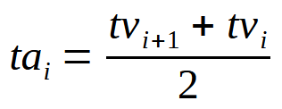
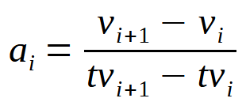
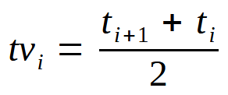
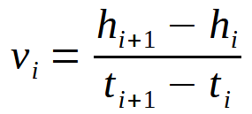
UML Arrays (Run Once)
i=0;
Input
Acceleration
i=0;
Read h_{i}, t_{i}
i++;
(Count entries)
i++;
More data?
i < ndata - 2
t_{i} >= 0.0
Output
i=0;
Velocity
ndata=i;
i=0;
i++;
i < n
i < ndata - 1
Write
h, th, v, tv, a, ta
LOOPS #
do..while 1
for 3
i++;

Slide 6
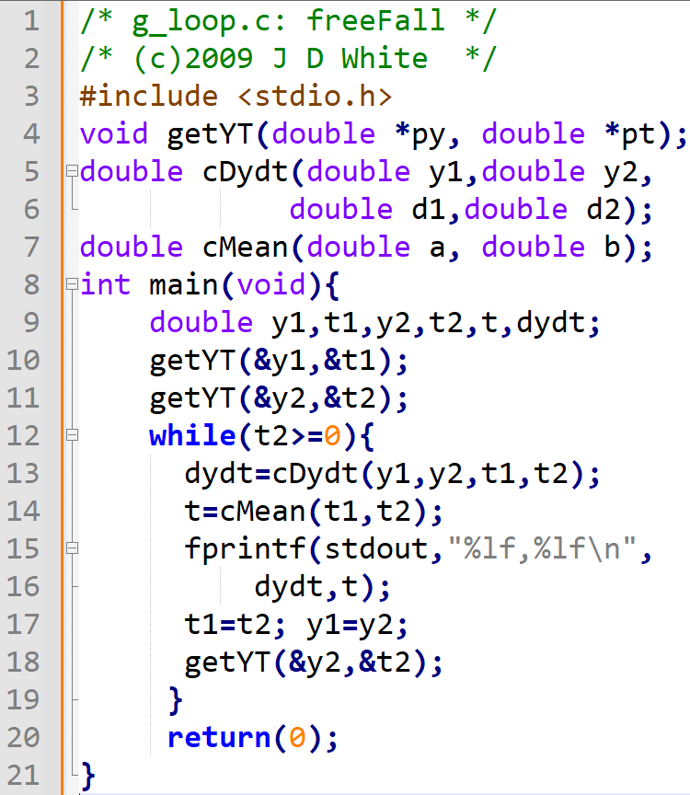
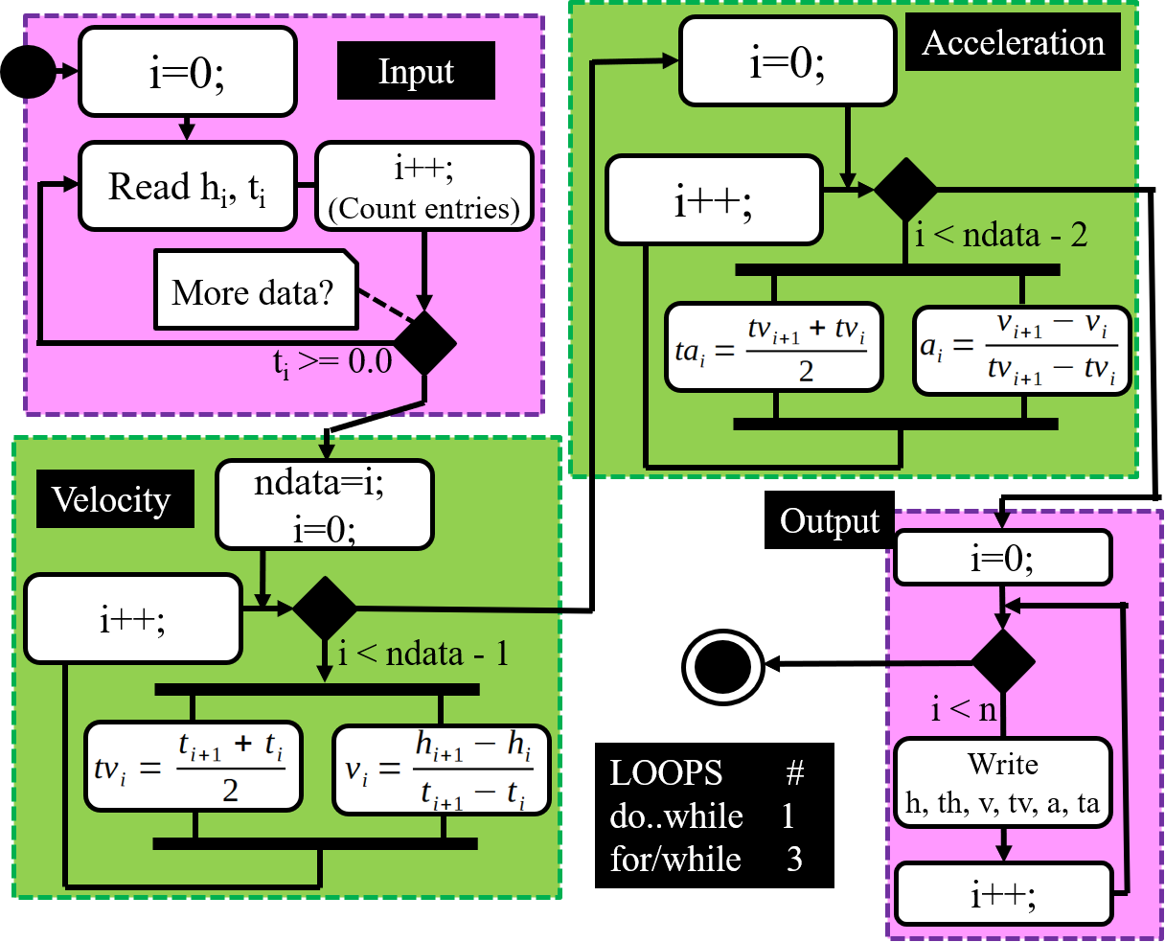
Modify Code to Implement Arrays
Modify loop code to store (y,t), (v,tv), and (a,ta) in arrays.
Hint: Make all changes in main() function

Slide 7
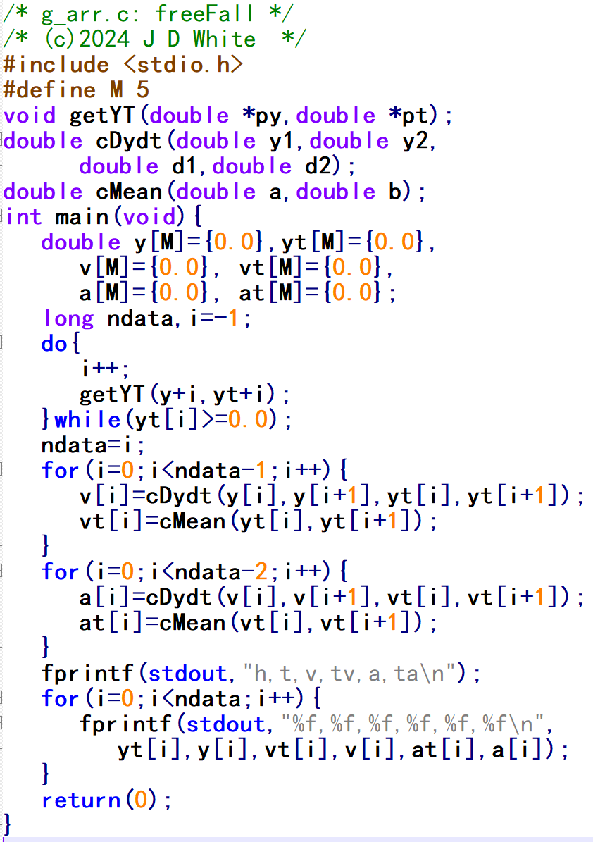
Run the Code
 | h[m] | t[s]
R | 42.5 | 0.00
14 | 39.5 | 0.78
12 | 33.5 | 1.36
e | -1 | -1
gcc –c –Wall -g g8arr.c
gcc –o g.exe g8arr.o
g
→ Run Code (gdb?)

Slide 8
Array Code Analysis (Start)
main()
ndata
i
-87
-1
y
yt
v
vt
a
at
0.0
0.0
0.0
0.0
0.0
0.0
0.0
0.0
0.0
0.0
0.0
0.0
0.0
0.0
0.0
0.0
0.0
0.0
0.0
0.0
0
0.0
0.0
0.0
0.0
0.0
0
0.0
0.0
0.0
0.0
0.0
0
0
0
0
1
1
1
1
1
1
2
2
2
2
2
2
3
3
3
3
3
3
4
4
4
4
4
4
Unconditional enter do-while loop

Slide 9
Array Code Analysis (Input)
2
3
1
3
0
42.5
39.5
0.78
33.5 1.36
-1.0 -1.0
yt[0] = 0.0 >=0.0, repeat
yt[1] = 0.78 >0.0, repeat
yt[2] = 1.36 >0.0, repeat
yt[2] = -1 .0 < 0.0, exit loop

Slide 10
Array Code Analysis (Velocity)
1
2
0
-3.85
0.39
0.0
0.0
-10.8
1.07
0.0
0.0
i=0 < ndata-1 (2) → enter loop
i=1 < ndata-1 (2) → repeat
i=2 = ndata-1 (2) → exit loop

Slide 11
Array Code Analysis (Accelerate)
0
1
0.73
0.0
0.0
-9.56
i=0 < ndata-1 (1) → enter loop
i=1 = ndata-2 (1) → exit loop

Slide 12
Array Code Analysis (Output)
1
3
0
1
2
-9.56
0.73
i=0 < ndata (3) → enter loop
i=1 < ndata (3) → enter loop
i=2 < ndata (3) → enter loop
i=3 = ndata (3) → exit loop
h,t,v,tv,a,ta
42.50,0.00,-3.85,0.39,-9.56,0.73
39.50,0.78,-10.8,1.07,0.00,0.00
33.50,1.36,0.00,0.00,0.00,0.00

