Slide 1
Falling Objects
From Problem Definition to Solution

Slide 2
Falling Objects
Implementing Repetition

Slide 3
Beyond the Basic Code
Problems:
  Each time we calculate, the program must be restarted.
  Need to enter same numbers twice
  Can’t read data from file
Solution → Repetition
  do all calculations without program restart
  No need to re-enter numbers
  Can read data from file.

Slide 4
Modify Current UML for Repetition
STOP
Repetition +
Need an input that will never occur
→ Negative Time, e.g., -1, -1

Slide 5
UML Including Repetition

Slide 6
Implement: Functions? What loop?
for (initialize; condition; increment){
statement to execute;
statement to execute;
}
But we don’t know when to stop
while(condition){
statement to execute;
statement to execute;
}
do{
statements to execute;
statements to execute;
}while(condition);
We only need to modify the function main(), no changes are needed in the other functions!

Slide 7
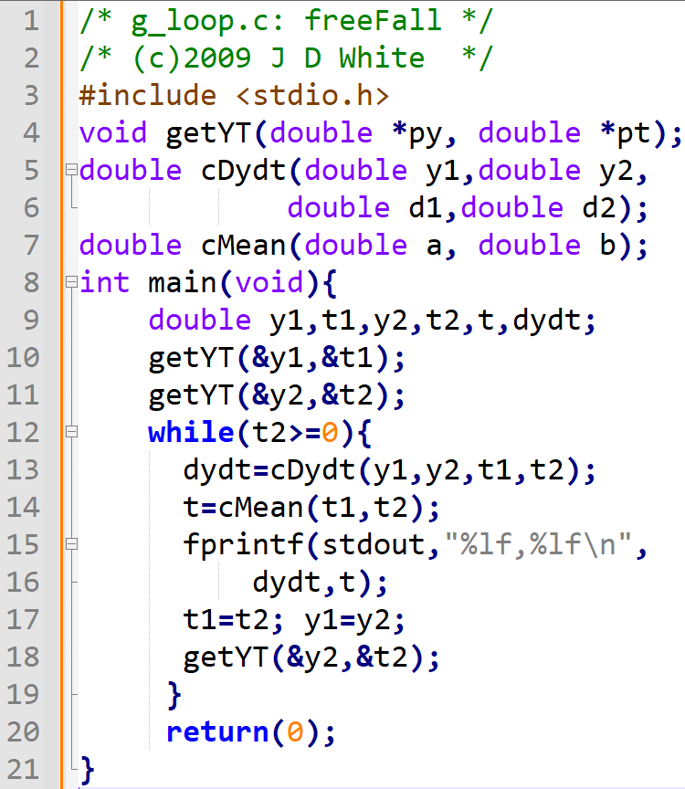
UML → Pseudo → C-code
We only need to modify the function main(), no changes are needed in the other functions!

Slide 8
Run the Code
gcc –c –Wall -g g7loop.c
gcc –o g.exe g7loop.o
g
→ Run Code (gdb?)

Slide 9
Repetition Code Analysis (Loop 1)
0.425e2
0.000e-9
0.395e2
t₂ ~ 0.78 > 0
→ enter loop
0.780e0
-0.385e1
0.39e0
-3.85000,0.390000,

Slide 10
Repetition Code Analysis (Loop 2)
0.395e2
0.425e2
0.780e0
0.000e-9
0.335e2
t₂ ~ 1.36 > 0
→ enter loop
0.395e2
0.136e1
0.780e0
-0.385e1
-0.1034e2
0.39e0
0.107e1
-3.85000,0.390000,
-10.34000,1.070000,

Slide 11
Repetition Code Analysis (Last Loop)
0.335e2
0.136e1
t₂ ~ -1 < 0
→ Skip loop
0.335e2
-0.100e1
0.136e1
-0.100e1
-0.271e2
t
0.278e1
-27.14000,2.78000,
-10.34000,1.070000,

