Slide 1
Falling Objects
From Problem Definition to Solution

Slide 2
Falling Object
Implementing in ANSI-C

Slide 3
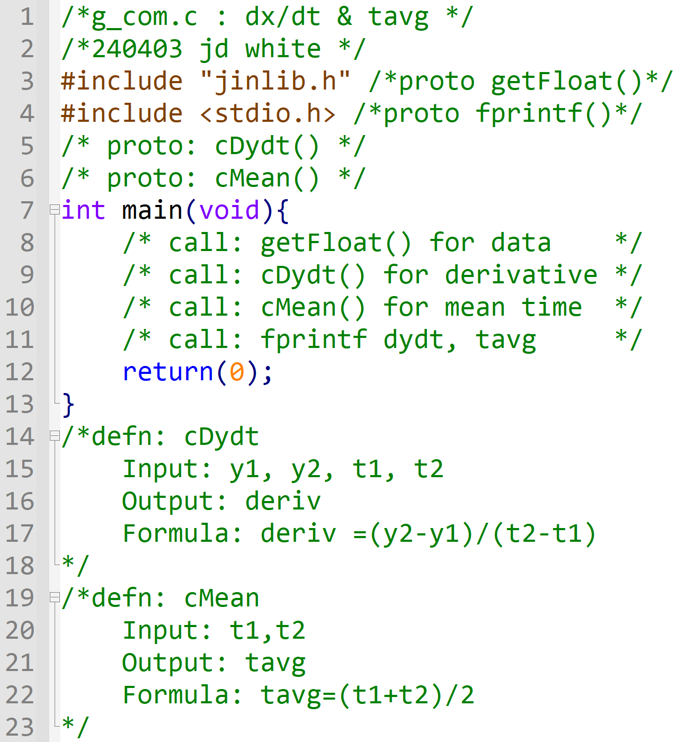
Pseudo-Code to ANSI-C
Observe how to convert Pseudo-Code to C-code
→Write ANSI-C

Slide 4
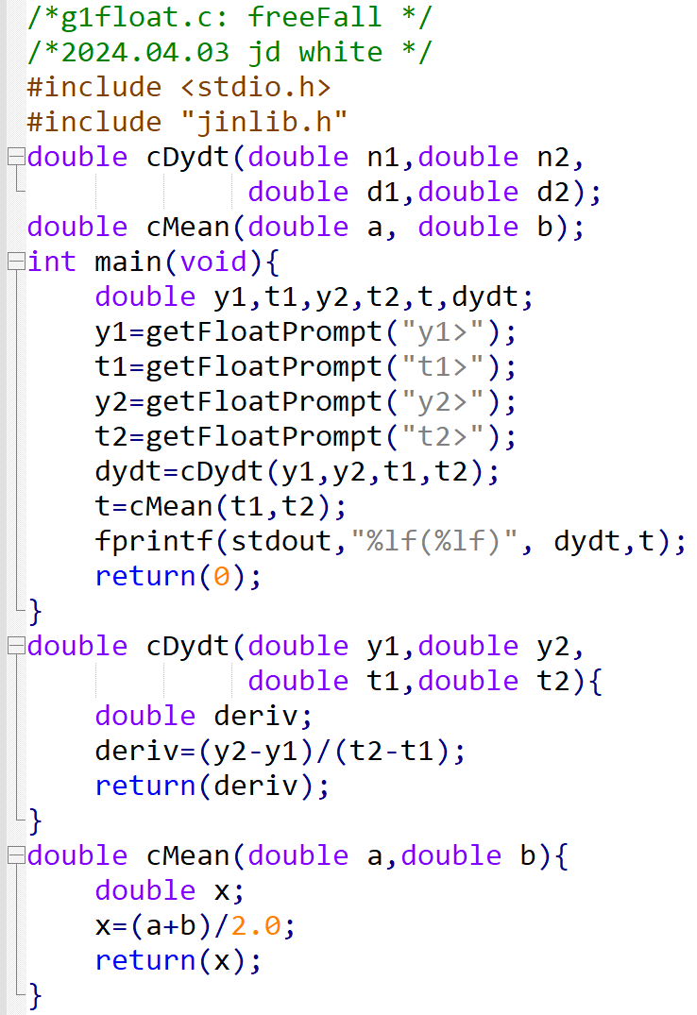
Pseudo-Code to ANSI-C

Slide 5
Run the Code
 | h[m] | t[s]
R | 42.5 | 0.00
14 | 39.5 | 0.78
12 | 33.5 | 1.36
e | -1 | -1
gcc –c –Wall -g xxx.c
gcc –o y.exe xxx.o jinlib.o
y
gdb y.exe
b main
r
→ Run Code (gdb?)

Slide 6
Code Analysis – Part 1 (main)
Info for Human Reader: program name, purpose, author, version
To Pre-processor:
Function prototypes
 | h[m] | t[s]
R | 42.5 | 0.00
14 | 39.5 | 0.78
12 | 33.5 | 1.36
e | -1 | -1
Function prototypes (this file)

Slide 7
Code Analysis – Part 2 (cDydt)
main()
y1
y2
dydt
0.425e2
0.395e2
-0.385e1
t1
t2
t
0.000e-9
0.780e0
cDydt()
y1
y2
deriv
0.425e2
0.395e2
-0.385e1
t1
t2
0.000e-9
0.780e0
getFloatPrompt()
y1> 42.5
t1> 0
y2> 39.5
t2> 0.78

Slide 8
Code Analysis –Part 3 (Mean)
-0.385e1
0.390e0
cMean()
a
b
x
0.000e-9
0.780e0
0.390e0
y1> 42.5
t1> 0
y2> 39.5
t2> 0.78

Slide 9
Code Analysis –Part 4 (End)
-0.385e1
0.390e0
fprintf()
y2> 39.5
t2> 0.78
-3.85000 (0.390000)

