Slide 1
Falling Objects
Implementing the UML
- Choosing the Functions -

Slide 2
UML → Functions (1st Program)
getFloatPrompt()
(3rd party)
cMean()
(own)
OS
main()
cDydt()
(own)
fprintf()
(standard)
3rd party
OS
main()
own
→Decide Functions
NB: These functions can be reused for acceleration
standard

Slide 3
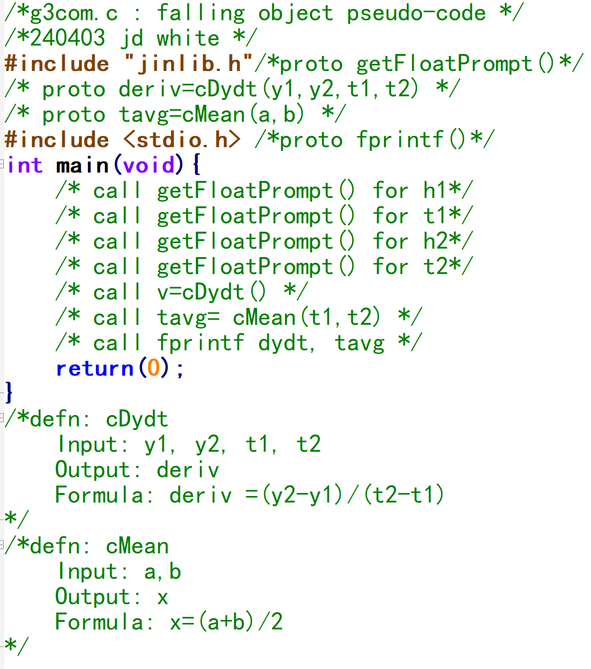
Functions → Pseudo-code
cMean()
(own)
getFloatPrompt()
(3rd party)
cDydt()
(own)
OS
main()
fprintf()
(standard)
→Write Pseudo Code

Slide 4

Review
Read h1, t1
Prototype
Read h2, t2
Call
t_{avg}=(t₁+t₂)/2
$$v=\frac{∆h}{∆t}=\frac{(h2−h1)}{(t2−t1)}$$
Definition
Save
v, t_{avg}

