Slide 1
Falling Objects
Understanding the Problem

Slide 2
Problem Definition
To determine the mathematical equations that indicate a relationship between
  Acceleration,
  Velocity
  Distance travelled
and time
for a free falling object.

Slide 3
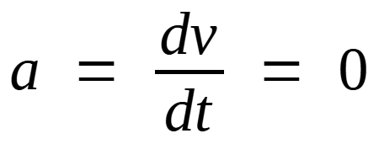
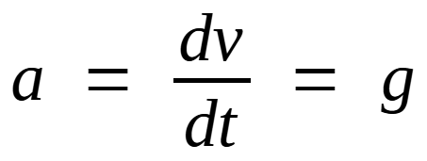
Literature Review
Aristotle’s hypothesis
Newton’s hypothesis
Objects fall with speed proportional to weight
Objects fall with speed proportional to time
v = g * m;
v = g * t;
* g is a constant to be determined by experiment

Slide 4
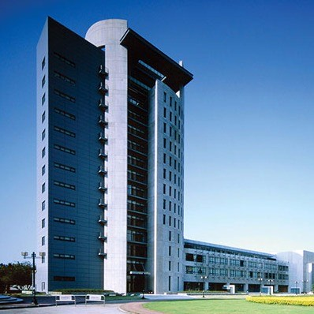
Experiment Design
Climb to the roof of building six
Drop light object
Record time object passes each floor
Drop heavy object
Record time object passes each floor
Find the acceleration
If Aristotle is correct → a=0
If Newton is correct → a != 0

Slide 5
Take Data: Heavy Object

Slide 6
Take Data: Light Object
Floor [-] | h [m] | t_{h} [s] | v[m/s] | t_{v}[s] | a[m/s/s] | t_{a}[s]
Roof | 42.5 | 0.00 | -3.00 | 0.50 | -0.39 | 1.18
14 | 39.5 | 1.00 | -3.53 | 1.85 | -0.13 | 2.68
12 | 33.5 | 2.70 | -3.75 | 3.50 | +0.07 | 4.53
10 | 27.5 | 4.30 | -3.60 | 5.55 | -0.06 | 6.78
7 | 18.5 | 6.80 | -3.75 | 8.00 | +0.09 | 9.28
4 | 9.5 | 9.20 | -3.52 | 10.55
G | 0.0 | 11.90

Slide 7
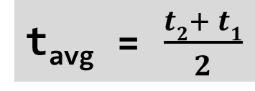
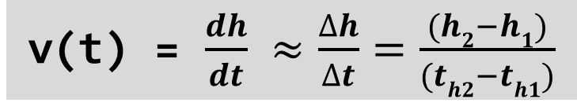
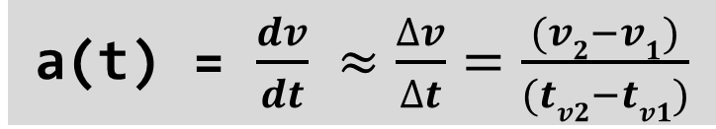
Mathematical Formulation
Velocity
Acceleration
v(t) = $\frac{dh}{dt} ≈\frac{∆h}{∆t}=\frac{(h2−h1)}{(th2−th1)}$
a(t) = $\frac{dv}{dt} ≈\frac{∆v}{∆t}=\frac{(v2−v1)}{(tv2−tv1)}$
t_{avg} = $\frac{t2+ t1}{2}$
The acceleration formula is the same as the velocity formula (only symbols differ)

Slide 8
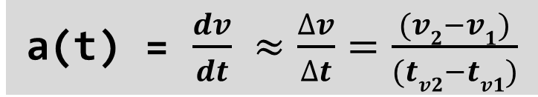
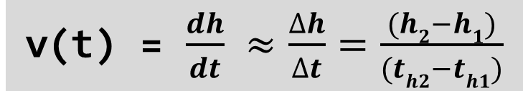
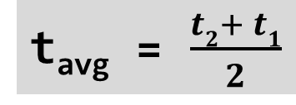
Hand Calculation: Heavy Object
v(t) = $\frac{dh}{dt} ≈\frac{∆h}{∆t}=\frac{(h2−h1)}{(th2−th1)}$
a(t) = $\frac{dv}{dt} ≈\frac{∆v}{∆t}=\frac{(v2−v1)}{(tv2−tv1)}$
t_{avg} = $\frac{t2+ t1}{2}$
If Aristotle is correct → a=0
If Newton is correct → a != 0

Slide 9
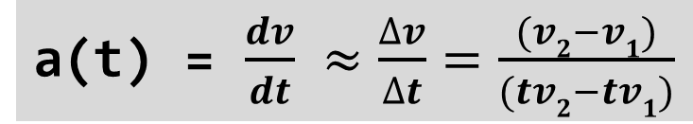
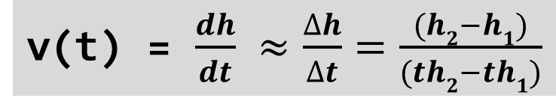
Hand Calculation: Light Object
v(t) = $\frac{dh}{dt} ≈\frac{∆h}{∆t}=\frac{(h2−h1)}{(th2−th1)}$
a(t) = $\frac{dv}{dt} ≈\frac{∆v}{∆t}=\frac{(v2−v1)}{(tv2−tv1)}$
Floor [-] | h [m] | t_{h} [s] | v[m/s] | t_{v}[s] | a[m/s/s] | t_{a}[s]
Roof | 42.5 | 0.00 | -3.00 | 0.50 | -0.39 | 1.18
14 | 39.5 | 1.00 | -3.53 | 1.85 | -0.13 | 2.68
12 | 33.5 | 2.70 | -3.75 | 3.50 | +0.07 | 4.53
10 | 27.5 | 4.30 | -3.60 | 5.55 | -0.06 | 6.78
7 | 18.5 | 6.80 | -3.75 | 8.00 | +0.09 | 9.28
4 | 9.5 | 9.20 | -3.52 | 10.55
G | 0.0 | 11.90
t_{avg} = $\frac{t2+ t1}{2}$
If Aristotle is correct → a=0
If Newton is correct → a != 0

Slide 10
From Sample Calculations
Weight of Object affects results
  Heavy Object follows Newton Hypothesis (a=g)
  Light Object follows Aristotle Hypothesis (a=0)
  → we need to do many cases to get more data
  →computer program helpful
Calculation is repetitive → Computer program will help us to do repeated calculations efficiently
?

