Slide 1
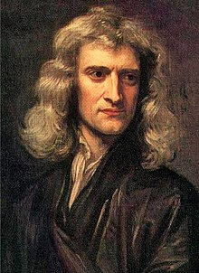
Newton & Jewish Writings
J D White

Slide 2
Our 4 Questions…
"What is the content?",
"Why did people respect/trust this book?",
"How it affect the lives of influential humans?“
“How can this help me to have a better life?

Slide 3
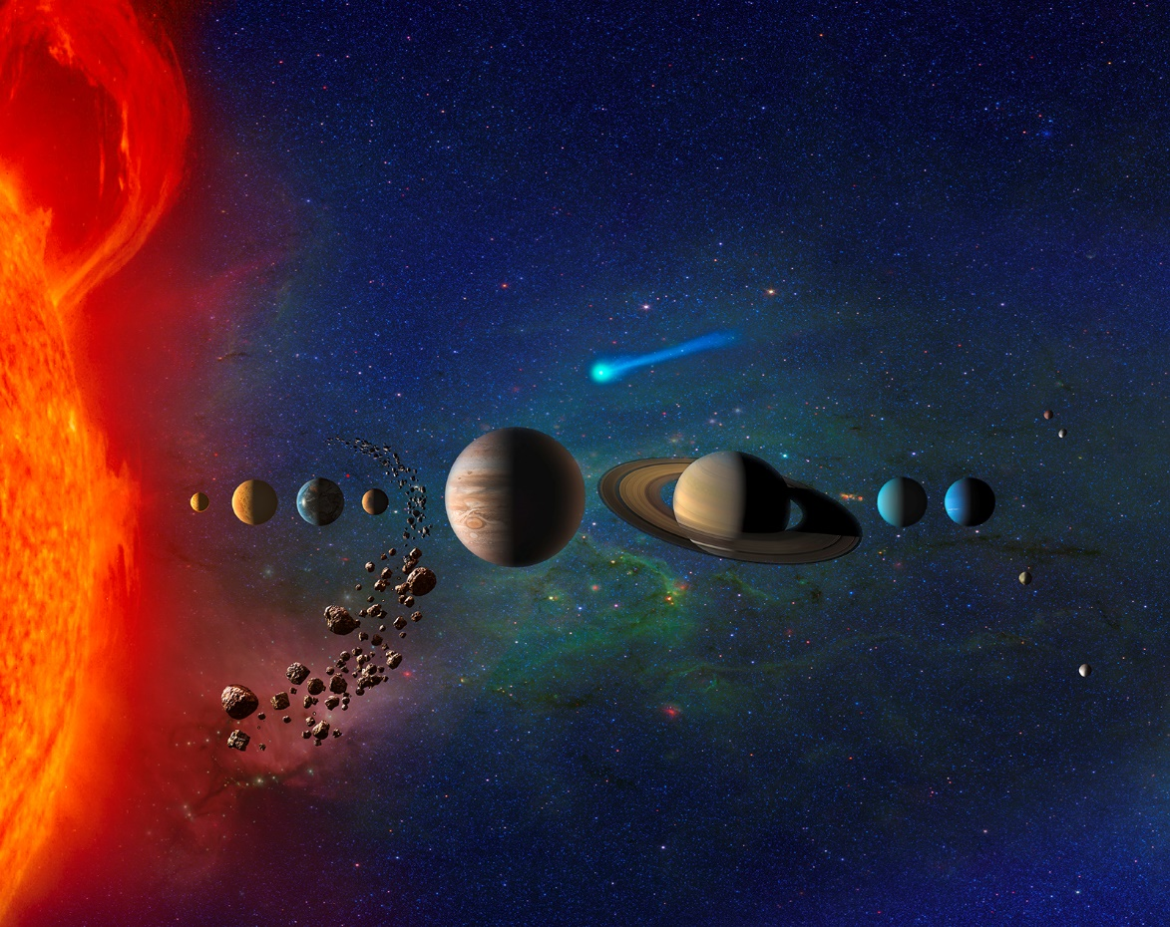
Newton on the Beginning
“Atheism is so senseless. When I look at the solar system, I see the earth at the right distance from the sun to receive the proper amounts of heat and light. This did not happen by chance. The motions of the planets require a Divine arm to impress them.”
NASA

Slide 4
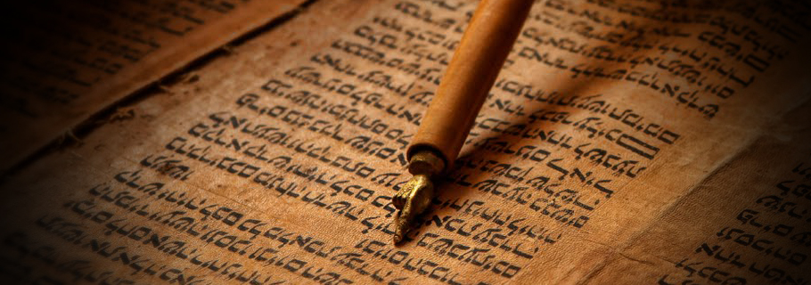
Newton on Prophecy
“The folly of interpreters has been to foretell times and things. The design of God was much otherwise. God gave the prophecies of the Old Testament (Jewish writings) that after they were fulfilled they might become intelligible. The prophecies afford convincing argument that the world is governed by Providence”

