Slide 1
Jesus
BC to AD: 3 Years to Change the World
Like Alexander – Died ~ 32-33 yrs
Like Socrates – His students write not himself
J D White

Slide 2
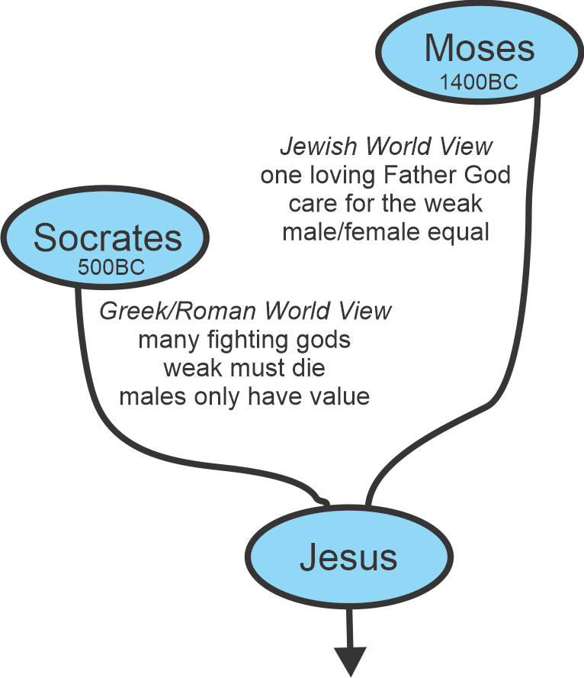

Slide 3
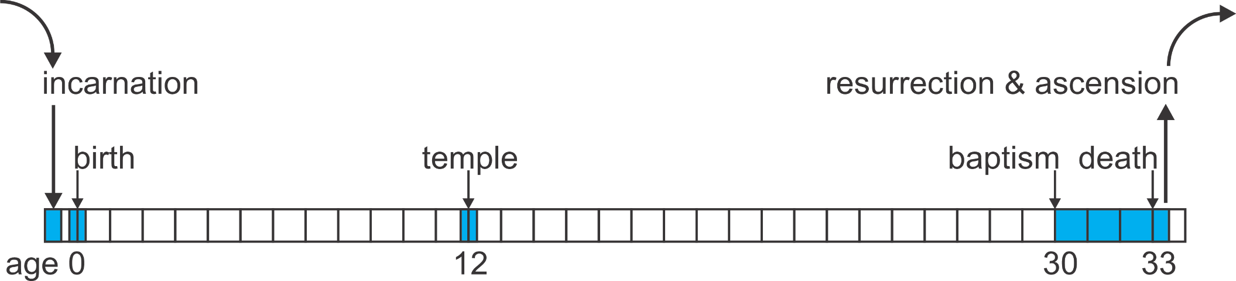
Jesus’ Life Timeline
The video is based on the writings of an historian and medical doctor named Luke.
Note: 3 other contemporary records of Jesus’s life
Video: Adapted for children (simpler English)
Please make notes in your workbook

Slide 4

Jesus’ Teaching on Prayer
int prayer(request){
  Our Father in heaven;
  Praise/Thanks;
  Request;
  In Jesus’ Name;
  return(1);
}
Int 祈禱（請求）{
我們在天上的父；
讚美/感謝；
需要请求；
奉耶穌的名；
return(1);
}
Relationship
Our Needs
Thankfulness
Mediator
https://i2-prod.cambridge-news.co.uk/incoming/article13097267.ece/ALTERNATES/s810/Family-fun.jpg

Slide 5
Special Notes

Slide 6
June 4, 2010 prayers

Slide 7
Our Prayers
Last Week’s Prayers
This Week’s Results
Ravi’s Father
  COVID 19
  Difficulty to breath
  Called and said he might be dead next day (dull/no talk)
Stephen
  Blood leaking into his brain (last 4 weeks & filling right side of brain (landseed hospital)
Ravi’s Father
  Now can talk with Ravi on phone
  Breathing normal now (20 days later)
Stephen
  Doing much better (2nd time similar problem)
  Thursday MRI shows bleeding less, less blood in brain, less headaches

Slide 8
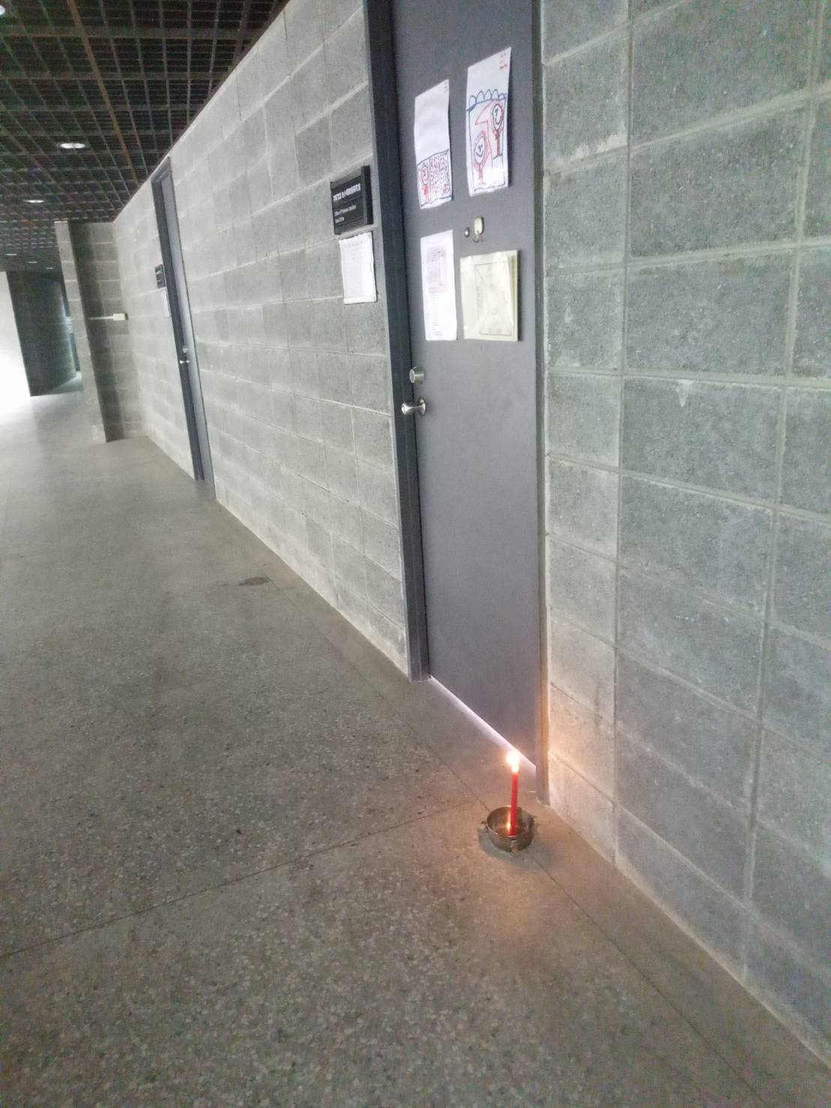
6-4
Although a day of
  sorrow
  disappointment
  the shattering of an illusion.
But a day God used to start to expand his kingdom from the countryside to the universities and heights of learning....

