Slide 1
Thoughts
J D White

Slide 2
Our 4 Questions…
"What is the content?",
"Why did people respect/trust this book?",
"How it affect the lives of influential humans?“
“How can this help me to have a better life?

Slide 3
Eg. Polar Winds Stop
Many horrible disasters in Revelation…
In middle, one seems strange: “polar wind stopped”
I (bxm) used to think, “Huh???”
Recently understand from global climate change models (Paul Beckwith)
  → predicting decrease in polar wind
  → affects will be worldwide
  → Typhoons move slow – more rain, fewer places

Slide 4
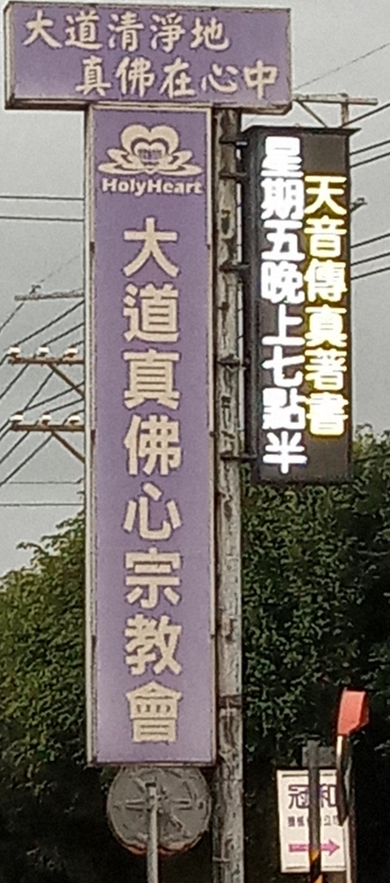
Venues for Visits
We have selected venues for you to attend. Why?
Told person in charge students may come so they are ready to sign.
They will welcome you.
Check that they normal.
E.g. Originally I thought to attend…

Slide 5
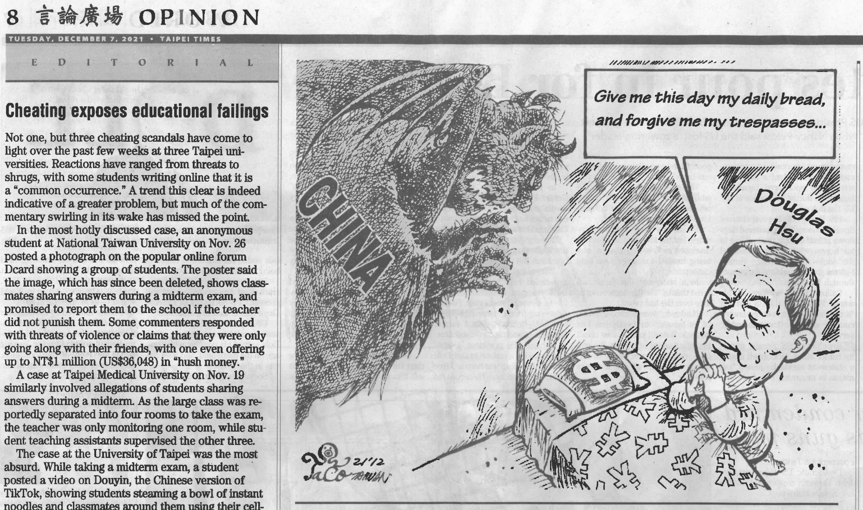
Influence: Taiwan Newspapers

Slide 6
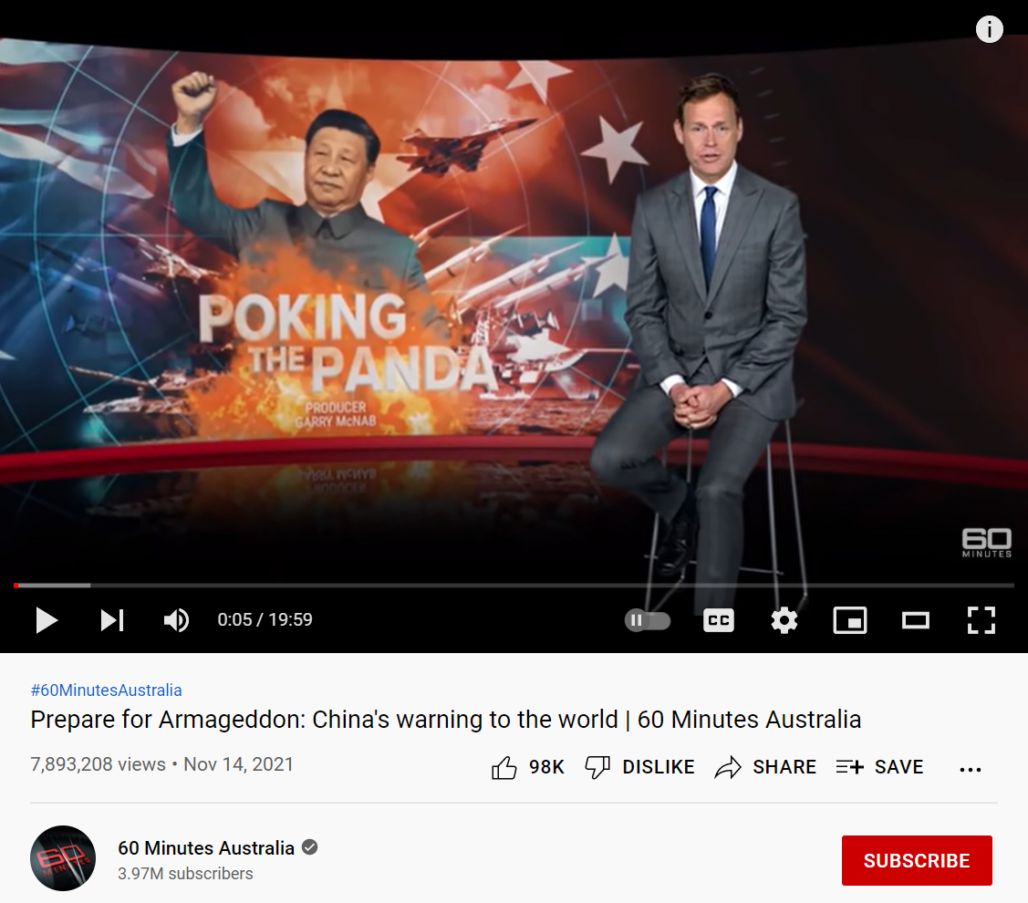
Influence: International News

Slide 7
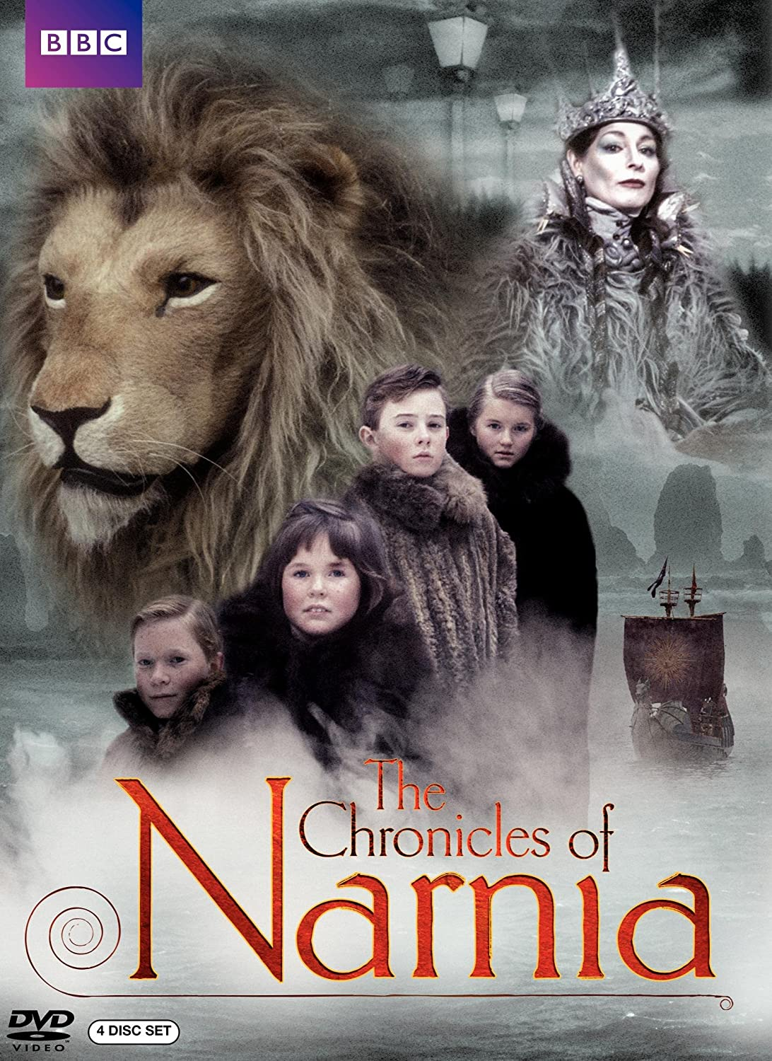
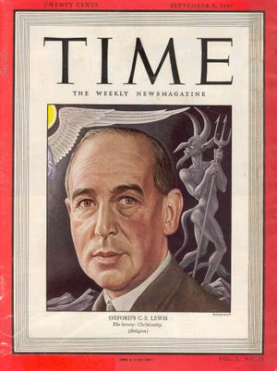
C S (Jack) Lewis
Influence: Literature

Slide 8
As the Ruin Falls
By C S Lewis
Phil Keaggy
All this is flashy rhetoric about loving you.
I never had a selfless thought since I was born.
I am mercenary and self-seeking through and through:
I want God, you, all friends, merely to serve my turn.
Peace, re-assurance, pleasure, are the goals I seek,
I cannot crawl one inch outside my proper skin:
I talk of love – a scholar's parrot may talk Greek –
But, self-imprisoned, always end where I begin.
Only that now you have taught me (but how late) my lack.
I see the chasm. And everything you are was making
My heart into a bridge by which I might get back
From exile, and grow man. And now the bridge is breaking.
For this I bless you as the ruin falls. The pains
You give me are more precious than all other gains.

Slide 9
當廢墟崩塌時 Tr. David Chang
說愛你全是花言巧語
我生來就是自私自利
徹頭徹尾的功利思想
上帝、你們、朋友、全是我的利益所在
我追逐的是平順、 穩當、和快樂
從不為別人著想一分半毫
高談大愛—學者口裡總能吐出舌燦蓮花
然而到底是自說自話，百無用處
而如今你使我缺陷我認清了自己的缺失
（這樣的覺悟來得太晚）
我見到了一道鴻溝。一直以來你都設法在我心裡搭一座橋，
等待我能迷途知返，長大成人。而這座橋正在崩塌。
我為崩塌的廢墟感謝讚美。你是我經歷了痛苦，
這一切要比其他的收獲更加難能可貴。

Slide 10
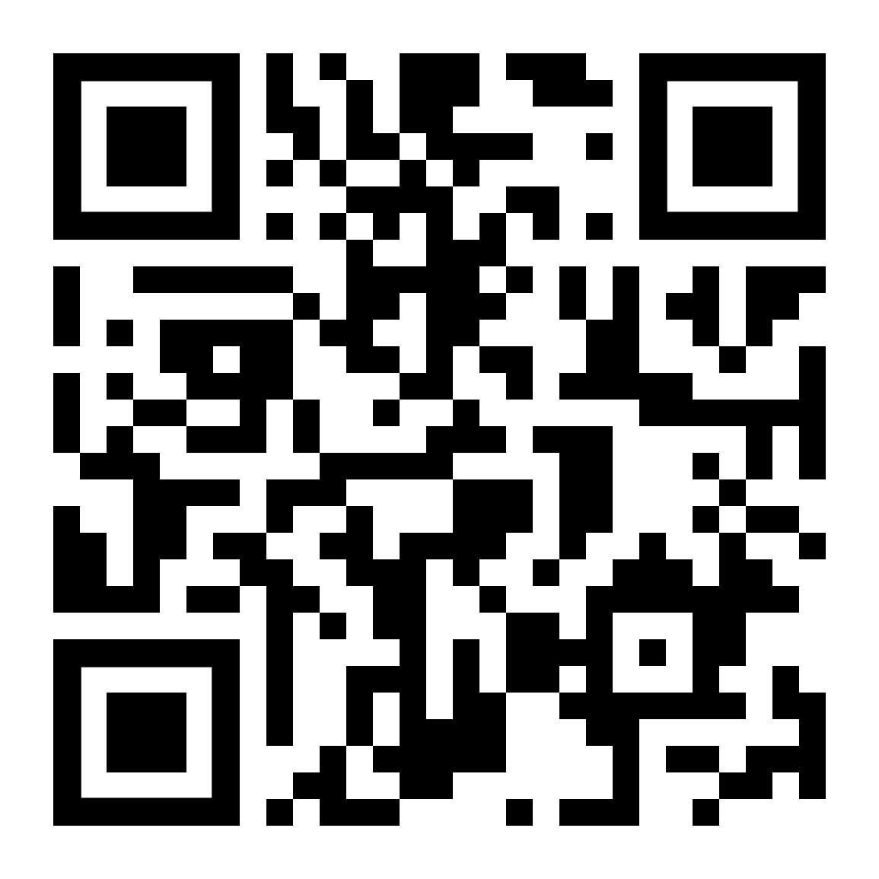
Test Time

Slide 11
Jesus, Moses & Religion
Last class

Slide 12
Love and Families
Moses: 2 Families
Love
God as Father
Us as Family
Freedom Jealousy
Forgiveness
love
孝
honor
愛
Problem
-broken relationships
- External (honor)
not Internal (love)
Notes:
Moses taught basis of relationships: 2 families
--- God love and we have filial piety
-- the family is the image of the relationship with God.
Forgiveness and religion. (last class)
But people forgot that the Key in relationships is LOVE
And both Hebrews and Chinese (Confucious) only remembered the outward act of filial piety but forgot the basis: LOVE
LOVE Jesus called people to repent. Reminding them that the basis of filial piety is love. He told them God would forgive
But what does love involve (Bible)?
Freedom to choose
Jealousy
Forgiveness
E.g. boy-girlfriend
But relationship has been broken since we don’t acknowledge father’s ideas.
Our lack of filial piety.
--NEW SLIDE----------------------
LOVE Jesus called people to repent. Reminding them that the basis of filial piety is love. He told them God would forgive them.
But how restore…
Religions;
- be a good person
- good works > bad works
- do this or that.
But let us think about the issue from family perspective…
- If you have broken relationship with your parents, how do you restore relationship?
Do you try to be a good person, do nice things for others? Would this help? NO
You go to your parents and say “I am sorry. I did wrong.”
What do your parents do? They hug you and forgive you.
Jesus said it is the same way with Father God.
- He wants us to confess our sin
Ask his forgiveness
Rejoin the family and honor/love him as Father.
Parable of the Lost Son
--------------- New Slide -------------------
: Parable of the lost son.
But one question this raises is about justice?
If you do wrong you should pay a penalty.
Ie. If you cheat on test, you fail – even you say sorry… As older brother said; “Unfair”
Our relationship is restored but still there are consequences.
The consequences of sin is death.
But we don’t need to pay the consequences – Jesus did when he died on the cross.
We know God the Father accepted Jesus’ sacrifice because Jesus rose from the dead.
This is the “good news” or religion called Christianity.

Slide 13
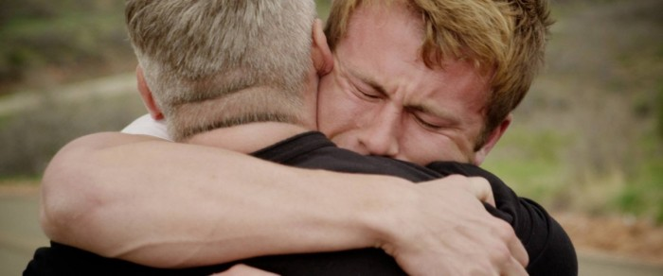
Recovering the Relationship
I was wrong.
I am sorry.
Please forgive me.
→ Rejoin the family.

Slide 14

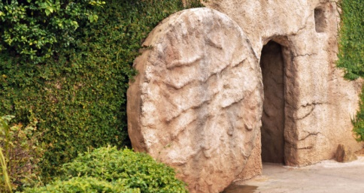
What about Justice?
He was pierced for our transgressions. He was crushed for our iniquities. The punishment that brought our peace was on him; and by his wounds we are healed. All we like sheep have gone astray. Everyone has turned to his own way; and Yahweh has laid on him the iniquity of us all. Isaiah 53:4-5 (500 BC)

Slide 15
他誠然擔當我們的憂患、
背負我們的痛苦．
我們卻以為他受責罰、
被 神擊打苦待了。
⁵那知他
為我們的過犯受害、
為我們的罪孽壓傷．
因他受的刑罰
我們得平安．
因他受的鞭傷
我們得醫治。

