Slide 1
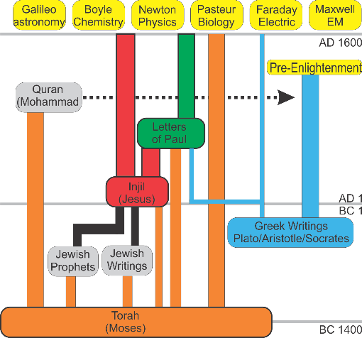
Greek Philosophers and How They Affect Us Today
Socrates → Plato → Aristotle
Joseph Shultz 2019.05.17

Slide 2
500BC to 330BC: Instability
Greece
China
Pythagoras (570-490)
Socrates (469-399)
Plato (428-347)
Aristotle (384-322)
Euclid (325-265)
Confucius (551-479)
  10 disciple(72 master)
Zengzi子輿(505-436)
Zisi 子思 (483-402)
Mencius孟子(372-289)
Xunzi 荀況 (310-238)
Warring States

Slide 3
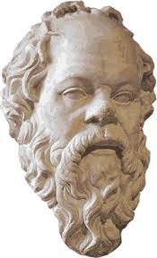
Socrates – The Man
470-399 BC
Soldier, teacher, philosopher
Put on trial in Athens and forced to commit suicide.
Student is Plato.
no documents that can be attributed to him, called the “Socratic problem”.
Known from Plato’s writings
  Dialogues
  Apology

Slide 4
Quotes by Socrates.
I cannot teach anybody anything, I can only make them think.
Know thyself.
The only true wisdom is to know nothing.
Falling down is not a failure. Failure comes when you stay where you have fallen.

Slide 5
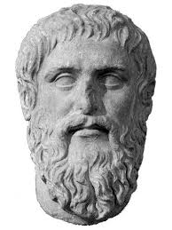
Plato – The Man
Born 428 or 427 BC in Athens, died 346 or 345.
Philosopher and wrestler
Innovator of dialogue and dialectic forms
Influenced by Pythagoras (mathematics)

Slide 6
Plato’s Ideas
Innovator of Platoism or the platonic form
2 kinds of form: abstract and concrete.
The ultimate form is the universal-the “ness”
Provides a definition-”What is . . .”
  What is Taiwan?
  What is home?
Soul is immortal

Slide 7
Plato’s Influence
Epistemology-Wisdom and knowledge
Ethics-Good is supreme, but no one does bad on purpose.
Politics-Only a few can rule, the “Philosopher King”
His writings have influenced Western thought for 2400 years, especially the idea of the abstract and the concrete.

Slide 8
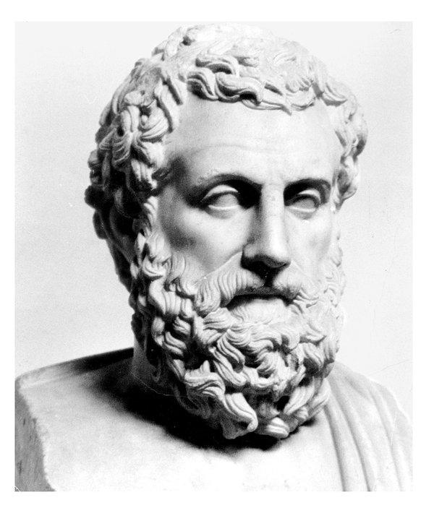
Aristotle – The Man
Born 384 BC
Died 322 BC
Tutor to Alexander the Great,
Founded schools of philosophy in Macedon and Athens.
Wrote treatises on many kinds of subjects

Slide 9
Aristotle’s Ideas (1)
Used logic
Example:
  All men are mortal
  All Greeks are men
  ⸫ All Greeks are mortal
Father of analytics
Epistemology-there is a natural world and a metaphysical world.
There is substance and essence, potential and actual.

Slide 10
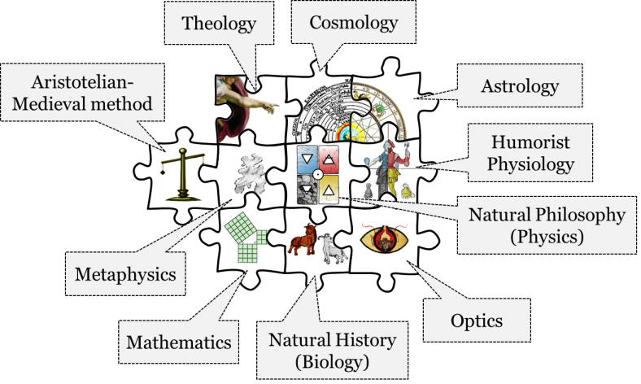
Aristotle’s Ideas (2)
Natural philosophy
Physics
  Motion (vfall = g × m)
  optics
  astronomy,
Geology, Biology.
Just War Theory
Ethics,
politics,
economics,
rhetoric.
http://hakobsandbox.openetext.utoronto.ca/part/chapter-7/

Slide 11
Aristotle’s Influence
Has influenced thought & science for 2300 years.
Middle Ages, Islam, Renaissance, and now renewed interest in the 21st century.
The father of critical thinking
  Why is Taiwan?
  Why is home?
Democracy

