Slide 1
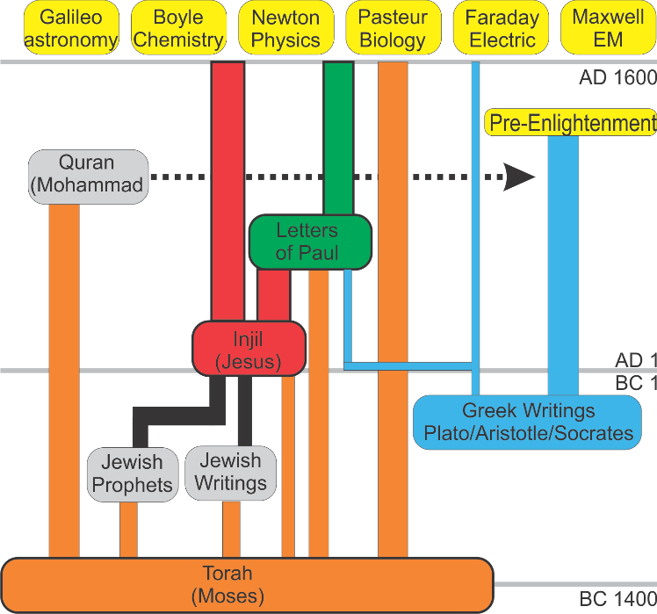
Greek History
From Persian Wars to Alexander
Presented by Joseph Shultz
2019.05.17

Slide 2
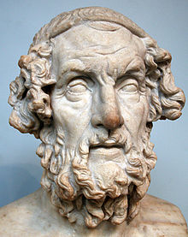
Background: Homer
Key Figure in Greek thinking
~850 BC
Books
  The Odyssey
  The Iliad (Trojan Horse)
Cannot fight your Fate/Destiny

Slide 3
500 to 330BC: Instability
Greece
China
Pythagoras (570-490)
Socrates (469-399)
Plato (428-347)
Aristotle (384-322)
Euclid (325-265)
Confucius (551-479)
  10 disciple(72 master)
Zengzi子輿(505-436)
Zisi 子思 (483-402)
Mencius孟子(372-289)
Xunzi 荀況 (310-238)
Warring States

Slide 4
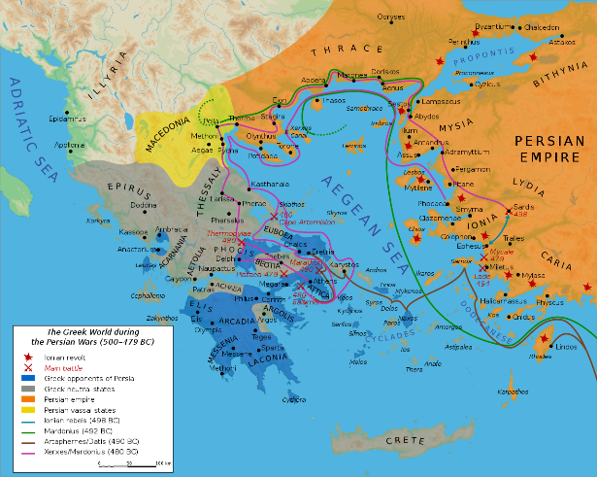
Greece Versus Persia
Greeks began settling Asian coast (Turkey)
Persians were angry
Two invasions of Greece
  Darius I (490 BC)
  Xerxes I (480 BC)
Fight: Greek Democracy vs Persian Autocracy
Palatae: Athens and Spartans unite
Marathon: Other Greeks Join (490BC)
Thermopylae: 300 Spartans (480BC)
Persia defeated (Time of Socrates)
https://upload.wikimedia.org/wikipedia/commons/thumb/3/3a/Map_Greco-Persian_Wars-en.svg/1280px-Map_Greco-Persian_Wars-en.svg.png

Slide 5
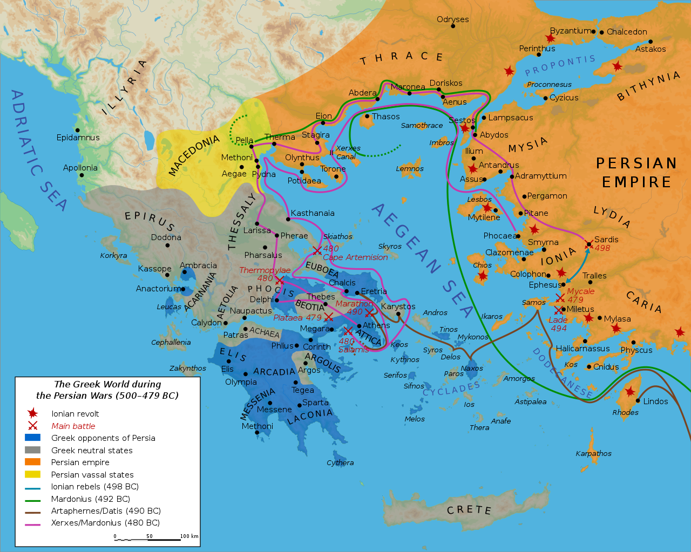
Greece in War with Persia
https://upload.wikimedia.org/wikipedia/commons/thumb/3/3a/Map_Greco-Persian_Wars-en.svg/1280px-Map_Greco-Persian_Wars-en.svg.png

Slide 6
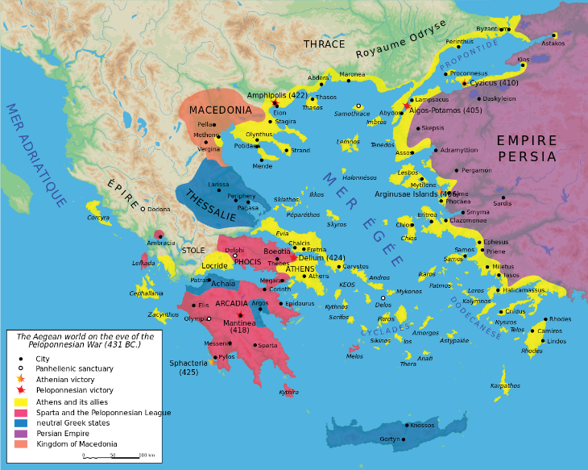
Peloponnesian War
Greeks divided.
Athens vs Sparta
  Athens: good navy
  Sparta: good army
  Stalemate
Persians help Sparta →Sparta wins
Greece made weaker (Time of Plato)
https://upload.wikimedia.org/wikipedia/commons/thumb/5/57/Map_Peloponnesian_War_431_BC-en.svg/1280px-Map_Peloponnesian_War_431_BC-en.svg.png

Slide 7

Greece during Peloponnesian War
https://upload.wikimedia.org/wikipedia/commons/thumb/5/57/Map_Peloponnesian_War_431_BC-en.svg/1280px-Map_Peloponnesian_War_431_BC-en.svg.png

Slide 8
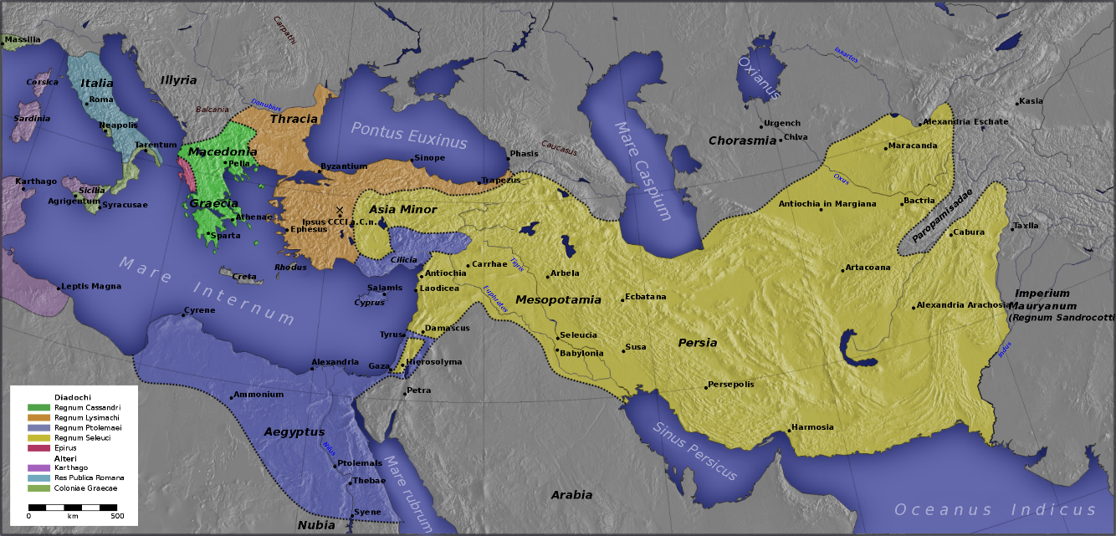
Alexander the Great
Born in Macedon (356BC) (Tutor is Aristotle)
Unites Greece. Revenge against Persians.
Makes it all the way to India.
Greatest military mind in history.
Warring States
Period (China)
(475–221 BC)
https://en.wikipedia.org/wiki/Diadochi#/media/File:Diadochi_LA.svg

Slide 9

Alexander the Great
https://en.wikipedia.org/wiki/Diadochi#/media/File:Diadochi_LA.svg

