Slide 1

Exodus (The Exit)
Moses – Start of Written History
Living/Writing 1400BC (3400 years ago)

Slide 2
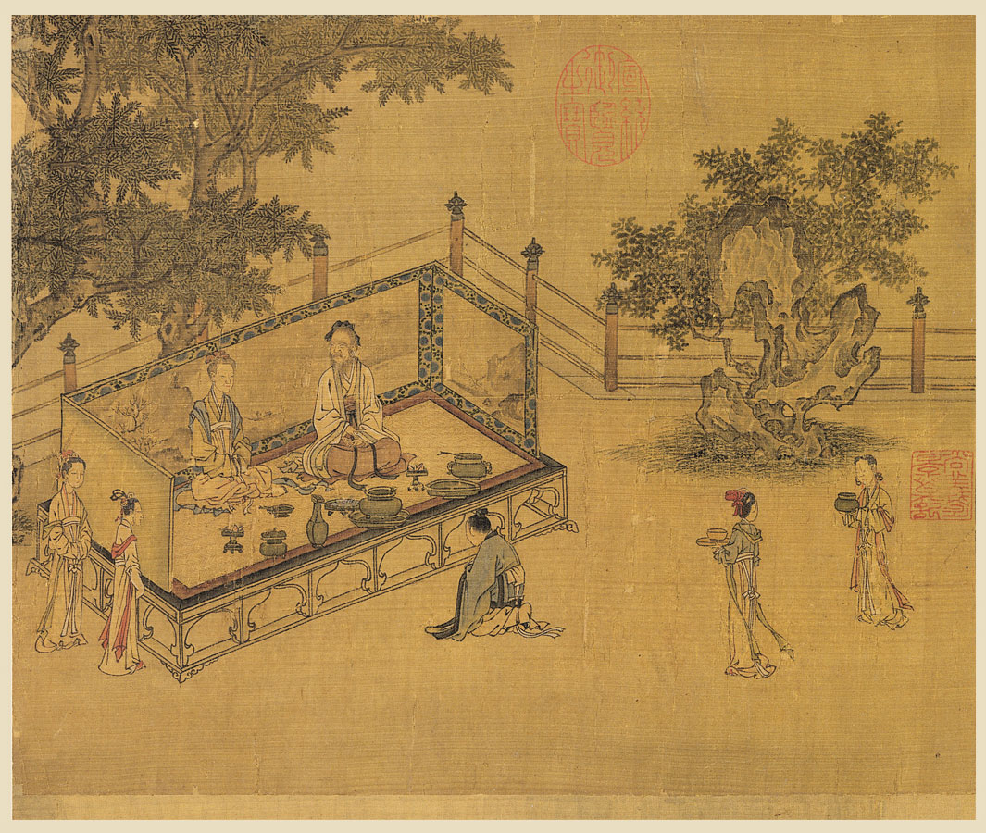
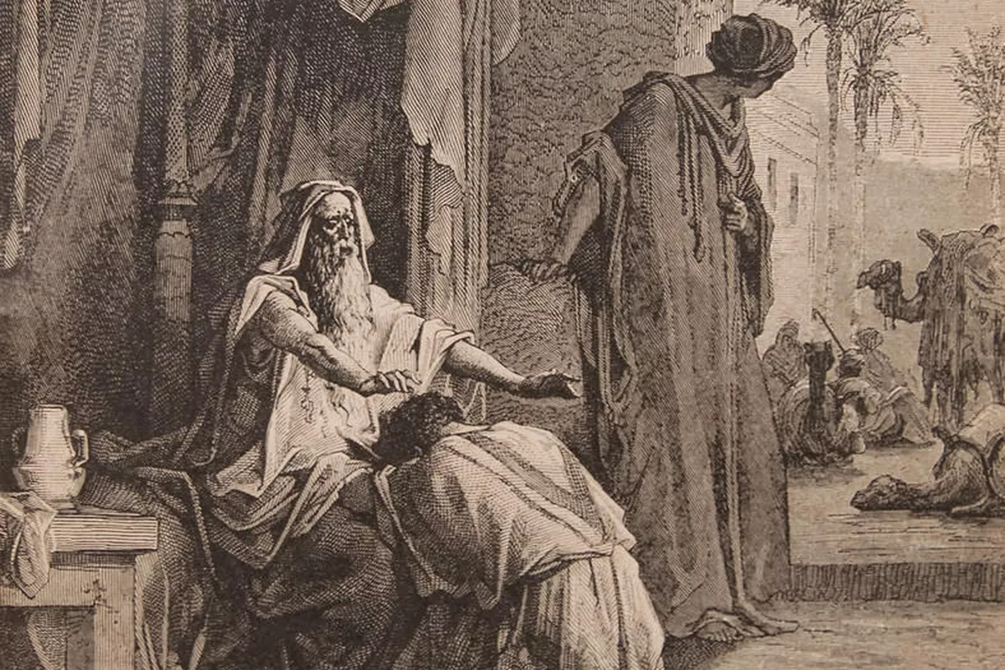
Review: Gn 1,2
關系
relationship
距離
separation
愛
love
孝
honor
In the Beginning (1st & 2nd Dispensations) Genesis 2 & 3

Slide 3


Review: Gn 3 promise
關系
relationship
距離
separation
愛
love
孝
honor
Promise: Reconciliation (initiated by God, at future time)

Slide 4
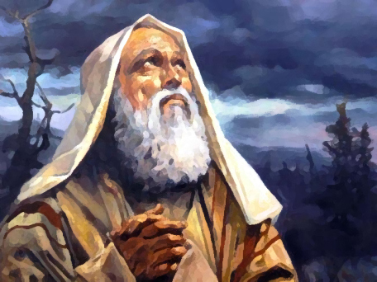

Oral History: Abraham 1800 BC
Many years have passed since creation.
The focus sharpens to a single man
Abraham 亞伯拉罕
Father of…
  Jews (Judaism)
  Arabs (Islam)
  (Christianity)
His family line…
Summary

Slide 5
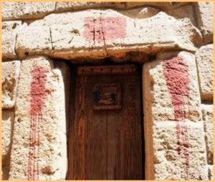

Overview Moses (1400BC)
Prophecy to Abraham
King’s men Murder Baby (Slave) Boys
God’s Concern for Slaves / Sending Moses @ 80
The King vs God
Final Plague → Passover
Through the Red Sea to Freedom
God gives Law
  Honor Heavenly Parent (basis of honor is love)
  Honor Earthly Parent
  Blood sacrifice for sin/rebellion

Slide 6
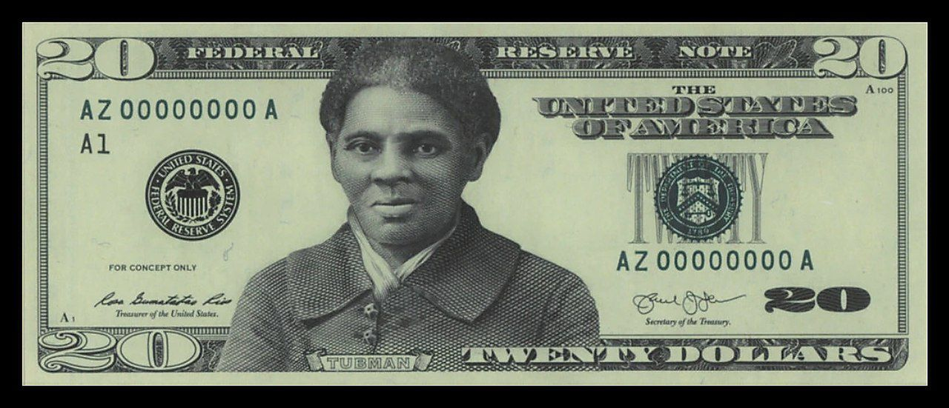
Influence: Harriot Tubman
-To be honored on US$20 to be issued in 2020 to commemorate women’s voting rights.
- But changes in all US$ bills postponed in 2019 to 2028

Slide 7
Key Points & Group Discussion
上帝... Observe God...
  知道未來 knows the future (e.g. warned Abraham)
  所眷顧 cares for his children
  給我們好多機會悔改 gives us many chance to repent
  通過人 works through people (e.g. Moses)
  用謙卑的人 uses humble people
  可以讓我們做不可能的事 can use us to do impossible
思考... Reflect on God...
  上帝掌管。 God is in control.
  抵擋上帝不是一個聰明的選擇。 Not a good idea to fight with God!
  受辱的，上帝關心。Shamed? God cares for you!
  難道你不想與這樣的上帝有關係？ Don't you want a relationship with this type of God?
  難道你不希望上帝讓你幫助別人嗎？Don't you want to be used by God to help others?
Discuss
  If you were in situation of Harriet/Moses
    Would you choose freedom or family?
    Would you leave freedom to go back many times to help others?
    What was their motivation?
  Why do you think that 3400 years later
    Moses’ life has so much impact?
    Moses’ writings have so much impact?
  孝的意思是什麼? What is the meaning of “filial piety” (~honor in English) ?
  The bible talks about 罪 (sin). Is the biggest sin a lack of filial piety?
  Are you a sinner according to the Bible? Why or Why not?

