Slide 1

Mid-Term Class Review
Moses – Start of Written History
Living/Writing 1400BC (3400 years ago)

Slide 2
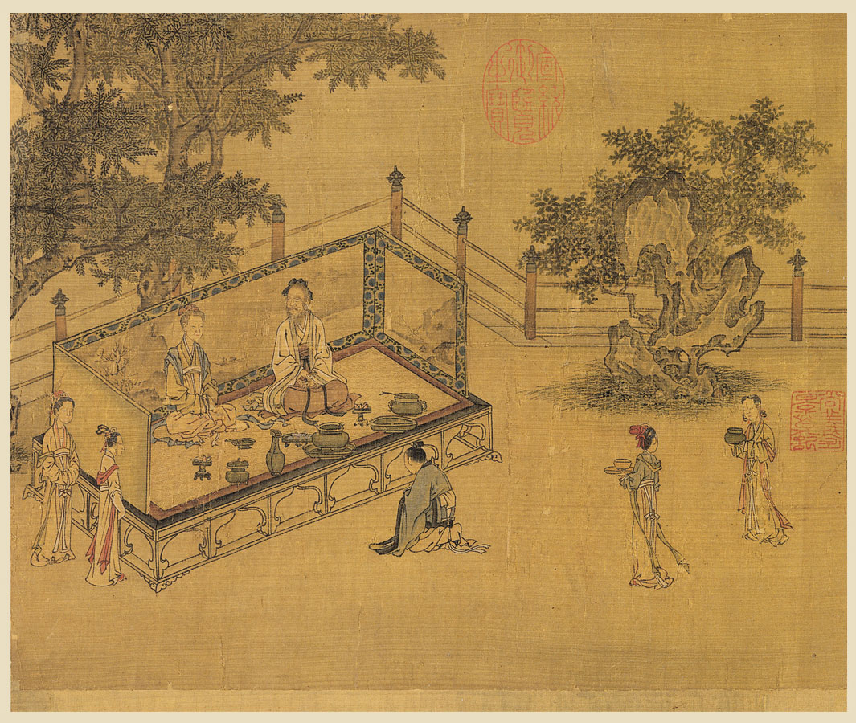
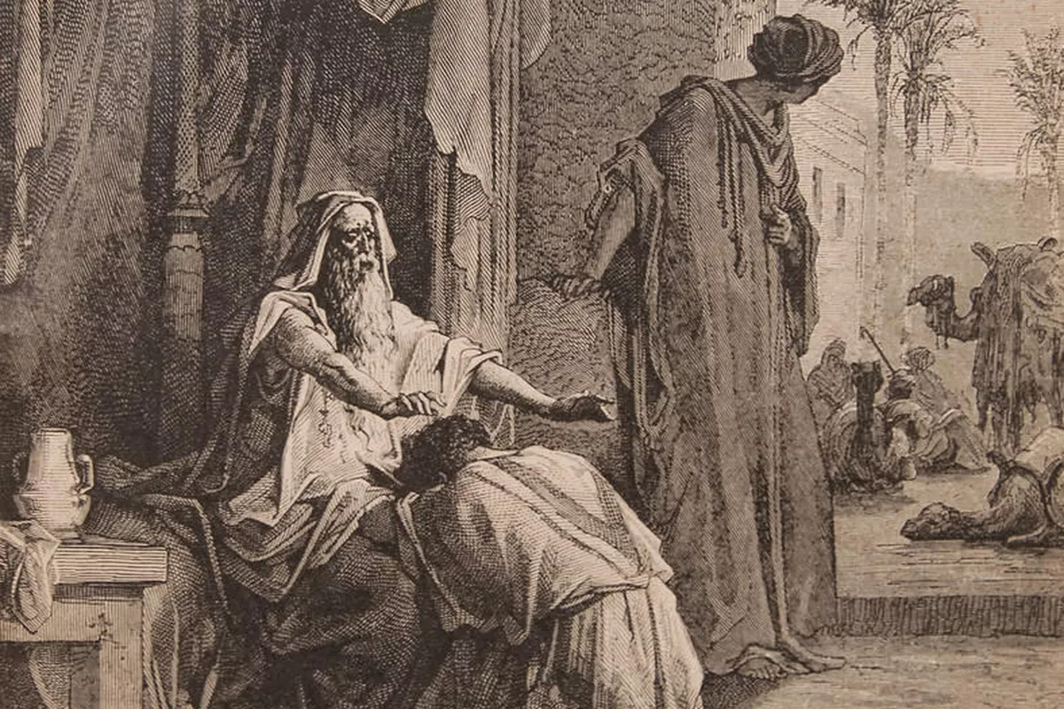

Review: Gn 1,2
關系
relationship
隔離
separation
愛
love
孝
honor
In the Beginning (1st & 2nd Dispensations) Genesis 2 & 3

Slide 3

Review: Gn 3 promise
關系
relationship
隔離
separation
愛
love
孝
honor
Promise: Reconciliation (initiated by God, at future time)

Slide 4
Moses & Genesis
Beginnings of Human Race
  Oral History
  put in Writing by Moses
  Genesis 1-11
Beginnings of the People of God
  Oral History
  Put in Writing by Moses
  Genesis 12-50

Slide 5
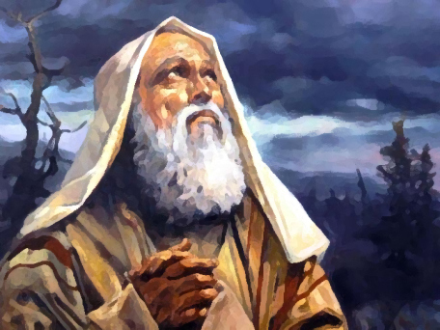
Oral History: Abraham 2100 BC
Many years have passed since creation.
God continues his plan → through a family
Abraham 亞伯拉罕的生命
  Father of Jews
  Father of Arabs (Muslims)
  (Spiritual) Father of Christians
Summary

Slide 6
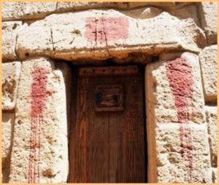

Overview Moses (1400BC)
God continues his plan: through a nation
Prophecy
King’s men Murder Baby (Slave) Boys
God’s Concern for Slaves / Sending Moses @ 80
The King vs God
Final Plague → Passover
Through the Red Sea to Freedom
God gives Law
  Honor Heavenly Parent (basis of honor is love)
  Honor Earthly Parent
  Blood sacrifice for sin/rebellion

Slide 7
Chinese Characters Tell Story

Slide 8
Greek Philosophers & Alexander
Their importance (Khan Academy: Socrates, Plato and Aristotle)
Further Study…
  Socrates and their legacy
  Aristotle – Plato’s most brilliant student, and Alexander the Great’s Tutor

Slide 9
Replacement Quizzes
Do quizzes based on the number of people who need to replace the quiz
Look for your name on the sheet for the quiz you will write.

