Slide 1
Moses's Writings: Genesis.
The Problem of Good and Evil
摩西的著作：創世紀。 善惡問題
Date: 22.10.13
Presenter: Jonathon White

Slide 2
Review 復習

Slide 3
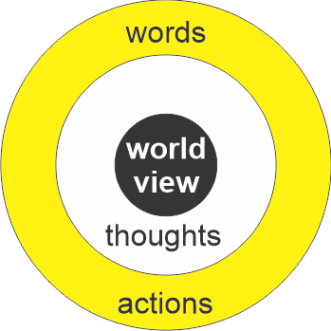
Religion ≠ Worldview
I have no religion. “我沒有宗教！”
But you have a worldview
Everyone has…
Even if they have not thought it through…
Religion ≠ Worldview
But your religious background contributes to your worldview

Slide 4
Moses – Author of the Torah –
1400 BC
摩西 – 律法書的作者 –
公元前 1400 年
Presenter: Jonathon White
Notes:
If you are using the class order: 3:Creation 4:fall 5:exodus
then can first show Bible Project Video Genesis Part 2

Slide 5
Moses’ Writings (5 oldest books)
Names Differ
  Jews: “The Torah” (教学書)
  Muslims: “The Tawrah”
  Christian (English): “The Pentateuch” lit. the 5 Books
  Chistian (Chinese) 律法書 (The Law)
Contents are the Same
  Genesis (pre-history)
  Exodus (History: slave’s freedom from Egypt)
  Leviticus (Laws for a New Nation)
  Numbers (History: Moses’ leadership of Israel)
  Deuteronomy (Laws for a New Nation: 40 years later)
How was Genesis written…
  Muslims/Orthodox Jews: God spoke → Moses wrote
  Atheist:
    Many people wrote and had discussions (like a class project)
    Moses was a brilliant man who collected prior knowledge (oral tradition + books that no longer exist) and put together the story in a clear logical manner
  Christians:
    God spoke → Moses wrote
    Moses wrote using prior knowledge of oral tradition and God made sure he made no mistakes.

Slide 6
Last Week: Three Creation Stories
Big Picture: Universe
  Only 1 God
  Creator of all (4D: x,y,z,ct)
  Self-existing (outside time-space)
Creation of Earth (Poetry)
  Earth: time-order, logical sequence, all good, 1/7 rest
  Man: nature: God’s image, Equality: man/female, Work: care for creation, Food: Vegetables
Creation of man (Prose)
  Unique: For Relationship
  Privilege: Free Choice
  Woman part of man: separate incomplete
  Marriage: 1 man/1 woman/1 life, new family
Check Your
Answers
So What?

Slide 7
Today’s Class
今天的課程

Slide 8
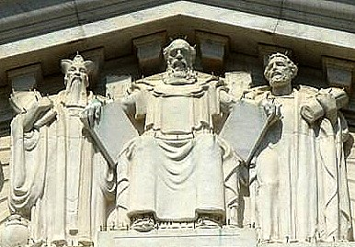
The Law: Key Lawgivers
Confucius Moses Solon
China Israel/Egypt Greece
500BC 1400BC 600BC
US Supreme Court Building, Washington DC, USA

Slide 9
A Big Question 一個大問題
Why is there evil in the world? 為什麼會有邪惡？
Why do people do bad things? 人為什麼要做壞事？
Is man good and then becomes evil? 人是善的，然後就變成惡的嗎？
Is man evil and teaching and laws stop him from doing evil? 人是邪惡的，教義和法律阻止他做惡嗎？
How many people would break any law if they knew they could get away with it? (Plato) 如果有多少人知道自己可以逍遙法外，他們會違法？ （柏拉圖）
  survey of male university students (Sarah Edwards): 10-30% said they would rape a classmate if no consequences (Problem is a small sample size)

Slide 10
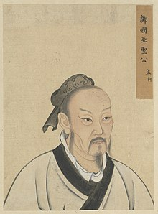
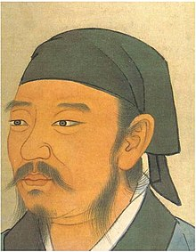
Confucius’ Disciples
人本為善
人本為惡
Mencius (孟軻):
Man is basically good
Environment makes him evil
Xunzi (荀子/荀況):
Man is basically evil
Need laws to train him to be good

Slide 11
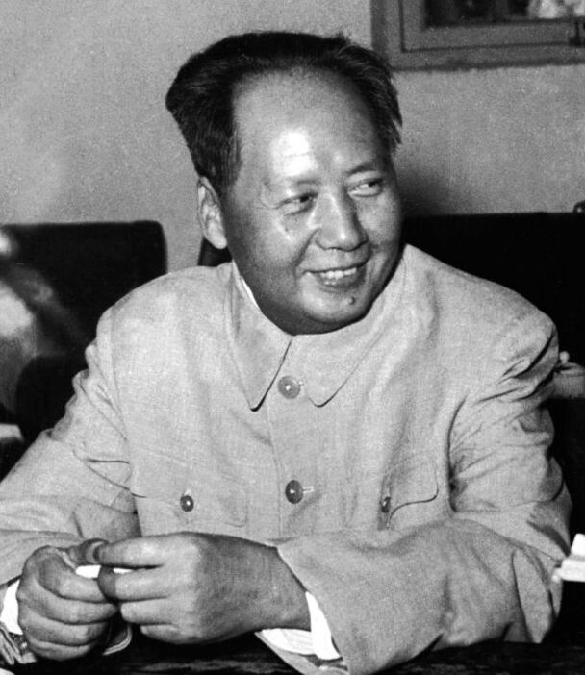
Mao Zedong 毛泽东 – Both!
~5-10% of people are good and will remain good no matter what happens
~5-10% of people are bad and will remain bad no matter what happens
~80% of people can be trained to be good or evil by the environment
→ Implications
  5% of the population needs to be eliminated
  5% can rule (CCP)
  80% of the population needs to be re-educated → Cultural Revolution

Slide 12
What did Moses think?

Slide 13
Review Moses: Genesis 1→2
All is good.
Man - Woman - Father God → harmonious relationship.
Man/woman are in the image of God
Work is a responsibility of man but is joyful
Man/woman are vegetarians (no killing of animals for food)
“And God saw it was good”
So, we have Moses and Mencius agreeing
But how do we account for evil?
好

Slide 14
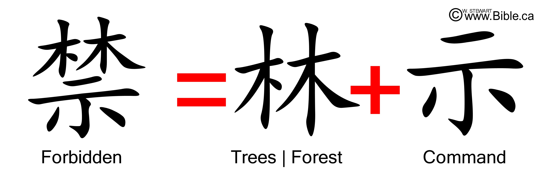
2 Trees : 1 Rule (Genesis 2:9,16)
Ref: https://www.bible.ca/ark/chinese/bible-evidences-chinese-language-characters-words-garden-of-eden-genesis.htm
First one tree, then 2nd tree forbidden
Lets see what happens after some time…
  (Genesis 3)

Slide 15
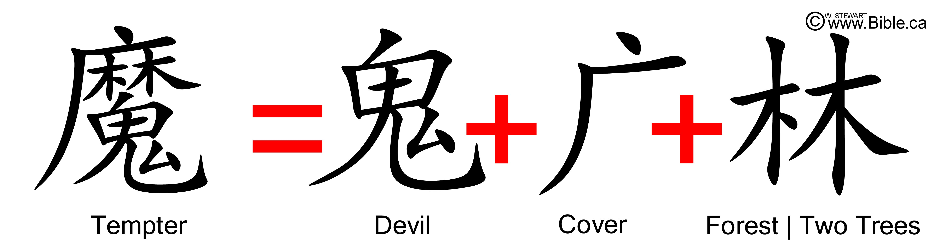
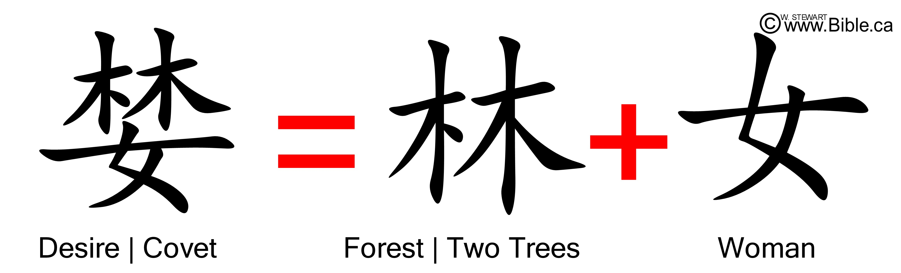
Genesis 3: Evil Enters the world

Slide 16
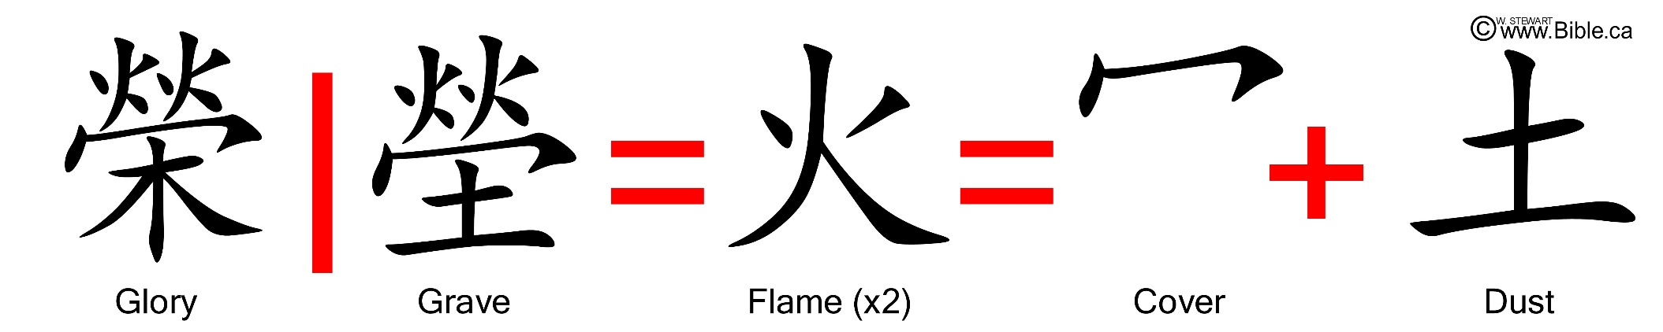
Consequences of Rebellion
Because of this decision glory has been replaced with shame and death
The image of God in man, while still present, is distorted.
Work becomes hard and relationships broken

Slide 17
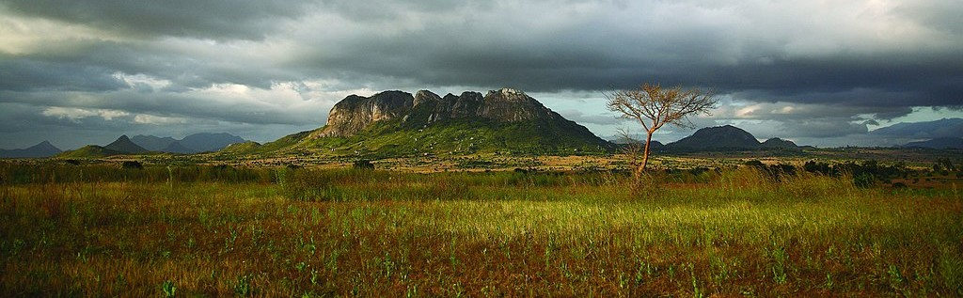
Life Outside the Garden (Gen 4)
Man is the master of his destiny
The first family divides labour:
  Cain: fruit & vegetables for food
  Abel: Sheep for wool (garments)
The first murder & death

Slide 18
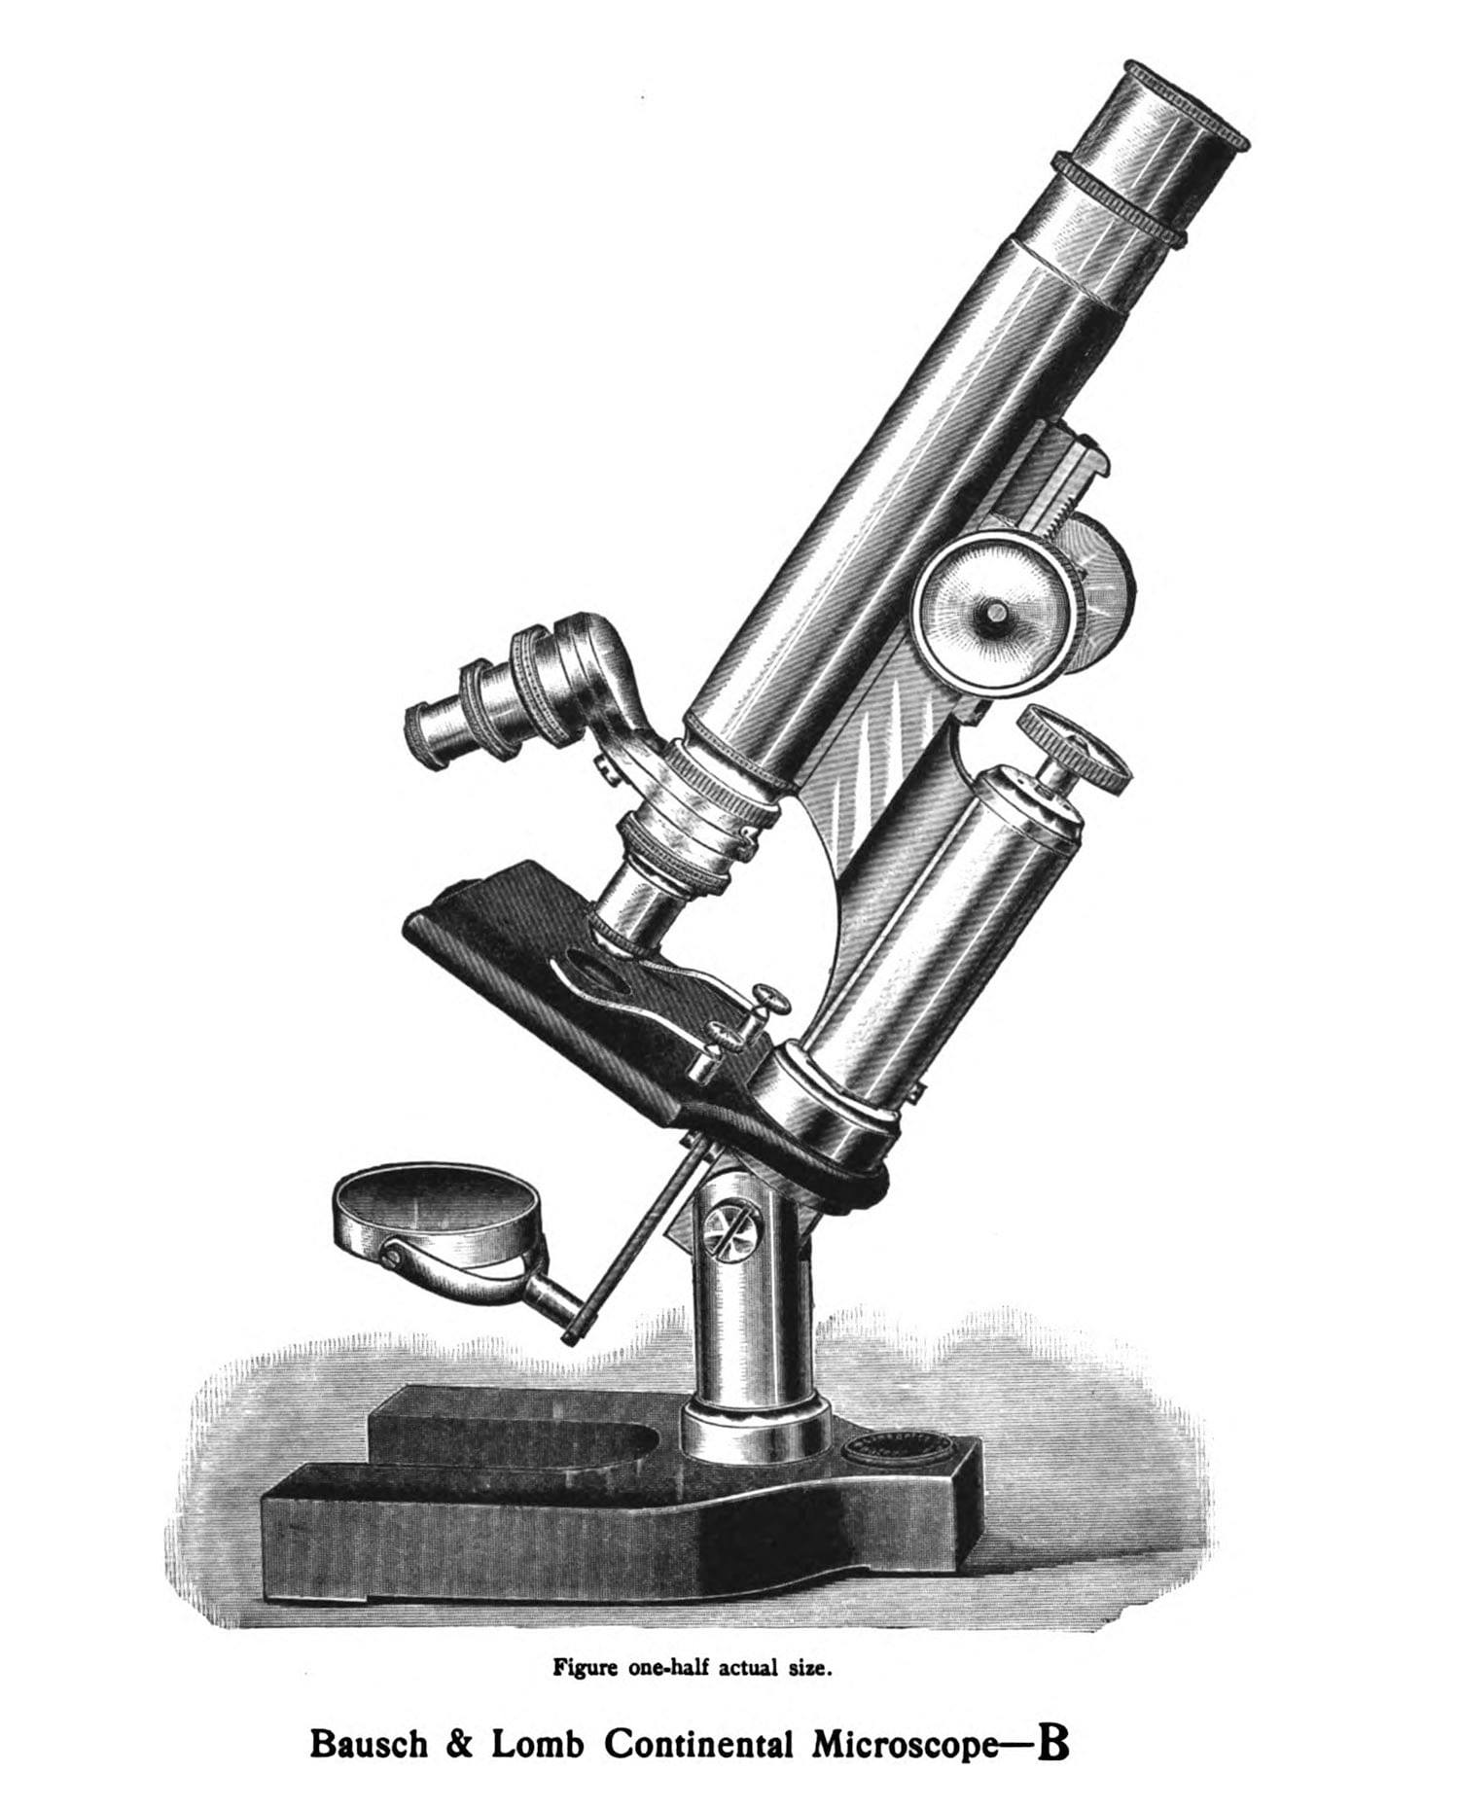
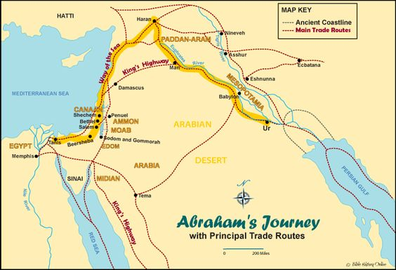
Abraham (1800 BC): Gen 22:1-19
Father of Jews (Son: Isaac)
Father of Arabs (Son: Ishmael)
Ancestor of Jesus (→ Christians)
Life Story of Abraham (25’)
https://youtu.be/DG7SjcOWcoI?si=ObBCaTOxJwLq3lbO&t=59

Slide 19
SG Discussion: Your thoughts?
Your thoughts on evil…
  Is this explanation for the existence of evil in the world reasonable? Why?
    Father-God made man good to have a relationship with him like a family
    Man chose to rebel and reject his father, resulting in the relationship being broken
    God respects his child’s decision, lets him go his way – But hopes for restoration…
  Do you think man is good or evil at heart? Why?
You and Relationships…
  What is the most significant relationship in your life?
  Why is this relationship important to you?
  Has there been times when this relationship is broken? If so, why did the relationship break?
  How do you feel?
  What broken relationships do you see in your daily life?
  Why do you think these relationships became broken?
You and God…
  How would you describe your relationship with God?
    [None || Enemy || slave:master || child:father]
  If it was possible to have a good relationship with God, would you be interested?

