Slide 1

Religion ≠ Worldview
人說: “我沒有宗教！”
But…
You have a Worldview
Everyone has one…
Even if they have not thought it through…
Religion ≠ Worldview
But your religious background may contribute to your worldview

Slide 2
Moses
– Author of the Torah –
1400 BC
摩西
– 律法書的作者 –
公元前 1400 年
Presenter: Jonathon White
Notes:
If you are using the class order: 3:Creation 4:fall 5:exodus
then can first show Bible Project Video Genesis Part 2

Slide 3
Moses’ Writings (oldest books)
Called by
  Jewish people: “The Torah”
  Muslims and Arabs: “The Tawrah”
  Christian English speakers: “The Pentateuch”
Contents
  Genesis (pre-history)
  Exodus (History, life of Moses, slave’s freedom)
  Leviticus (Laws for a new nation: First Revision)
  Numbers (History of Moses’ leadership of Israel)
  Deuteronomy (Laws for a new nation: Final Revision)
How is Genesis written
  Muslims/ Orthodox Jews: God spoke: Moses wrote
  Atheist:
    Many people wrote and had discussions (like a class project)
    Moses was a brilliant man, who collected prior knowledge (oral tradition + books that no longer exist) and put together the story in a clear logical manner
  Christians: Moses wrote using his prior knowledge of oral tradition and God made sure he made no mistakes.

Slide 4
But Who was Moses?

Slide 5
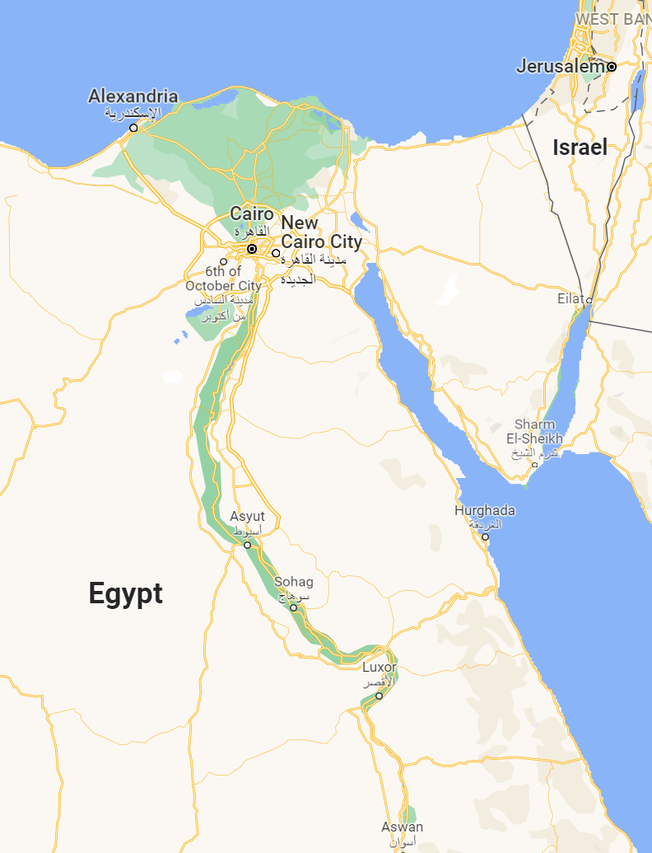

Historical Setting 背景
xxxx BC Creation
xxxx BC Man is created good
xxxx BC Man rebels (chooses evil)
xxxx BC Universal flood
1900 BC God calls Abraham to move west to Israel
Abraham → Isaac → Jacob → 12 children inc. Joseph
1800 BC Joseph
  Sold by brothers → slave in Egypt
  Interprets Pharoah’s dream:
    7 years of plenty then
    7 years of famine
  Rises to 2nd in power
  Family (n~70) → Egypt
1500 BC Multiply (n>64*210)
  Slaves
  Construction work
  Baby boys being executed.
  Begging God for freedom

Slide 6
Life of Moses – 4 Stages
摩西的一生 – 4 個階段
Slave Baby:
Breastfed for 2-4 years?
奴隸寶寶：
母乳喂養2-4年？
Royal Upbringing:
4 - 40 years old
皇家教養：在宮殿
直到40歲
Shepherd Outcast: In
desert 40-80 years old
牧羊人在沙漠
直到 80 歲
Leader of a New Nation:
80-120 years old
新國家的領袖：
直到 120 歲

Slide 7
Many Presentations of His Life
“The Ten Commandments” (1956, 180’)
  Director: Cecil B. DeMille
  Star: Charlton Heston
  (8th most successful film (Guinness World Records)
  Oscar + 7 Academy Award Nominations
Sight & Sound Theatres (~2000 seats)
  One of the world’s largest live theatre venues
Greatest Heroes: The Story of Moses (1978, 62’)
  https://youtu.be/Q1nUIA2uGMI?si=oP33QuPq6tRJfh6C&t=226
Disney The Prince of Egypt (1998, 99’)
  Oscar for Best Music

Slide 8
Let’s Learn about Moses’ Amazing Story!
讓我們了解
摩西的奇妙故事!

