Slide 1
Greeks? Torah? Injil?
So what?
J D White

Slide 2
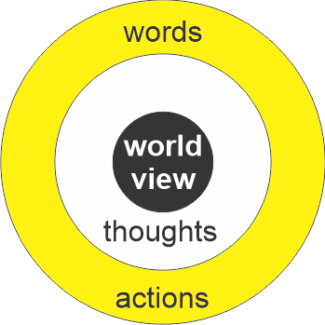
World View

Slide 3
“The unexamined life is not worth living.”
Socrates (~500BC)

Slide 4
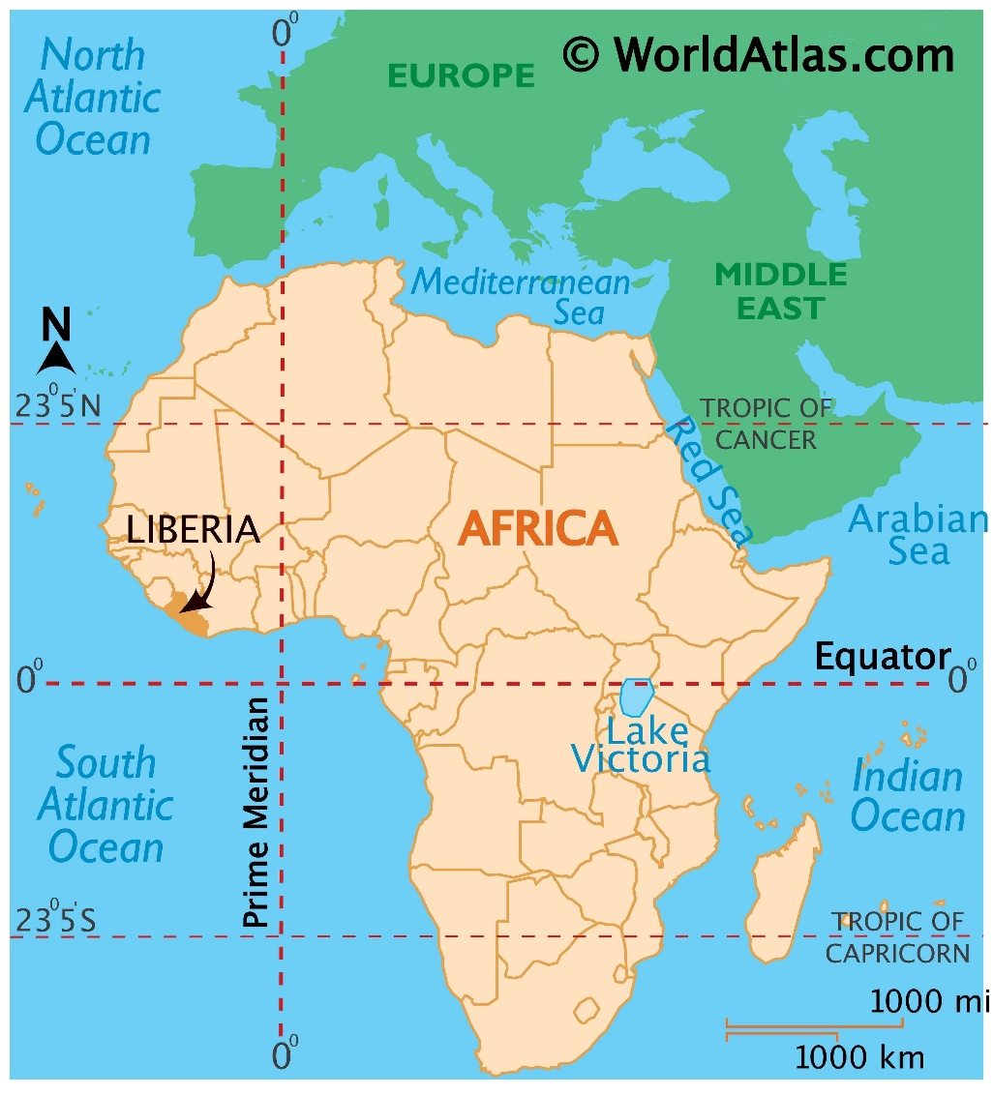
Recall: Kaboo→Samuel Morris
Born: 1873
Son of African Tribal Leader
Experiences a life-changing moment → escape from certain death
He said that this happened:
  Ropes binding him fell off
  There was a bright light
  Heard voice: “Run, Kaboo, Run”
His interpretation: Jesus saved his life.
Worked his way from Africa → America on a ship
Reluctantly admitted to Taylor University – which was going to be closed within a month
His actions/life kept Taylor University. open
Died: May 12, 1893 (only 19 or 20!)
https://www.worldatlas.com/maps/liberia

Slide 5
2.1 Greeks Philosophers (500BC)

Slide 6

Where do I find their writings?
Maintained by Gregory R. Crane at Tufts University, Bedford (Boston), USA
http://www.perseus.tufts.edu

Slide 7
1 Greeks: Who are they?
(Homer)
Socrates
Plato
Aristotle

Slide 8
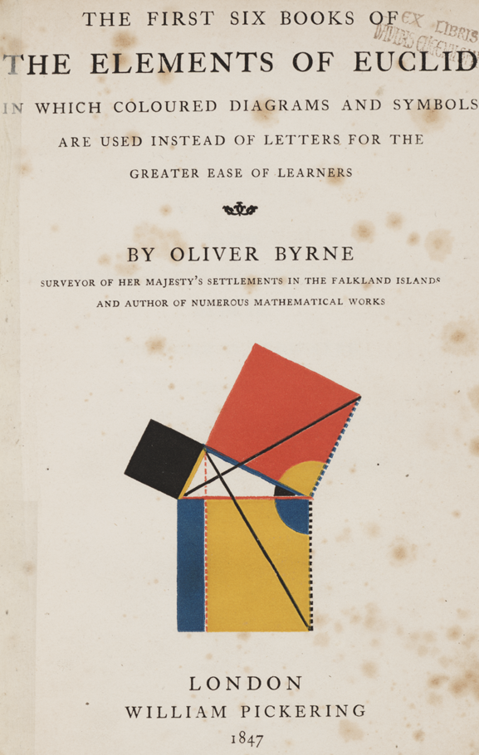
What is their Influence?
Teaching: Socrates (vs Confucius)
Logic: Aristotle
Earth-centered universe: Ptolemy
5 elements: Empedocles
Buoyancy: Archimedes
Geometry: Pythagoras (c² = a² + b²) → Euclid
Remember triangles
from Junior, Senior
High School tests?
Thank Euclid!

Slide 9
2.2 Torah and Injil

Slide 10

Where? Included in the Bible (聖經)
A Collection of Books that
Have remarkable logical consistency
Have had immense influence on Western Society
Contains the teaching of Moses & Jesus

Slide 11
The Bible is… (聖經)
The word “Bible” means book
  Bibliography
  Bibliophile -- Bibliophobia
Collection of 52(66) books written from 1400BC~130 AD
  39 from 1400BC to 500BC (some of world’s oldest literature)
  27 from 30AD to 130AD
Collection can be divided into 5 main sections:
  Torah or the Books of the Law (Moses, 1400 BC)
  (Jewish) Prophets
  (Jewish) Writings
  Injil (Jesus AD1)
  Letters (mainly of Paul) (30~130AD)
Key Figures: Moses, Abraham, David, Jesus, Paul
Genesis
Luke

Slide 12
2.2.6 Why study? Influence!
為什么學習? 影響！

Slide 13
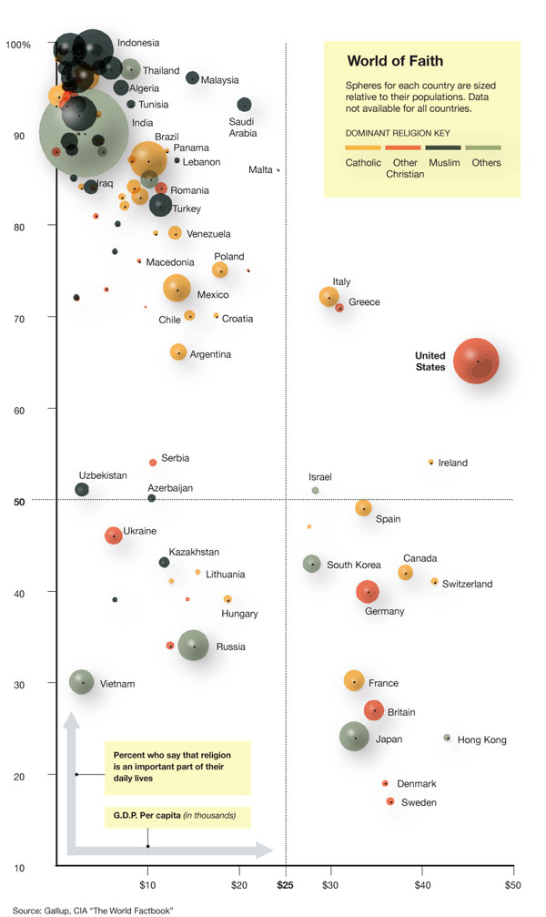
Understand Others: Belief & Life
Most people's life affected by religious beliefs
General: religious & poor
But lets look in detail the quarters…
% say religion important in their life
GDP/person
Ref: http://www.nytimes.com/2010/09/04/opinion/04blow.html
Gallop CIA published August 31, 2010
Notes:
Details:
- More religious, more poor is the general situation.
- Most people are religious and poor.
More carefully.
- Bottom left, some countries are poor without religion.
- Bottom right: countries rich without religion – most have Christian background and if we asked this question 50 years ago…
- Rich and religious are all countries that are related to Judeo/Christian thought

Slide 14
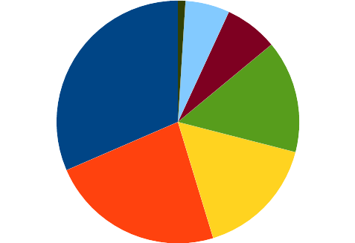
Influence: on People
為什么?
…影響
民間宗教 Folk
佛教 Buddhism
基督教
Christianity
印度教
Hinduism
回教 世俗
Islam Secular
Ref: https://en.wikipedia.org/wiki/List_of_religious_populations

Slide 15
Influence: on People
為什么?
…影響
民間宗教 Folk
佛教 Buddhism
基督教
Christianity
→
印度教
Hinduism
Love
→
回教 世俗
Islam Secular
→
Ref: https://en.wikipedia.org/wiki/List_of_religious_populations

Slide 16
Influence: Western Literature
為什么?
…影響
Allusions
  "born again",
  "prodigal son",
  “saw the light”
  "lost sheep"
Quotations: "give pearls to pigs“, “love is patient, love is kind…”
“You can't understand a large portion of Western Literature without first understanding the Bible"
3. 22% Nobel Laureates = Jewish (0.02%) ← Torah (Moses)

Slide 17
Influence: Western Law
為什么?
…影響
Basic Law (Torah by Moses: 3400 years ago)
Marriage Law (Moses: Torah)
Work Week (Moses: Torah)
Human Rights (Torah/Jesus)
Democracy (Torah/Jesus)

Slide 18
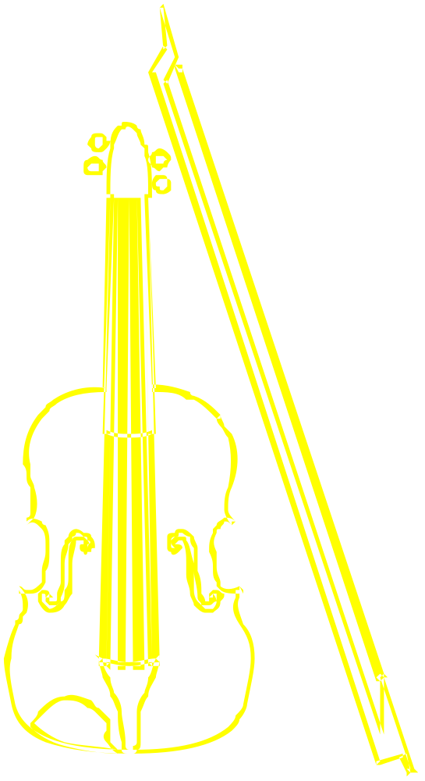
Influence: Music
為什么?
…影響
Jewish Poetry/Hymns (BC)
Gregorian Chants
Tang Dynasty
Johann Sebastian Bach
Handel's Messiah
Amazing Grace
Bob Marley (Reggae)
Beauty of Grace (America)
野地的花 (Taiwan)

Slide 19
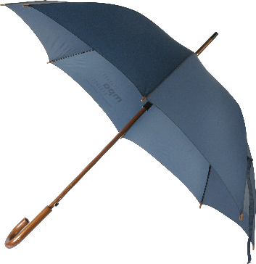
Influence: Science
為什么?…影響
Developed under the umbrella of respect for teachings of Moses, Jesus
Biblical ideas: the basis of the scientific method.
  One God (not fighting between gods)
  God loves order:
    He has given man moral laws to follow
    He rules creation by natural laws that He generally follows
  Evil done by person → Physical Disaster
Jesus: “Don't think this happened because they were more wicked then you."

Slide 20
為什么學習聖經? Why study?
Nature
影響 (Influence):
  信徒 (Number of followers)
  西方的文化 (Western Culture)
  科學 (Science)
內容 (Contents): Life and Death Issues
帕斯卡 (Blaise Pascal): 賭博者 (The Gambler)
Understand Others: Belief & Life
關鍵:關係 KEY concept: Relationship

Slide 21
2.1.C Contents: Questions
內容: 存在命題

Slide 22
內容: 存在命題 (Existential Questions)
Why is there 'good' and 'evil' in the world?
Why am I here?
Does my life have any meaning?
How should I live my life?
Is there a God?
If there is a God,
  Does he care about me?
  How can I communicate with him?
  What does he require from me?
What happens after I die? Is death the end?

Slide 23
關鍵:關係 Key: Relationships
God
↕
Man
Man ↔ Man
Man
↕
Nature

Slide 24
2.3 The Gambler (Blaise Pascal)
(1 + x)^{n} →
1
1
1 2 1
3 3 1
1 4 6 4 1
賭博者 (帕斯卡)

Slide 25

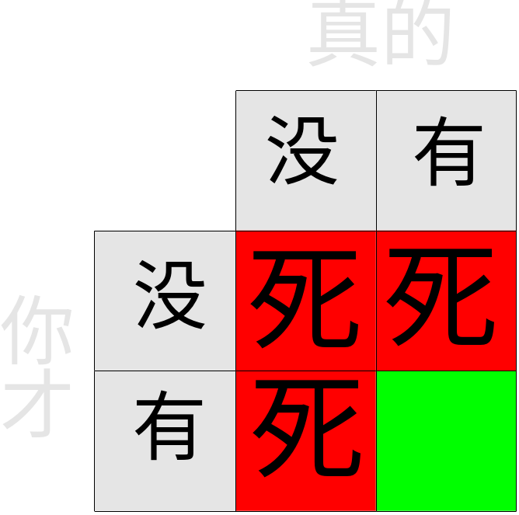
Pascal (帕斯卡): The Gambler 賭博者
A. The Bet: 你的生命
B. The Choice:
  有神 Theism
  没有神 Atheism
C. The Payoff
Håkan Dahlström from Malmö, Sweden [CC BY 2.0] (https://creativecommons.org/licenses/by/2.0)]
→Conclusion: 寻求上帝

Slide 26
為什么學聖經? Why Study?
影響 (Influence):
  信徒 (Followers)
  西方的文化 (Western Culture)
  科學 (Science)
內容: 存在命題 Life and Death Issues
帕斯卡 (Blaise Pascal): 賭博者 (The Gambler)
關鍵:關係 KEY: Relationship
My hope is that as we study together that you…
1. 考虑:真的或假的 Think: Is this true or a lie?
2. 表达你的意见 Express your opinion and ideas.

Slide 27
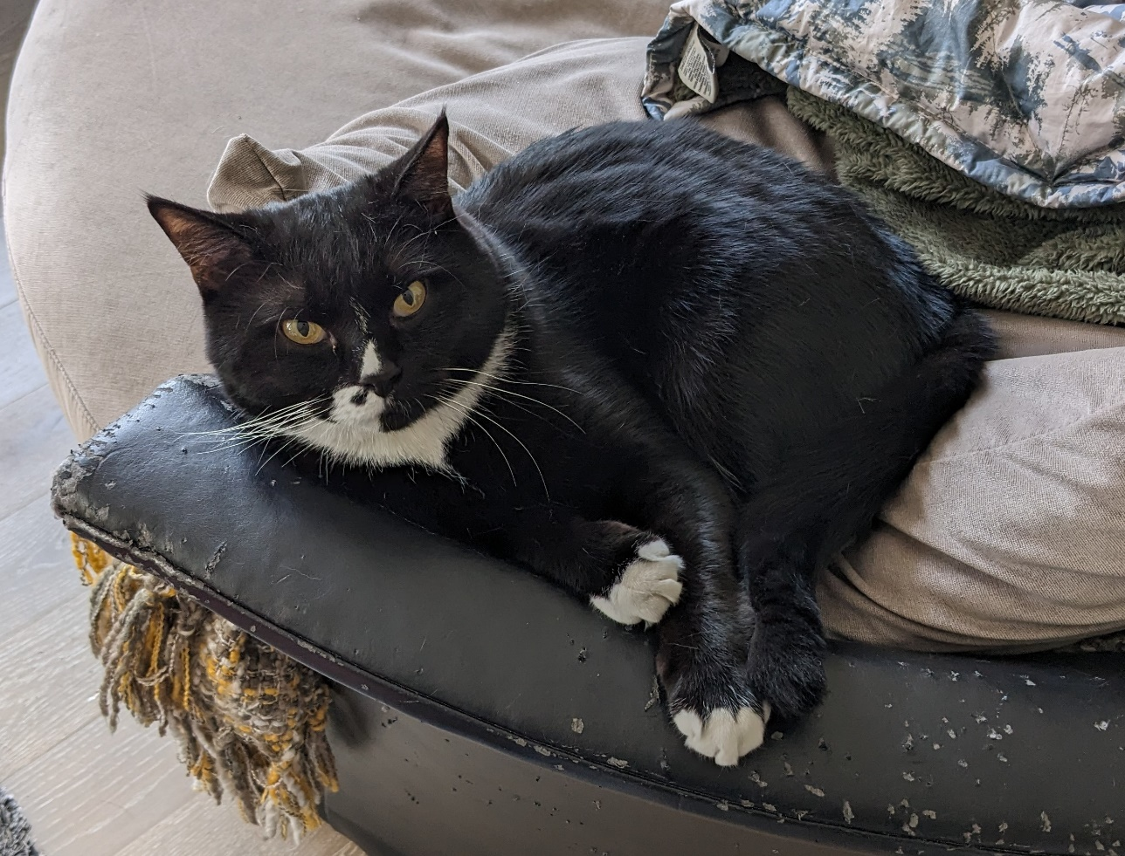
Small Groups
Share with others your name, and country.
What animal best describes your personality?
Why?

Slide 28
Key Topics
God/Life/Light

Twilight Zone
Death

Slide 29
Key Topics
God/Life/Light

Nature of God
Death

Slide 30
Key Topics
God/Life/Light

Nature of Man
Death

Slide 31
Key Topics
God/Life/Light

Life's Origin/Meaning/Purpose
Death

Slide 32
Key Topics
God/Life/Light

How to Live Life
Death

Slide 33
Key Topics
God/Life/Light

How to know God: Jesus
Death

Slide 34
Key Topics
God/Life/Light

Future of the Earth
Death

Slide 35
Key Topics
God/Life/Light

After Death, the After-Life
Death

Slide 36
為什么學聖經? Why Study?
影響 (Influence):
  信徒 (Followers)
  西方的文化 (Western Culture)
  科學 (Science)
內容: 存在命題 Life and Death Issues
帕斯卡 (Blaise Pascal): 賭博者 (The Gambler)
Understand Others: Belief & Life
關鍵:關係 KEY: Relationships

