Slide 1
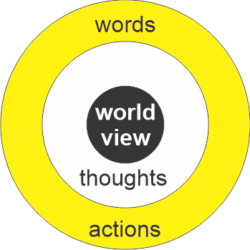
Value
Worth
Junk
Empty
Good
Right
Evil
Wrong

Slide 2
“The unexamined life is not worth living.”
Socrates (~500BC)

