Slide 1
15 Final Review
Outline of Today’s Class
J D White

Slide 2
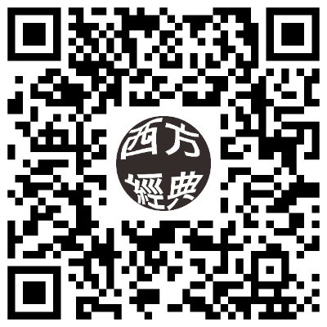

First, your feedback please
https://forms.gle/NmCBLPmDhPxF6aPE7

Slide 3
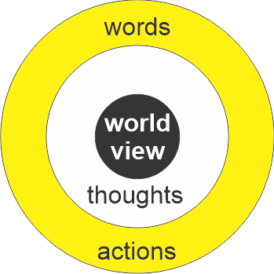
An Overview of Concepts
Purpose: To give a “birds eye view” of the theme rather than content that provide for a “world view”
Objectives:
  Students should understand the “Judeo-Christian World View”
  Understand it is unique amongst other world views
What is a
Worldview?

Slide 4
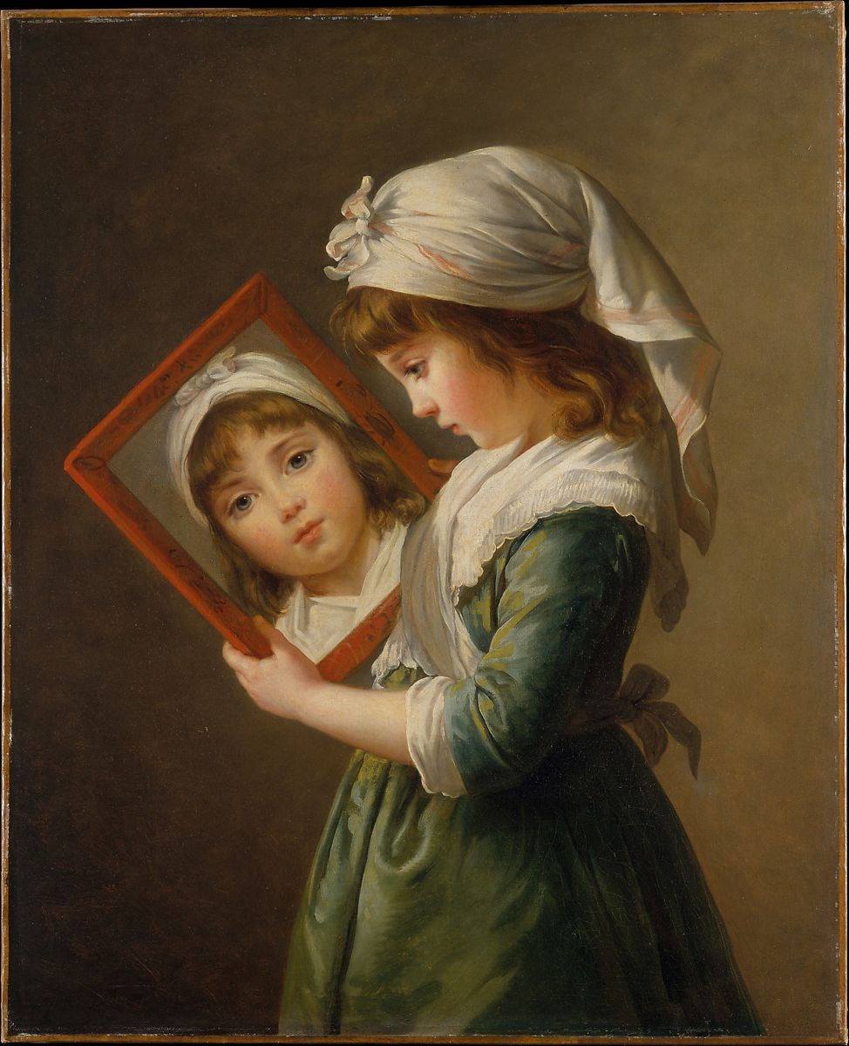
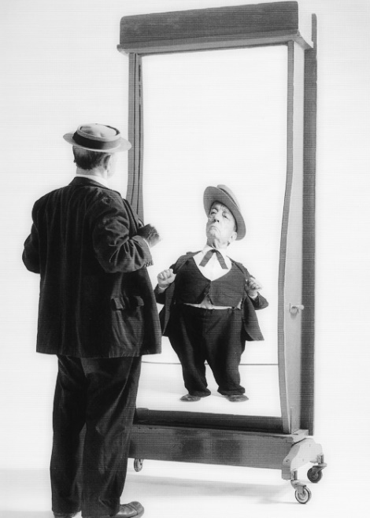
Object → Image
Look in a mirror
What do you see?
NO, not your face
Image of your face
You have never seen your face.
You have only seen the image of your face.
Plato:
  Unseen is the reality
  The image flawed reflection of reality.
Notes:
We need to step back and get some philosophy. 5. You have never seen your face. You have seen other people’s faces. But you have never seen your face. 8. Not the type of mirror that most ladies would like in their house!

Slide 5
Object → Image
Have you seen God?
No!
But we have seen the image of God
Where?
When I look at you!
You are the proof that there is a God.
Only man+woman is the image of God
Notes:
We need to step back and get some philosophy. 5. You have never seen your face. You have seen other people’s faces. But you have never seen your face. 8. Not the type of mirror that most ladies would like in their house!

Slide 6
Physical is Image of Spiritual
Isaac Newton/Galileo/Kepler:
  God has written universal laws (in Scripture) to guide man morally
  → God must have similar laws to guide nature.
  “I want to discover these laws.”
Man’s relationship with an unseen God is imaged in human relationships.

Slide 7
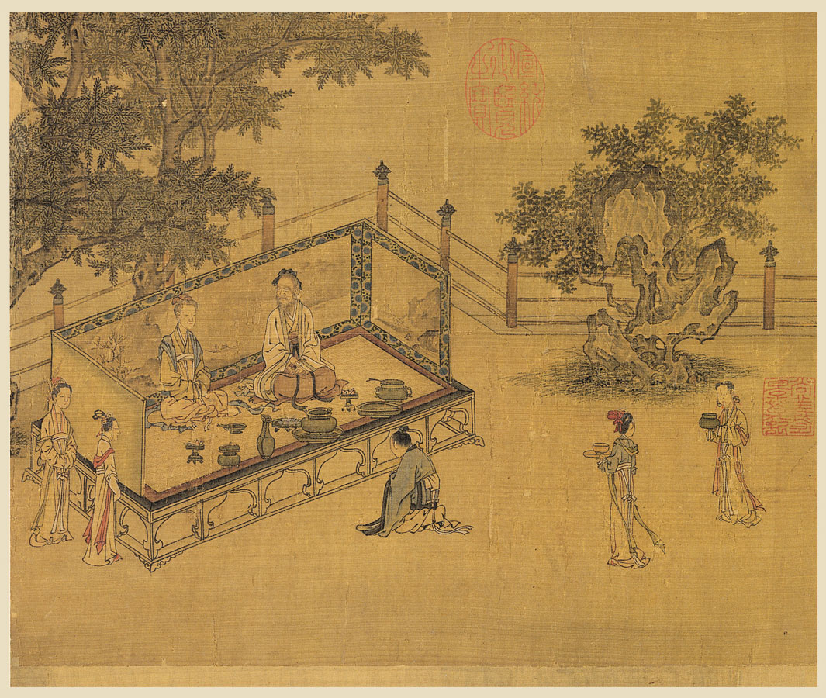
Parallels 創造的鏡子
Spiritual Reality 精神現實
Earthly Image 地球形象
God ←→ Humans
Jesus ←→ Church
Parents ←→ Children
Husband ←→ Wife
關系
relationship
慈
愛
Love
孝
順
Filial
Piety

Slide 8
關系 Relationship
Earthy Family
Heavenly Family
Communication
Love
Filial Piety
Correction and punishment
Communication
Love
Filial Piety
Correction and punishment

Slide 9
慈愛 Love
Father God prepared for man
  A universe
  The earth
  Plants
  Animals
  Garden
  Companionship
父神為人預備
  一個宇宙
  地球
  植物
  動物
  花園
  友誼

Slide 10
Filial Piety孝順
Bring Honor not Shame 帶來榮譽而不是恥辱
E.g. Garden(花園), 1st Family(第一家庭)
Seen in 10 Commandments 十誡
  Follows an account of God’s love for people
  Heavenly Father (First 4) 天父（上四）
  Earthly Father (Next 6) 地上的父親（下六）
Imagery 整個
  A son shows filial piety to his father. If I am a father, then where is my honor? (Malachi 6:1)
  「兒子應當孝順父親。我是你們的父親，但你們對我的孝順在哪裡呢？
Notes:
Filial piety. Filial Piety owed to your parents. Owed to God. Involves bring Honor not Shame to family. Honor, Do not murder. If I murder someone, I bring shame on my parents.

Slide 11
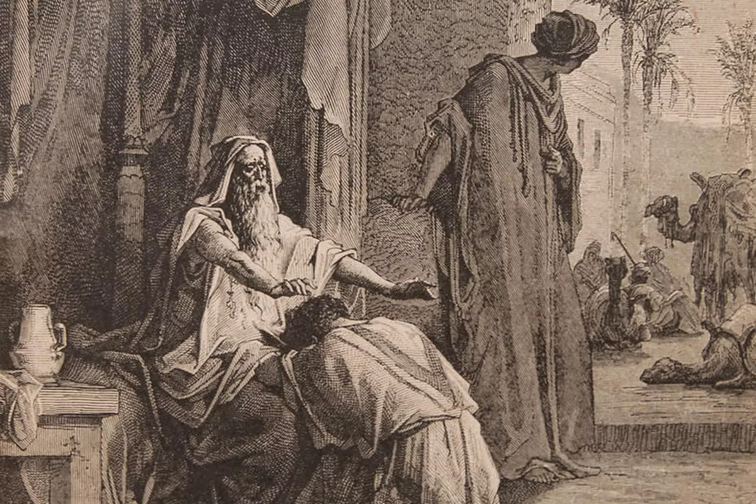

關系
relationship
距離
separation
愛
love
孝
honor
In the Beginning (1st & 2nd Dispensations) Genesis 2 & 3
The Decalogue (Exodus 20)
  Actuator: God’s Love seen in his actions (Exodus 20:2)
  Response: Honor (Ex 20:3-17)

Slide 12
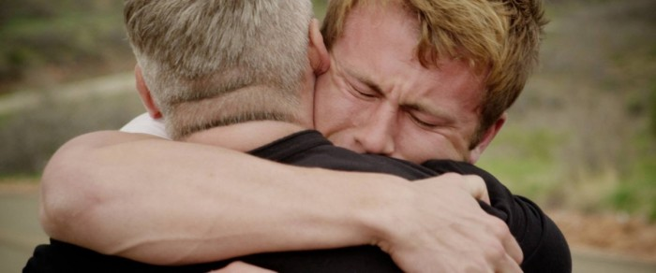
關系
relationship
距離
separation
愛
love
孝
honor
The Loving Father & His Rebellious Son
A Parable of Jesus

Slide 13
關系
relationship
距離
separation
愛
love
孝
honor
四個字 4 Words

Slide 14
World View →
God desires to communicate with man (理所當然)
Man’s failure breaks the relationship.
Jesus’s death→You can be forgiven
decide to come home?
Father will welcome

Slide 15


Jesus Gave a Story to Illustrate

Slide 16
Important info for exam/sim
Over to Prof Chung, Ravi, Tinny, Joseph…

